Slide 2
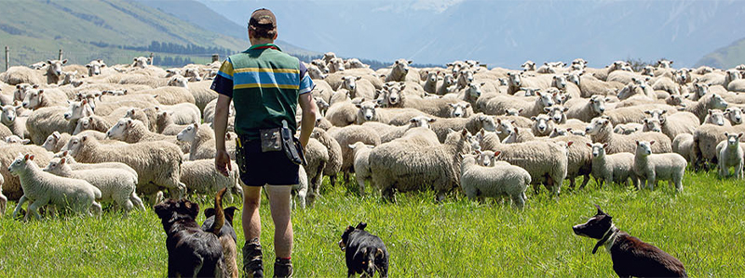
Sheep Farming Calendar of Operations

Slide 3
Sell wool
Crutch ewes
Flushing ewes
Shear lambs
Buy rams
Sell remaining lambs - store
Rams joined with ewes- Tupping
Continue to dip sheep
Main shear
Rams removed after 2-3 cycles
Dag sheep
Summer
Dec- Feb
Autumn
Mar- May
Continue drafting prime lambs.
Scan ewes
Spring
Sep-Nov
Winter
June- Aug
Wean & drench lambs
Draft early prime lambs
Empty ewes culled
Pre lamb drenching & vaccination
Docking/tailing
Drench ewes
Cull dry ewes
Pre lamb crutching or shearing
Lambing
Increase feeding of ewes

Slide 4
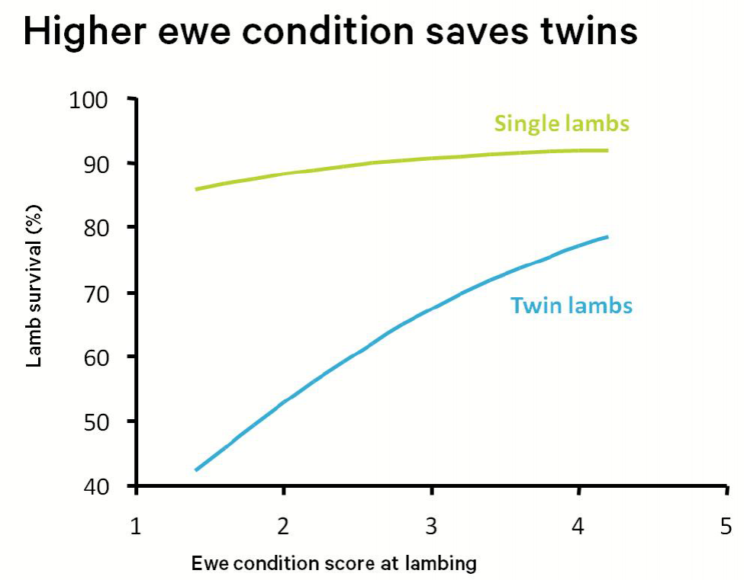
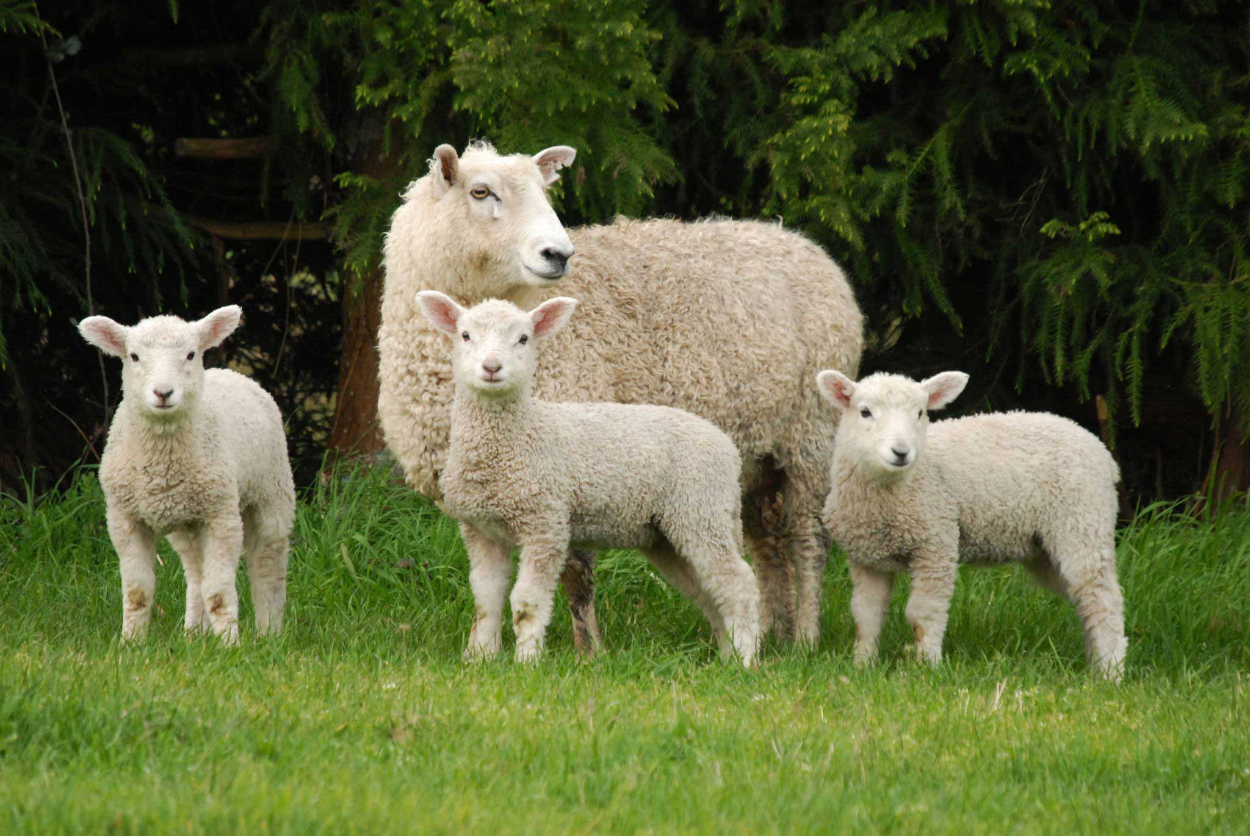
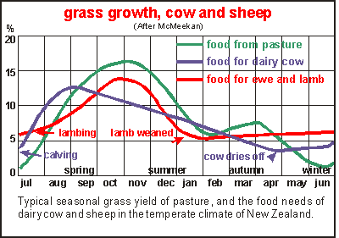
Lambing
In general lambing begins earlier in the North Island than the South Island. Farmers plan the start of lambing to coincide with increasing pasture growth rates.
The average ewe lambing percentage for spring 2023 was an estimated to be 129.9% across the whole country.
The higher the ewe body condition score the higher the lambing percentage and survival rate.

Slide 5
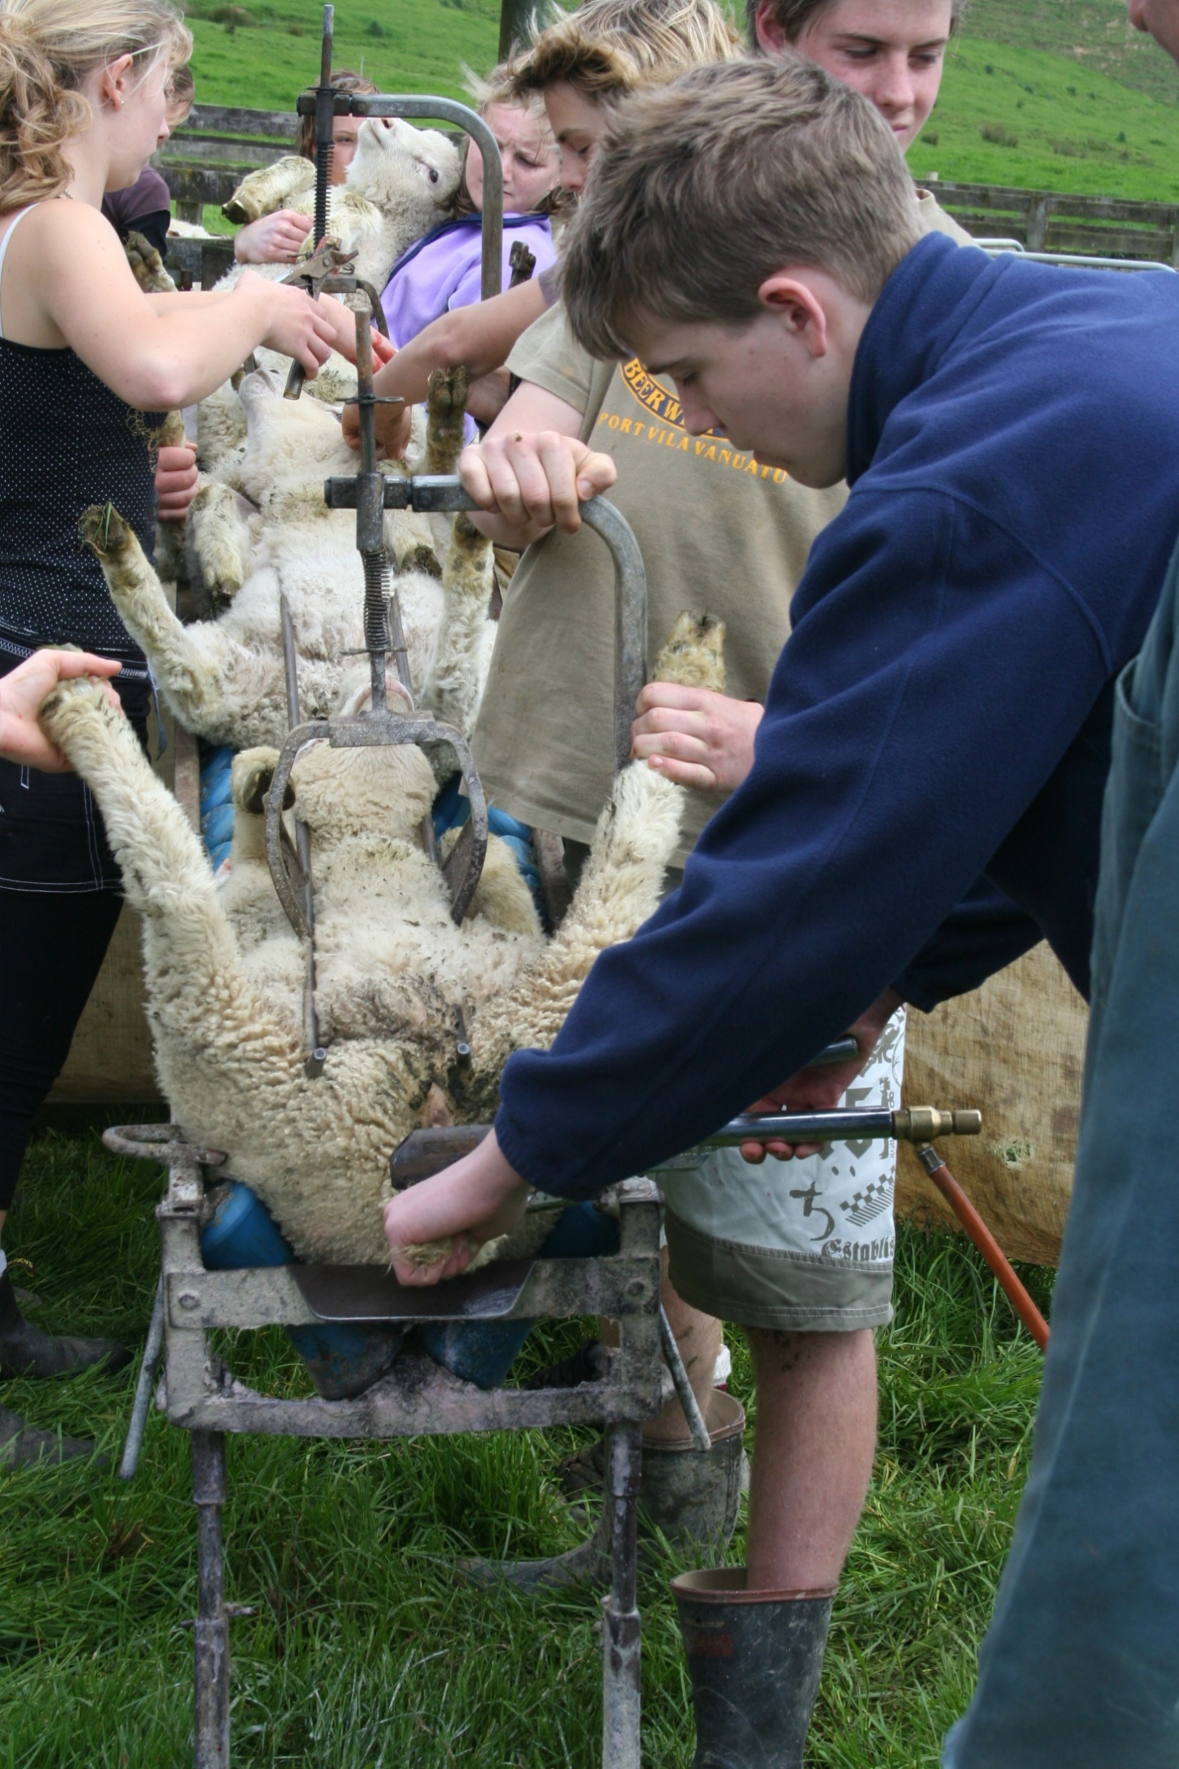
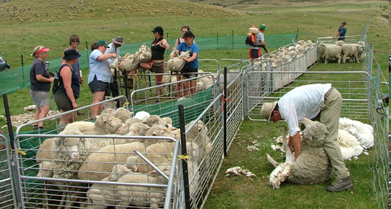
Tailing/Docking
Tailing usually occurs at 3-8 weeks of age. Tailing reduces the build up of faecal material (dags) reducing the risk of flystrike.
Ram lambs are generally left entire or turned into cryptorchids.
Lambs are ear-marked and or ear tagged for identification purposes.
Lambs may also be vaccinated against clostridial diseases.
Watch Tailing, 2021!!

Slide 6
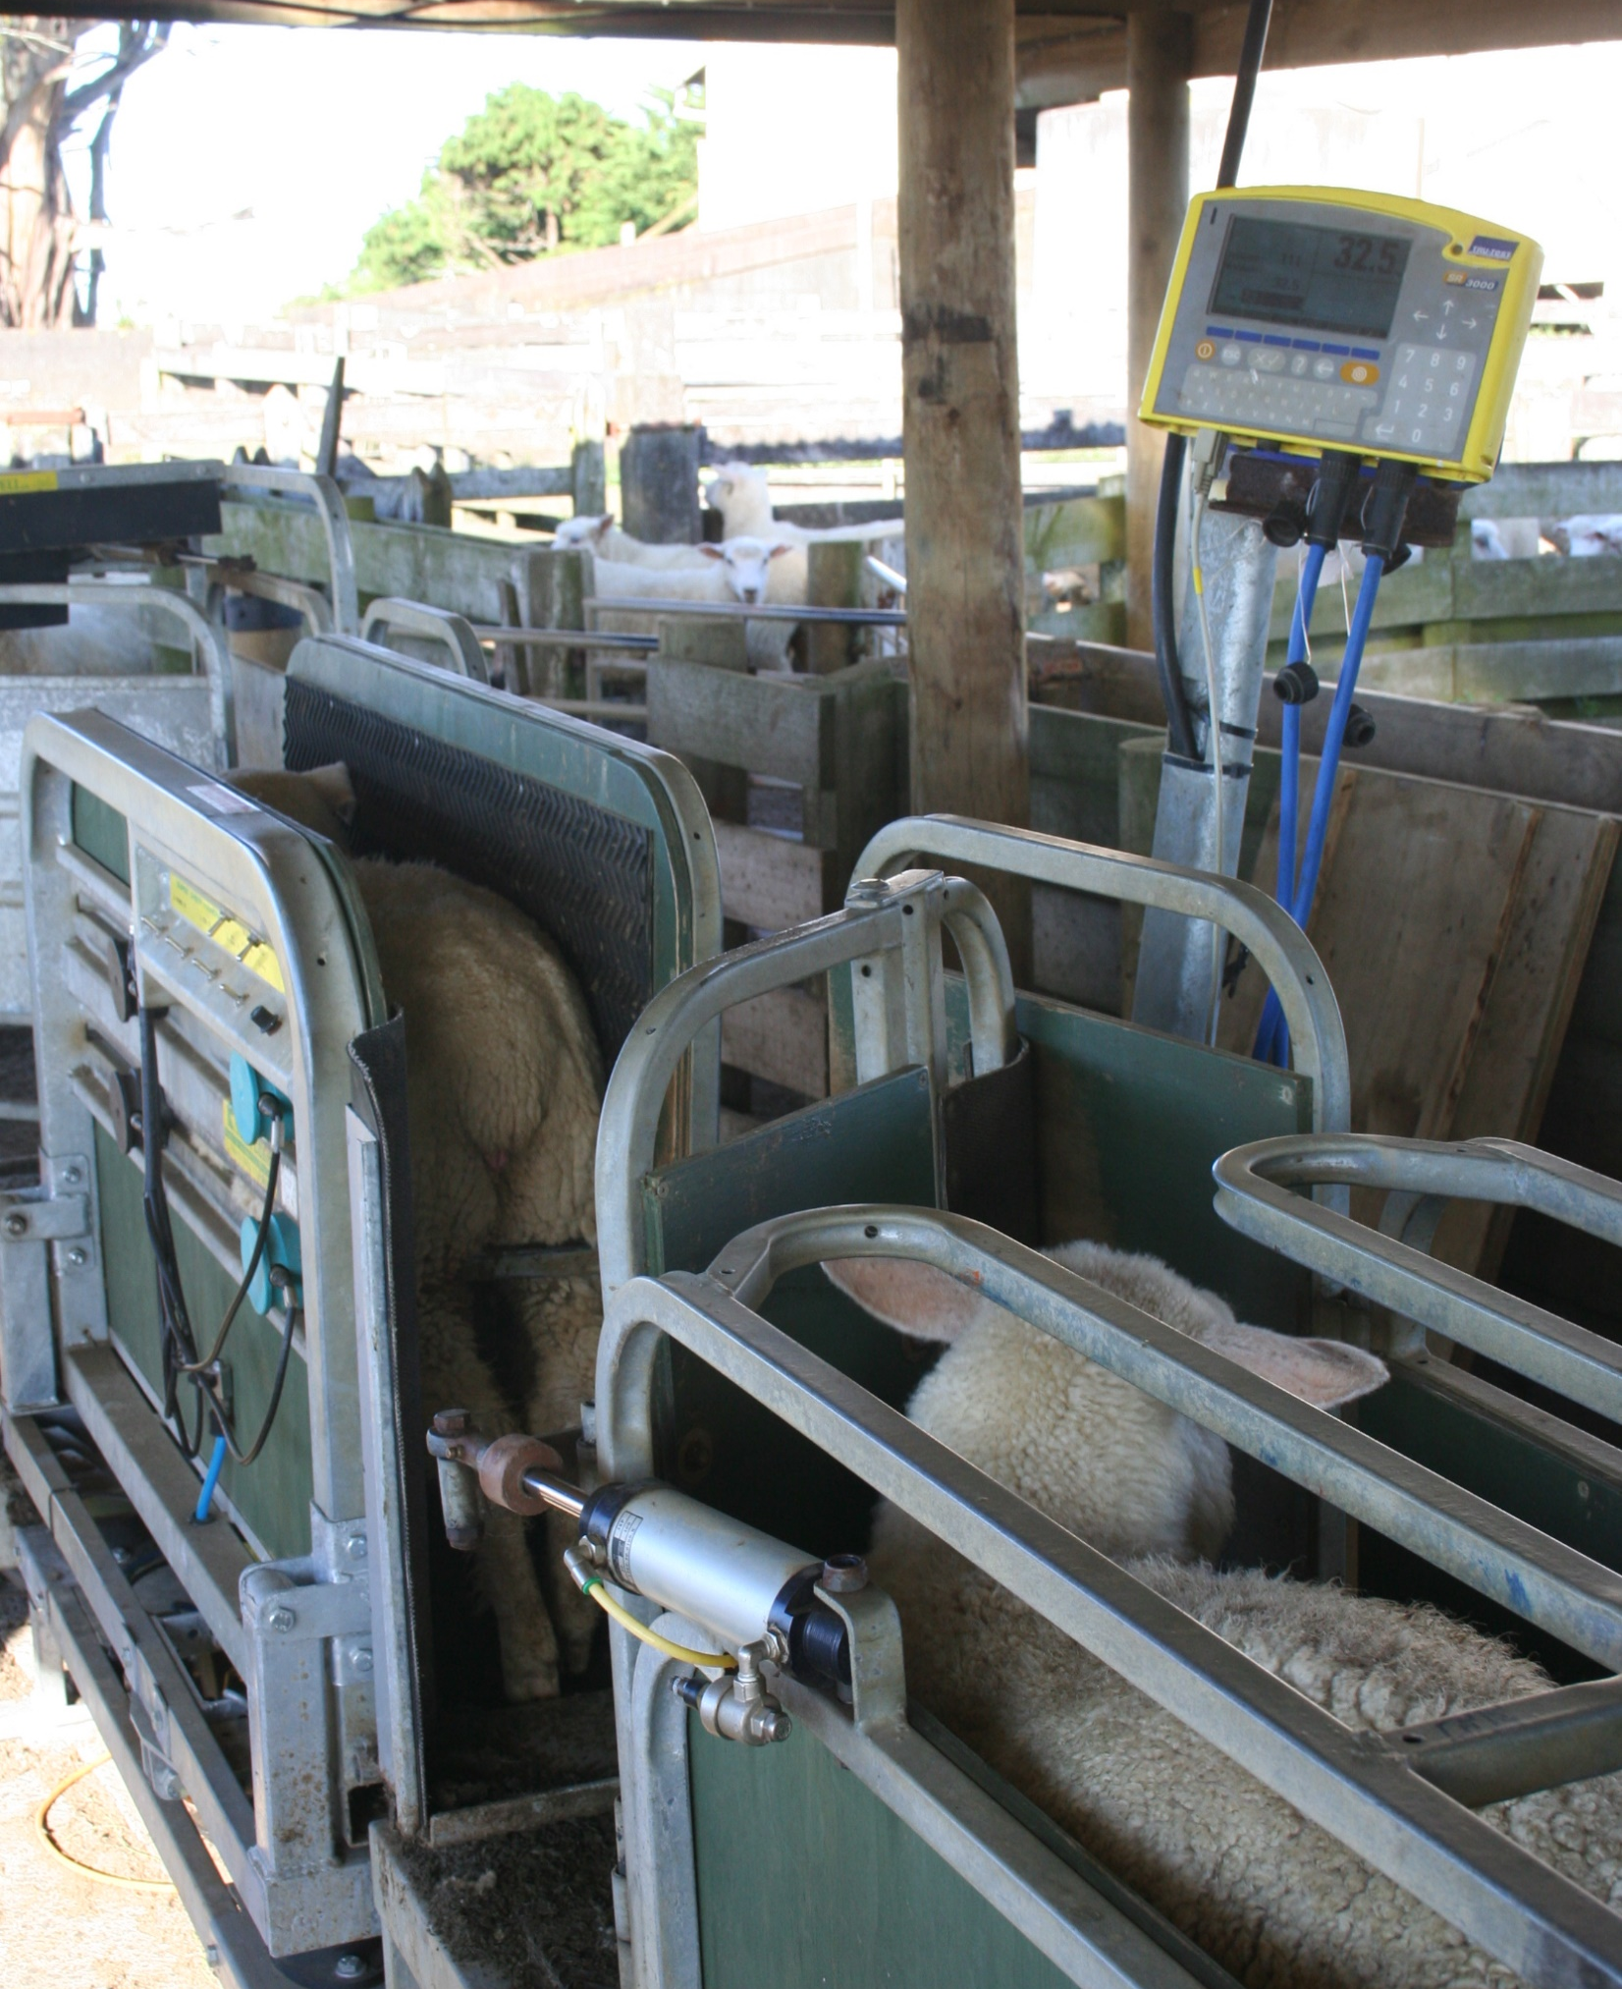
Weighing lambs
Lambs kept should be weighed regularly to draft out prime lambs.

Slide 7
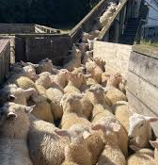
Weaning
On average lambs are weaned at 10-14 weeks of age.
Ram lambs 32-38kg are drafted and sold prime directly to slaughter.
Lighter rams lambs and ewe lambs not being kept for replacements are either kept to grow on to prime, or sold store to a finishing farm.

Slide 8
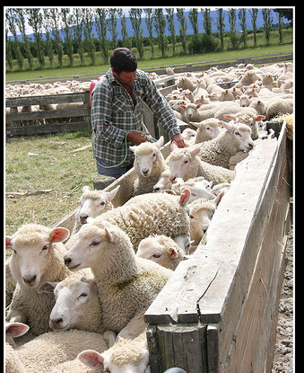
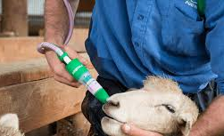
Drenching lambs
Young sheep are susceptible to internal parasites. They should be drench every 28 days from weaning.
Weight a sample of lambs and set the dose rate to the heaviest lamb.

Slide 9
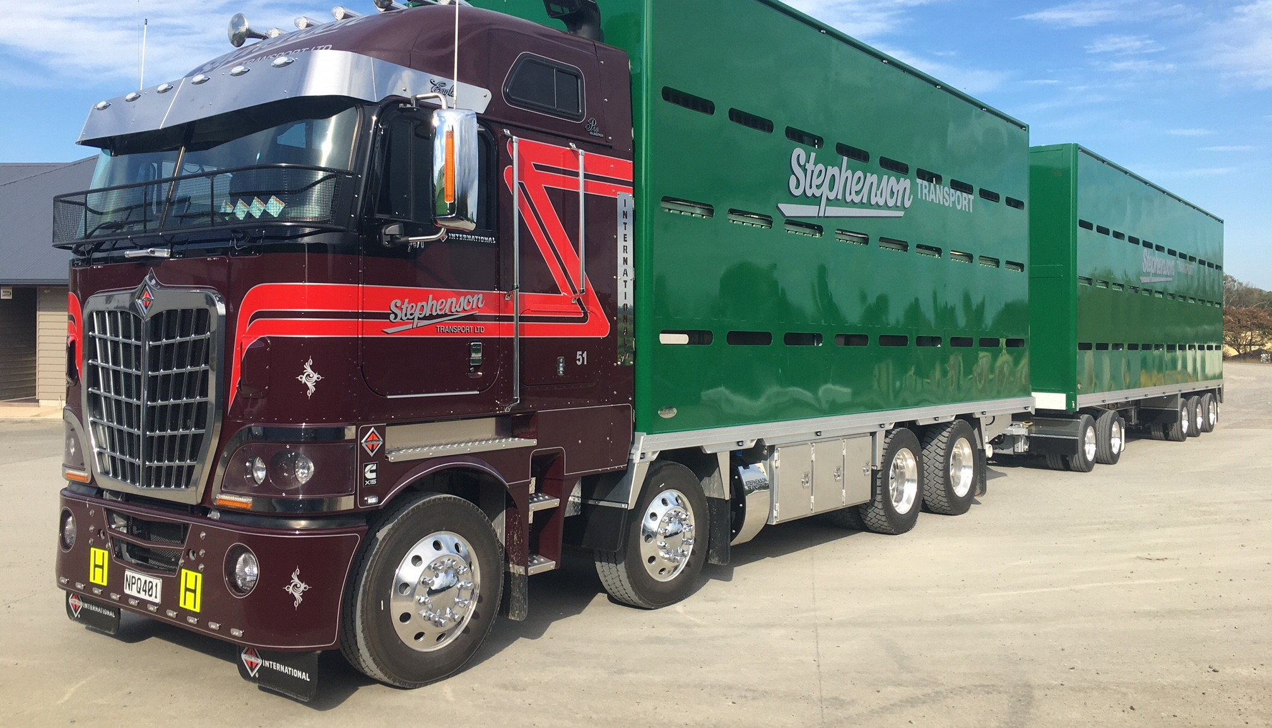
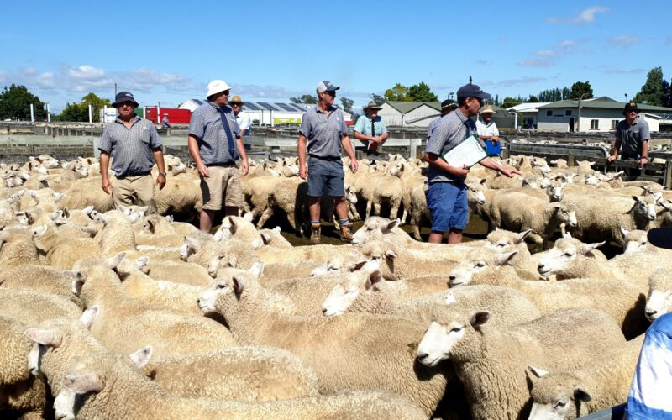
Cull ewes
After weaning, ewes not suitable for breeding stock are sold onto other farmers or culled. Culling of ewes is usually based on
Failure to rear a lamb to weaning
Poor teeth, feet or udder

Slide 10
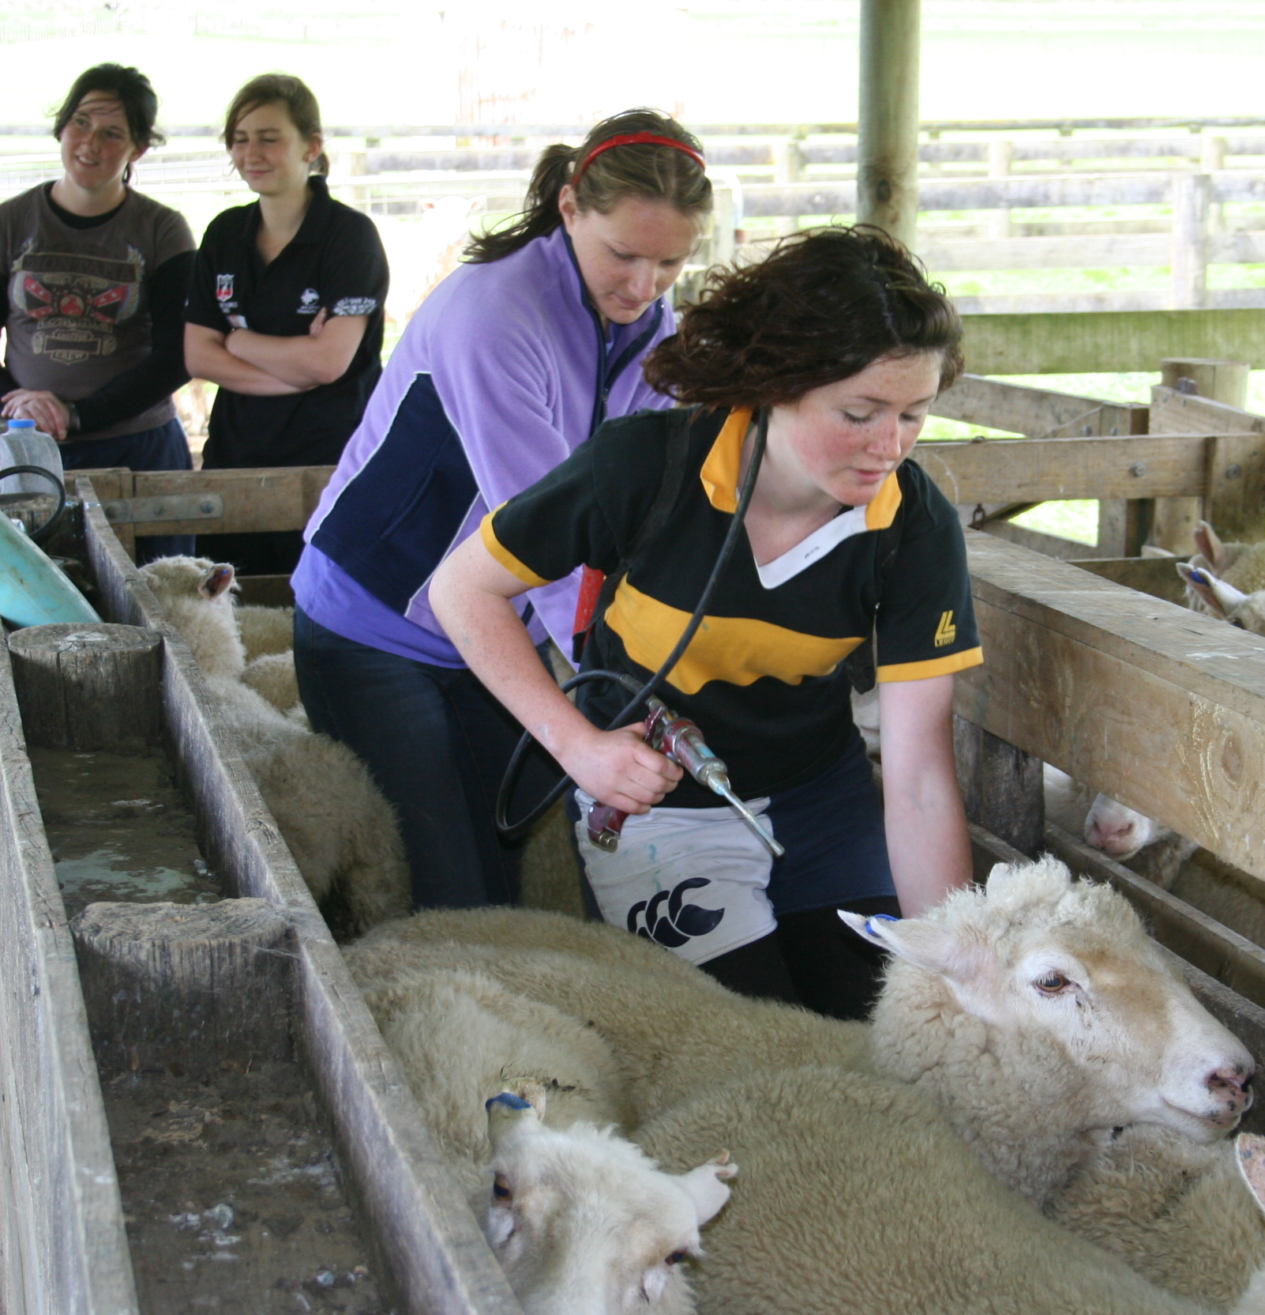
Drench ewes
Drench ewes and feed them based on their body condition score to get them to a body condition score of 5 for mating.

Slide 11
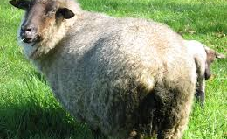
Dagging
Dagging or crutching is the cutting away of dirty, wet wool from around the tail and anus (crutch) of the sheep. The wet, dirty wool attracts flies especially the blow flies.
Sheep are dagged before shearing to keep the fleece clean and before going to slaughter.

Slide 12
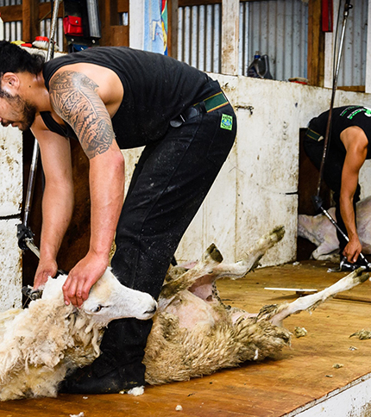
Shearing
Main shear is during summer after weaning. Fleeces range from 3-5kg.
Shearing reduces the risk of flystrike
Lambs are generally shorn after the main flock.
New Zealand Sheep Shearing Demonstration | From start to finish

Slide 13
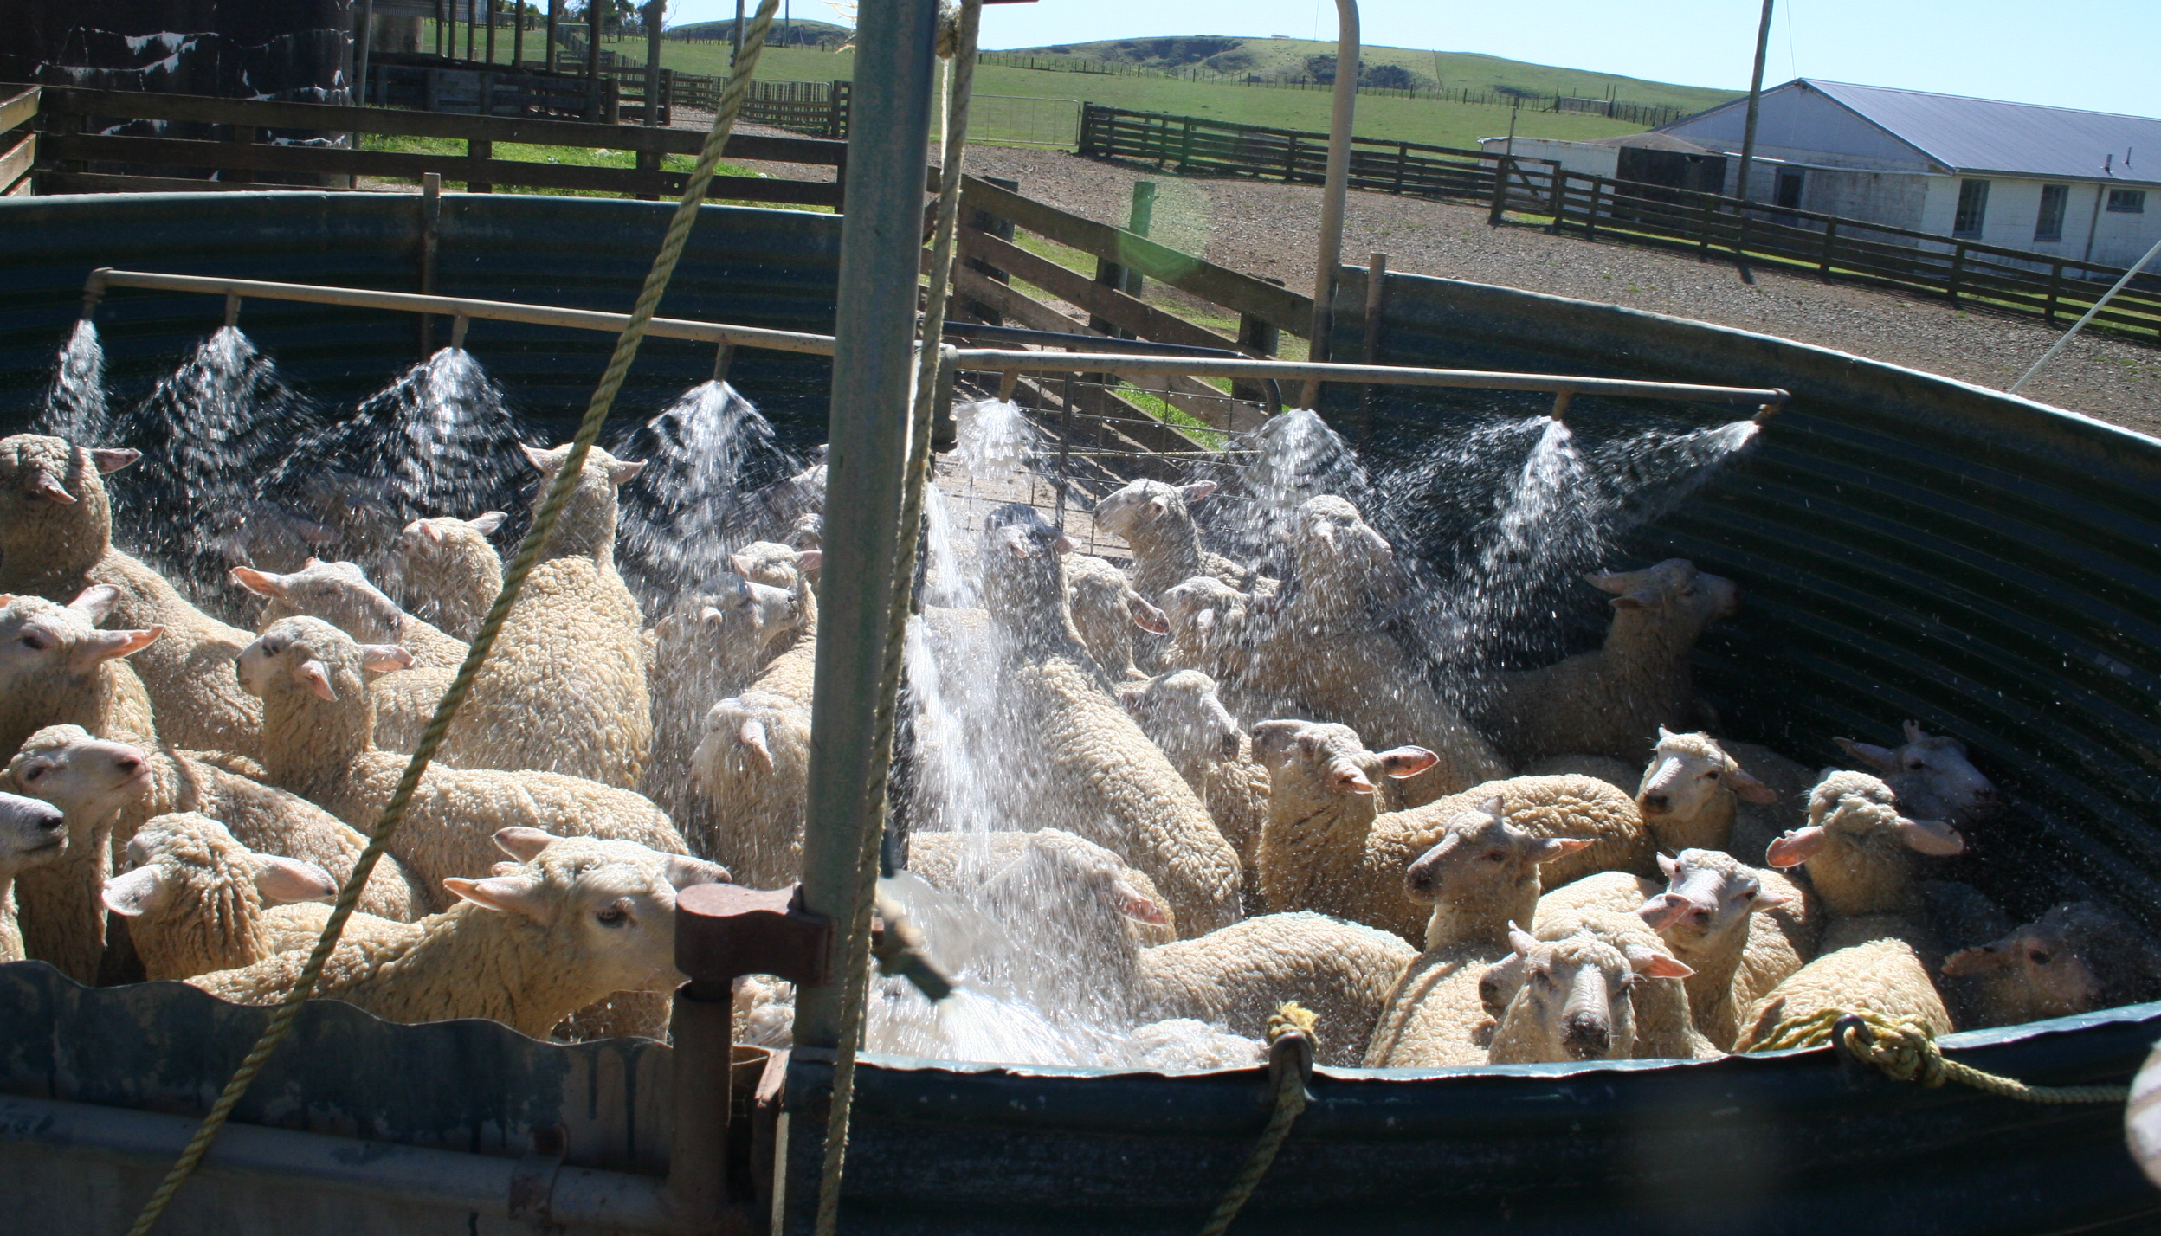
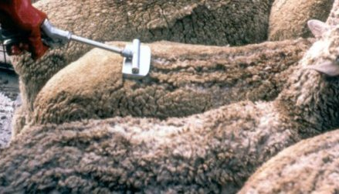
Dipping
A few weeks after shearing ewes are dipped or sprayed with insecticide to minimise the risk of flystrike.

Slide 14
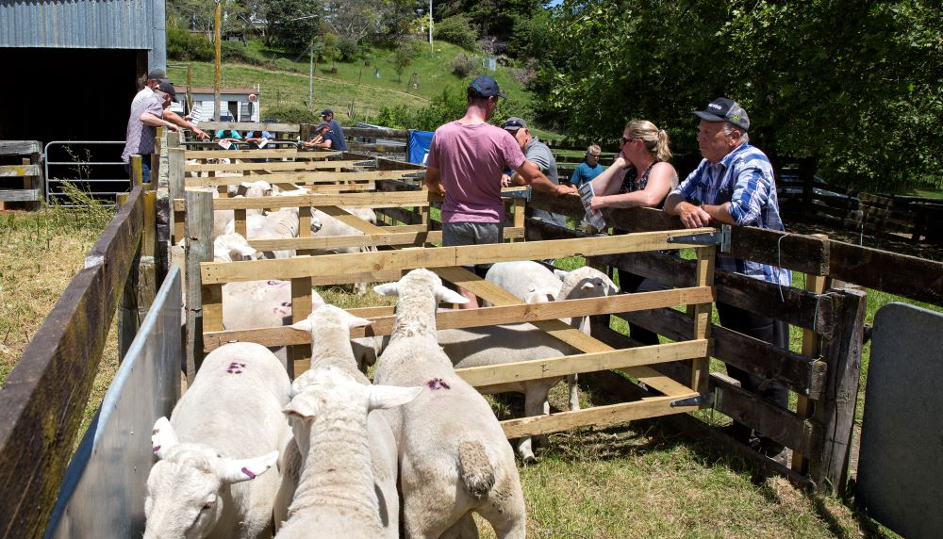
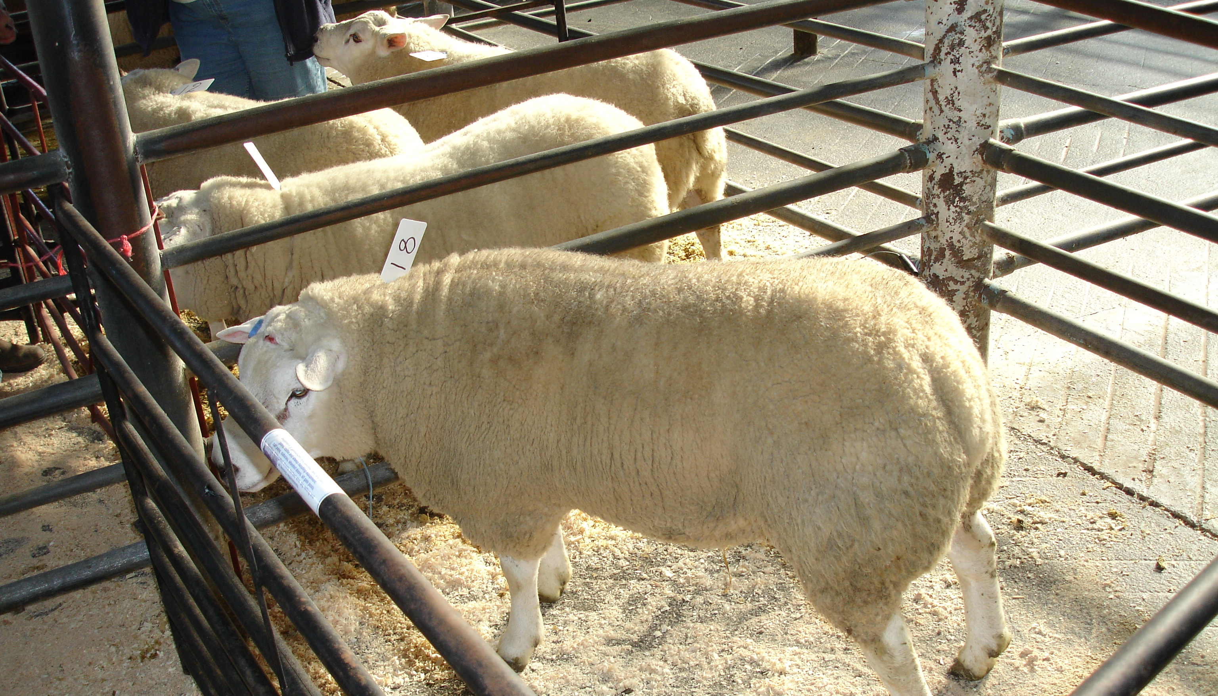
Buying Rams
Replacement rams bought.
Rams should be well fed and in good body condition and health eight weeks before being joined with the ewes.

Slide 15
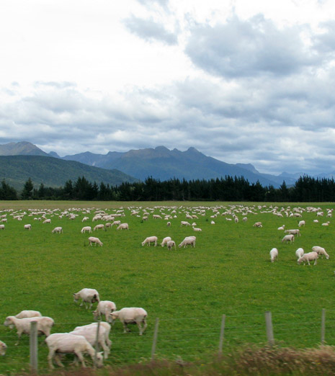
Flushing ewes
Feeding ewes on a higher plane of nutrition three weeks prior to tupping improves the number of lambs conceived.
If ewes gain an average of 0.5 body condition score in the 3 weeks before tupping starts it improves the lambing percentage.

Slide 16
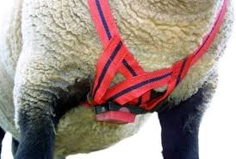
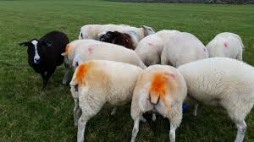
Tupping
Ewes come into oestrus (heat) every 16-17 days.
Rams are out with the ewes for 2-3 cycles.
1 ram – 100 ewes
A crayon harness is often used on rams. The harness leaves a mark on the ewe during mating. The colour of the crayon is changed during the tupping period.

Slide 17
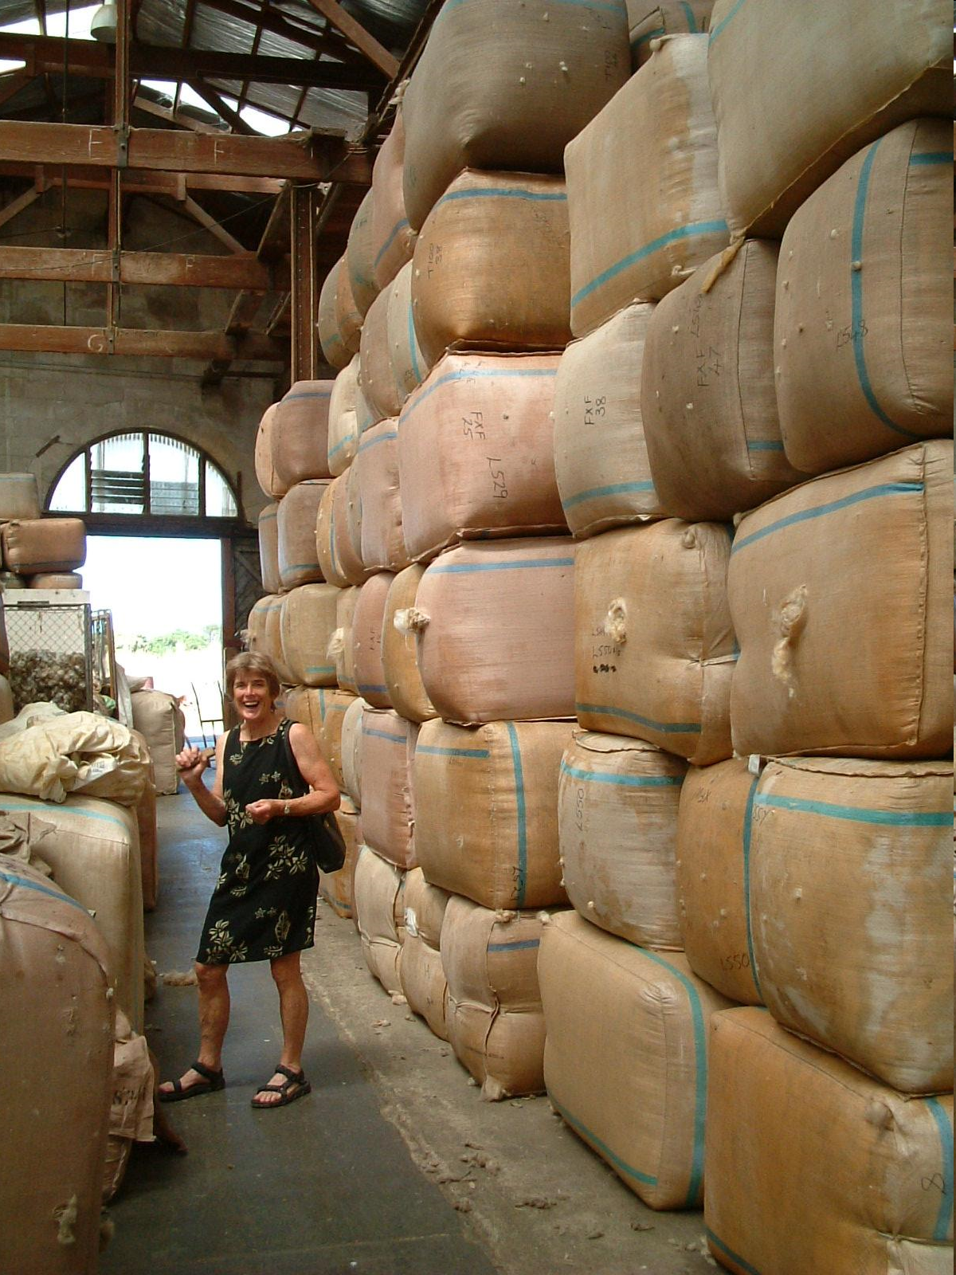
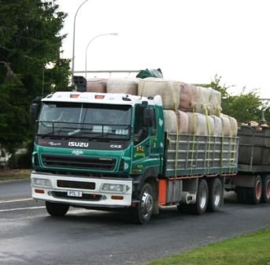
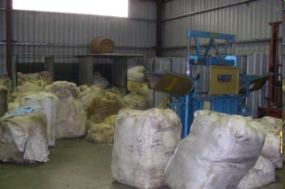
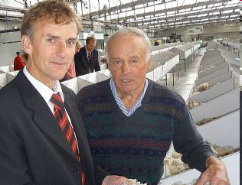
Selling wool

Slide 18
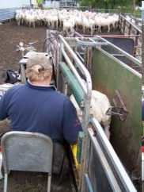
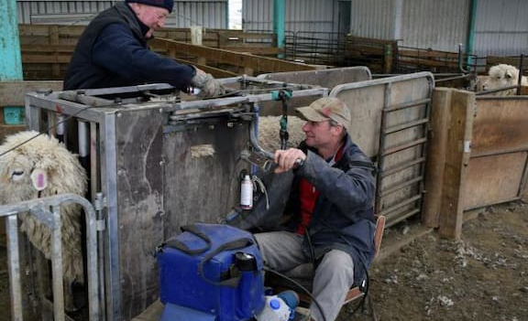
Scanning Ewes
40-50 days after the rams have been removed form the ewe flock, ewes are pregnancy scanned using and trans – abdominal ultra sound.
Non pregnant ewes are culled.

Slide 19
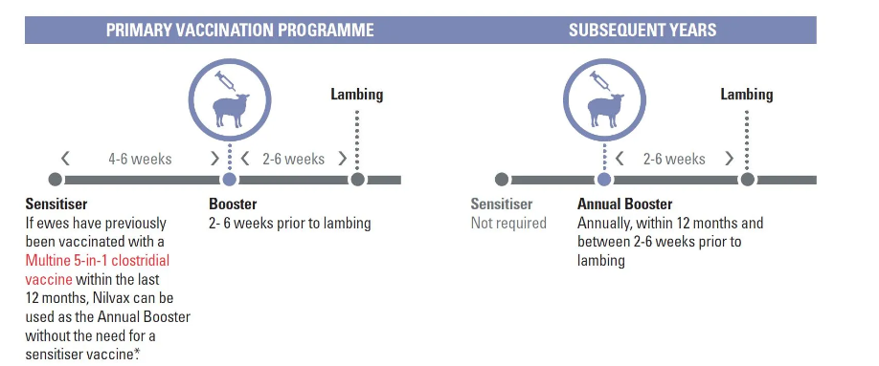
Pre lamb drench and vaccination
Ewes are generally drench before lambing to make sure they have no parasites to excrete onto pasture which can then affect the lambs. With a reduced worm burden ewes will produce more milk increasing lamb growth rates.
Pre lamb vaccination protects ewes and their lambs against clostridial diseases.

Slide 20
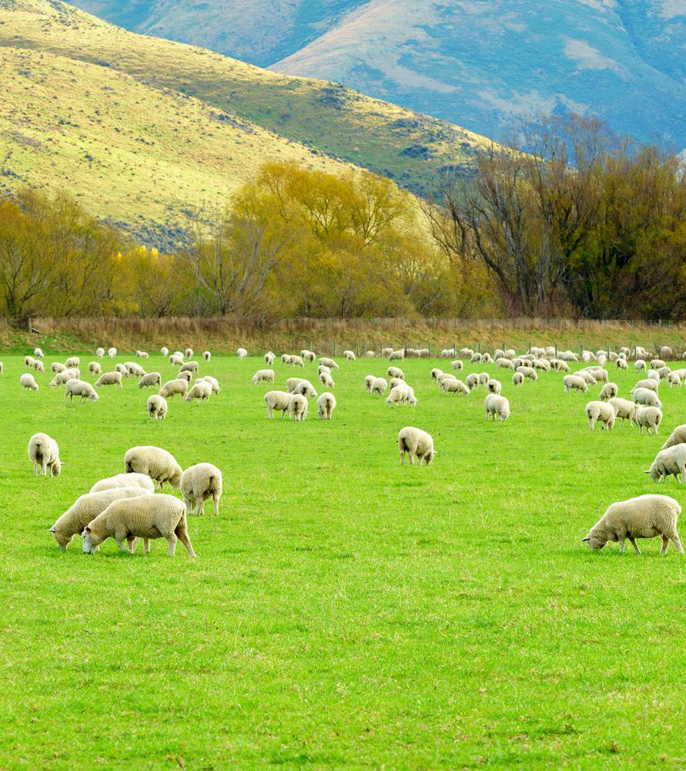
Set stocking for lambing
Ewes are set stock 2-3 weeks before lambing.

