Slide 2
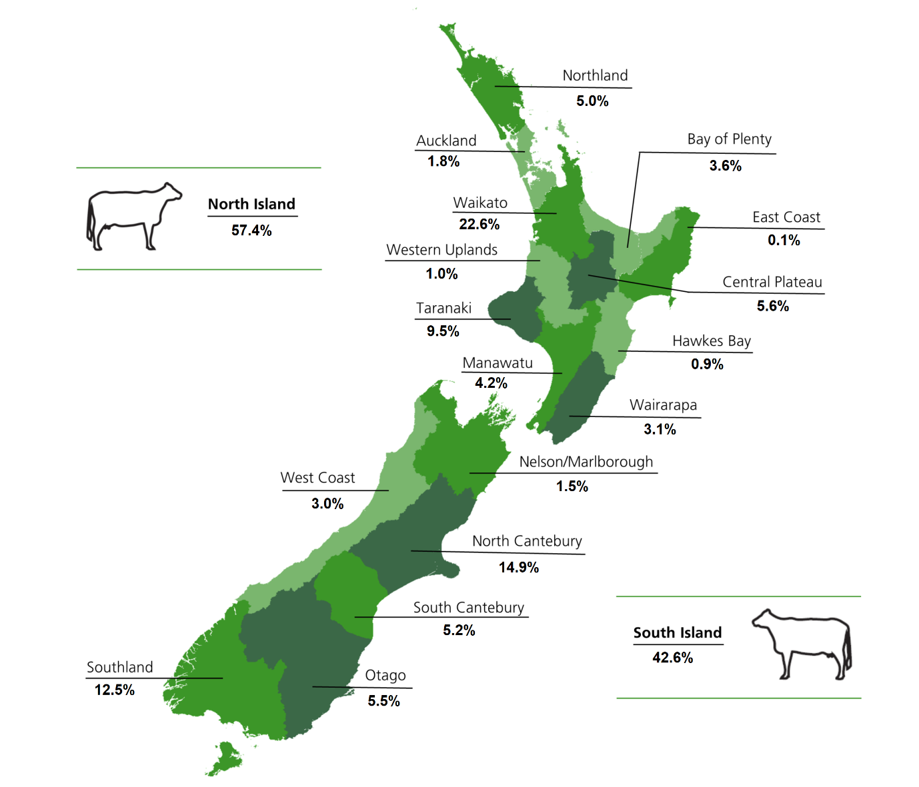
Dairy Faming in New Zealand

Slide 3
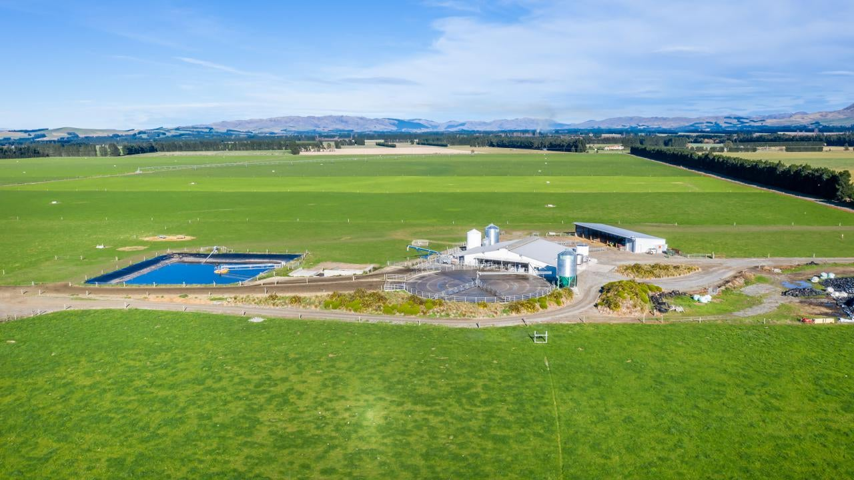
Dairy Farming
Dairy farms need to grow lots of grass all year to feed cows. Dairy farming is found in many regions. The biggest regions are Waikato, Taranaki, Canterbury and Southland. These regions have:-
Areas of flat to rolling country that is easily accessible by machinery.
Moderate temperatures for growing grass and crops to feed cow outside all year round.
Reliable rainfall either natural rain or from irrigation.
Fertile soils.

Slide 4
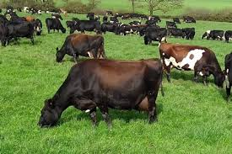
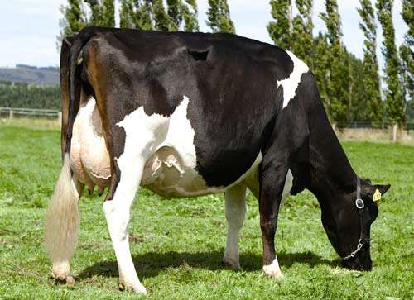
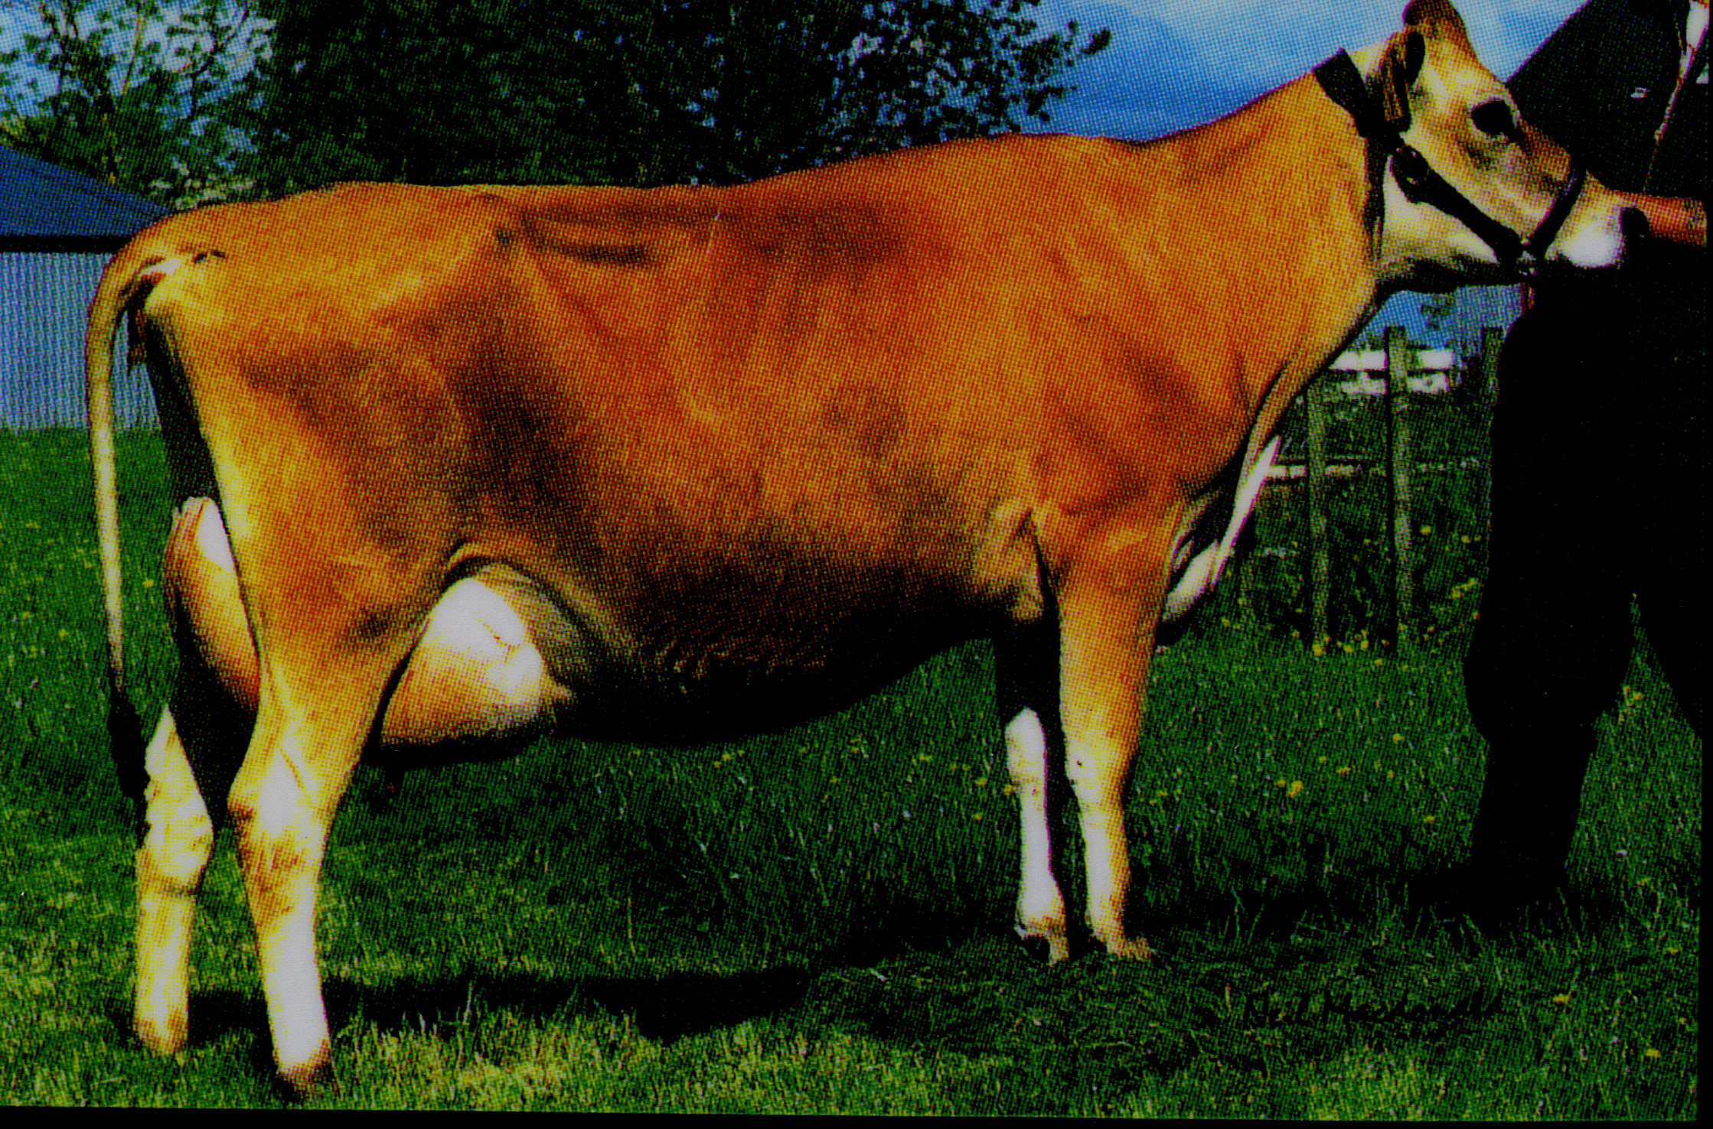
Dairy breeds

Slide 5
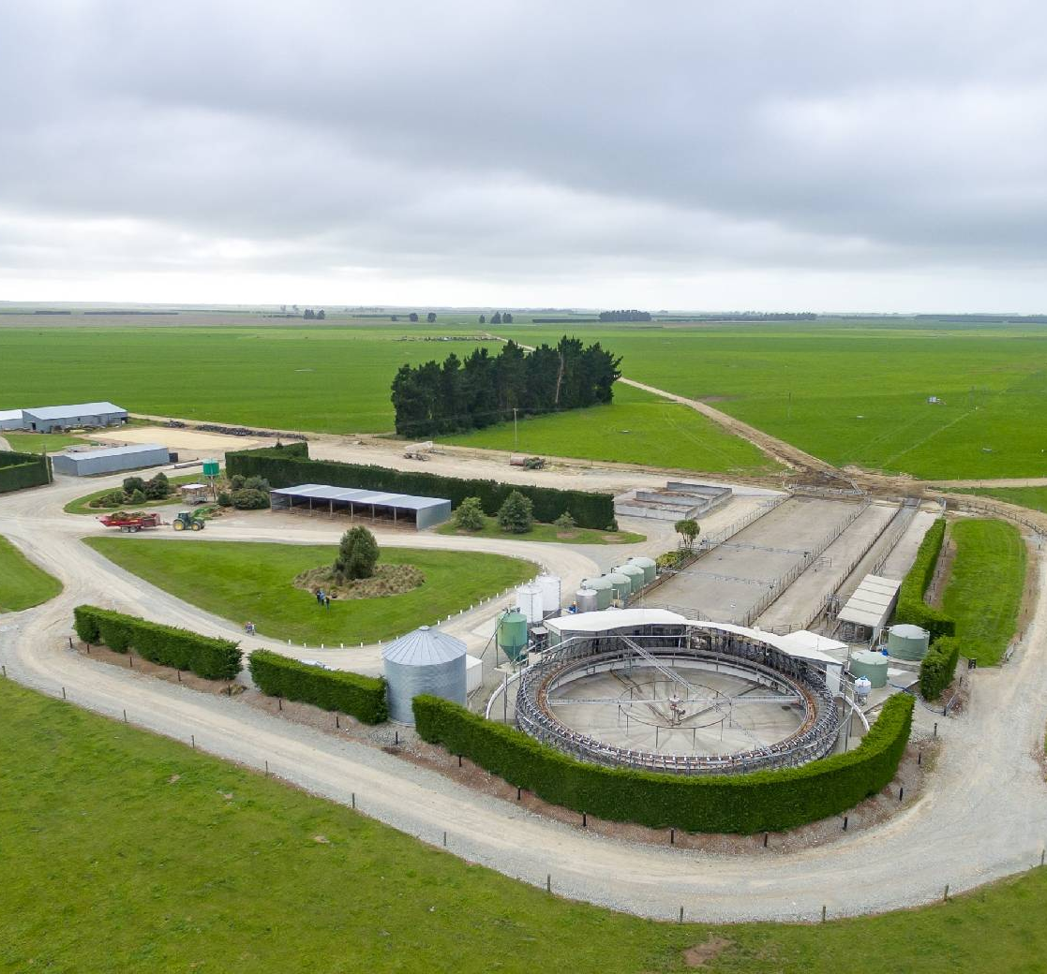
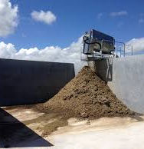
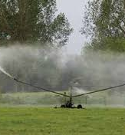
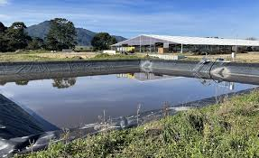
Infrastructure on dairy farms
The infrastructure on dairy farm varies but the will all have
Dairy shed
Calf and implement sheds
Tanker race
Raceways
Effluent ponds/solids separator
Effluent irrigator
Even sized paddocks with troughs
Farm houses

Slide 6
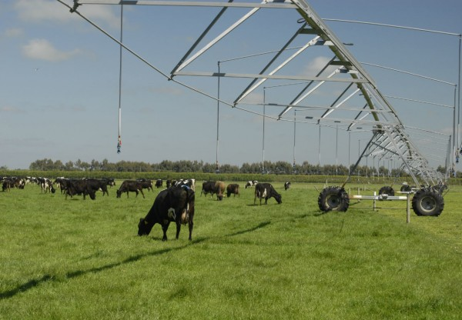
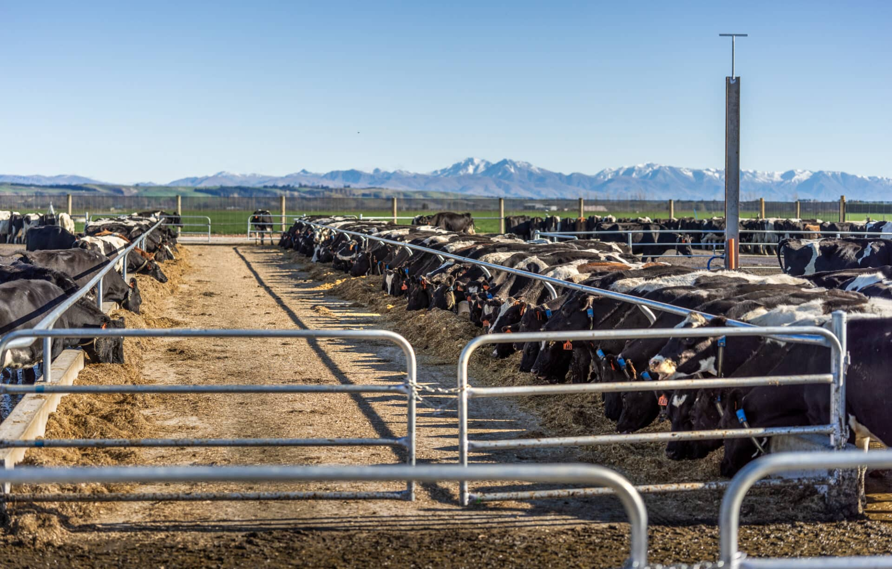
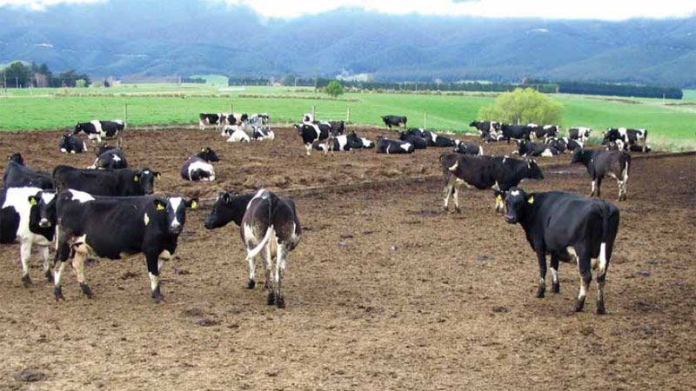
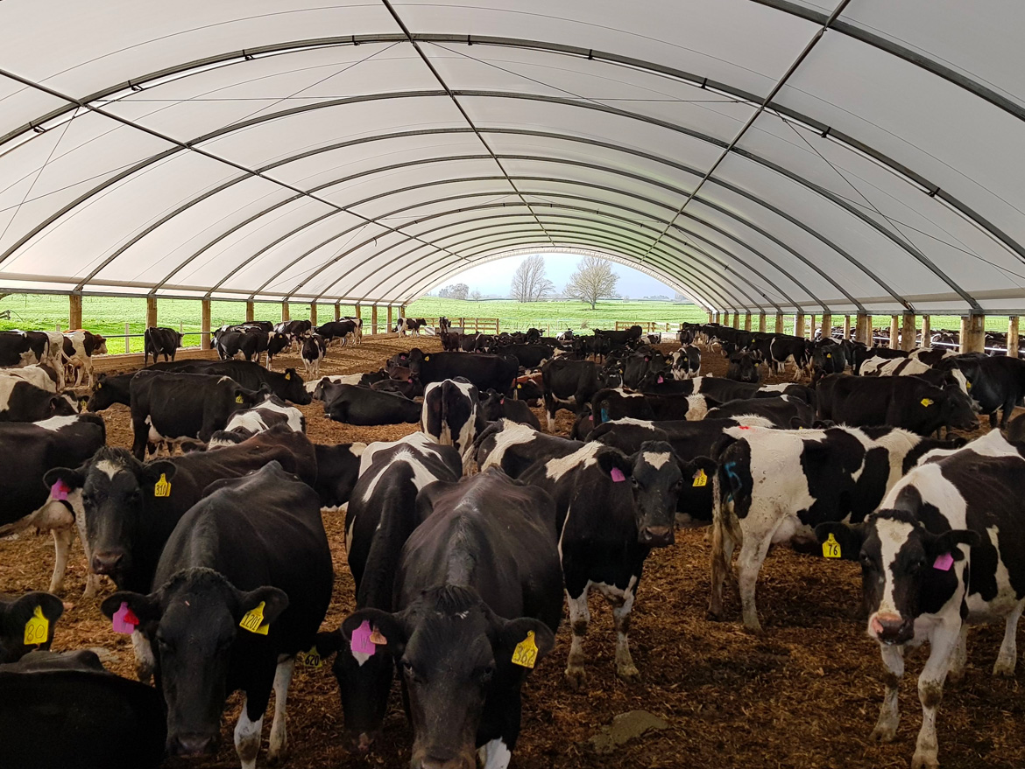
Other infrastructure dairy farms could have
Irrigation
Feed pad or stand off pad or herd home

Slide 7
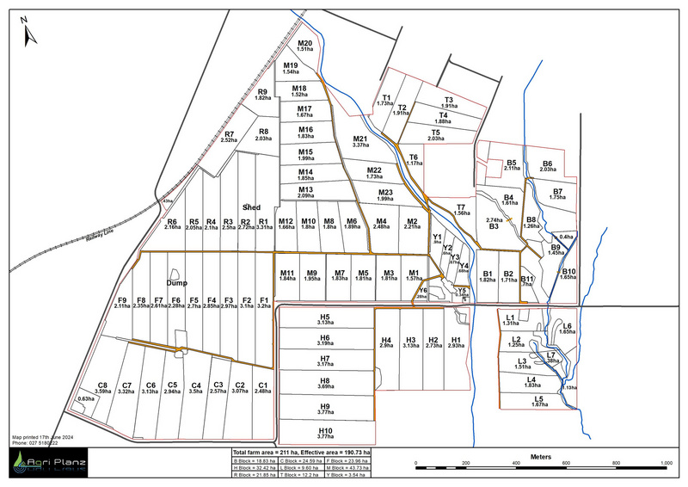
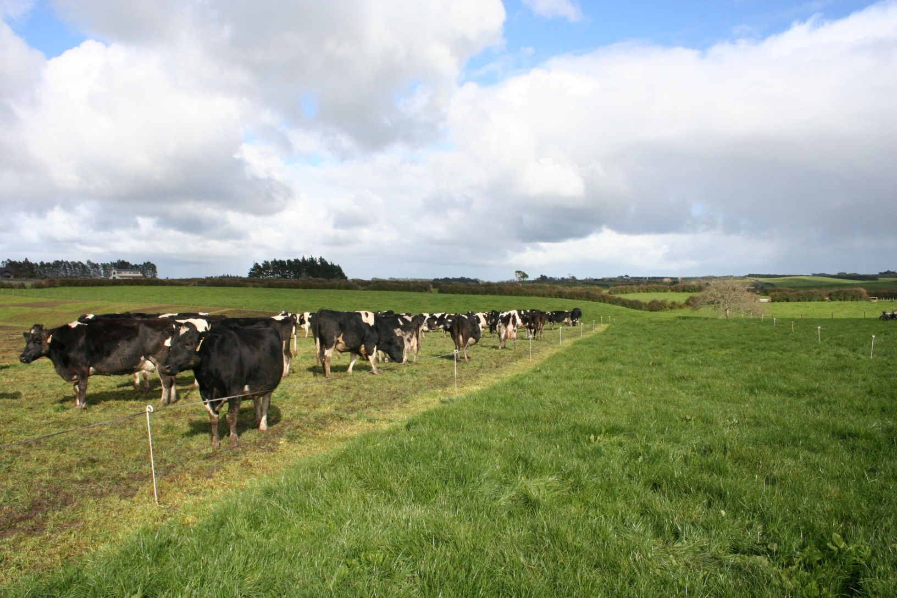
Paddocks
Dairy farms typically have multiple paddocks, which are usually rectangular in shape. Farmers use rotational grazing combined with break feeding to manage their pastures. This method makes break feeding more efficient and helps reduce pugging, as the rectangular shape of the break feed blocks encourages cows to graze more evenly.

Slide 8
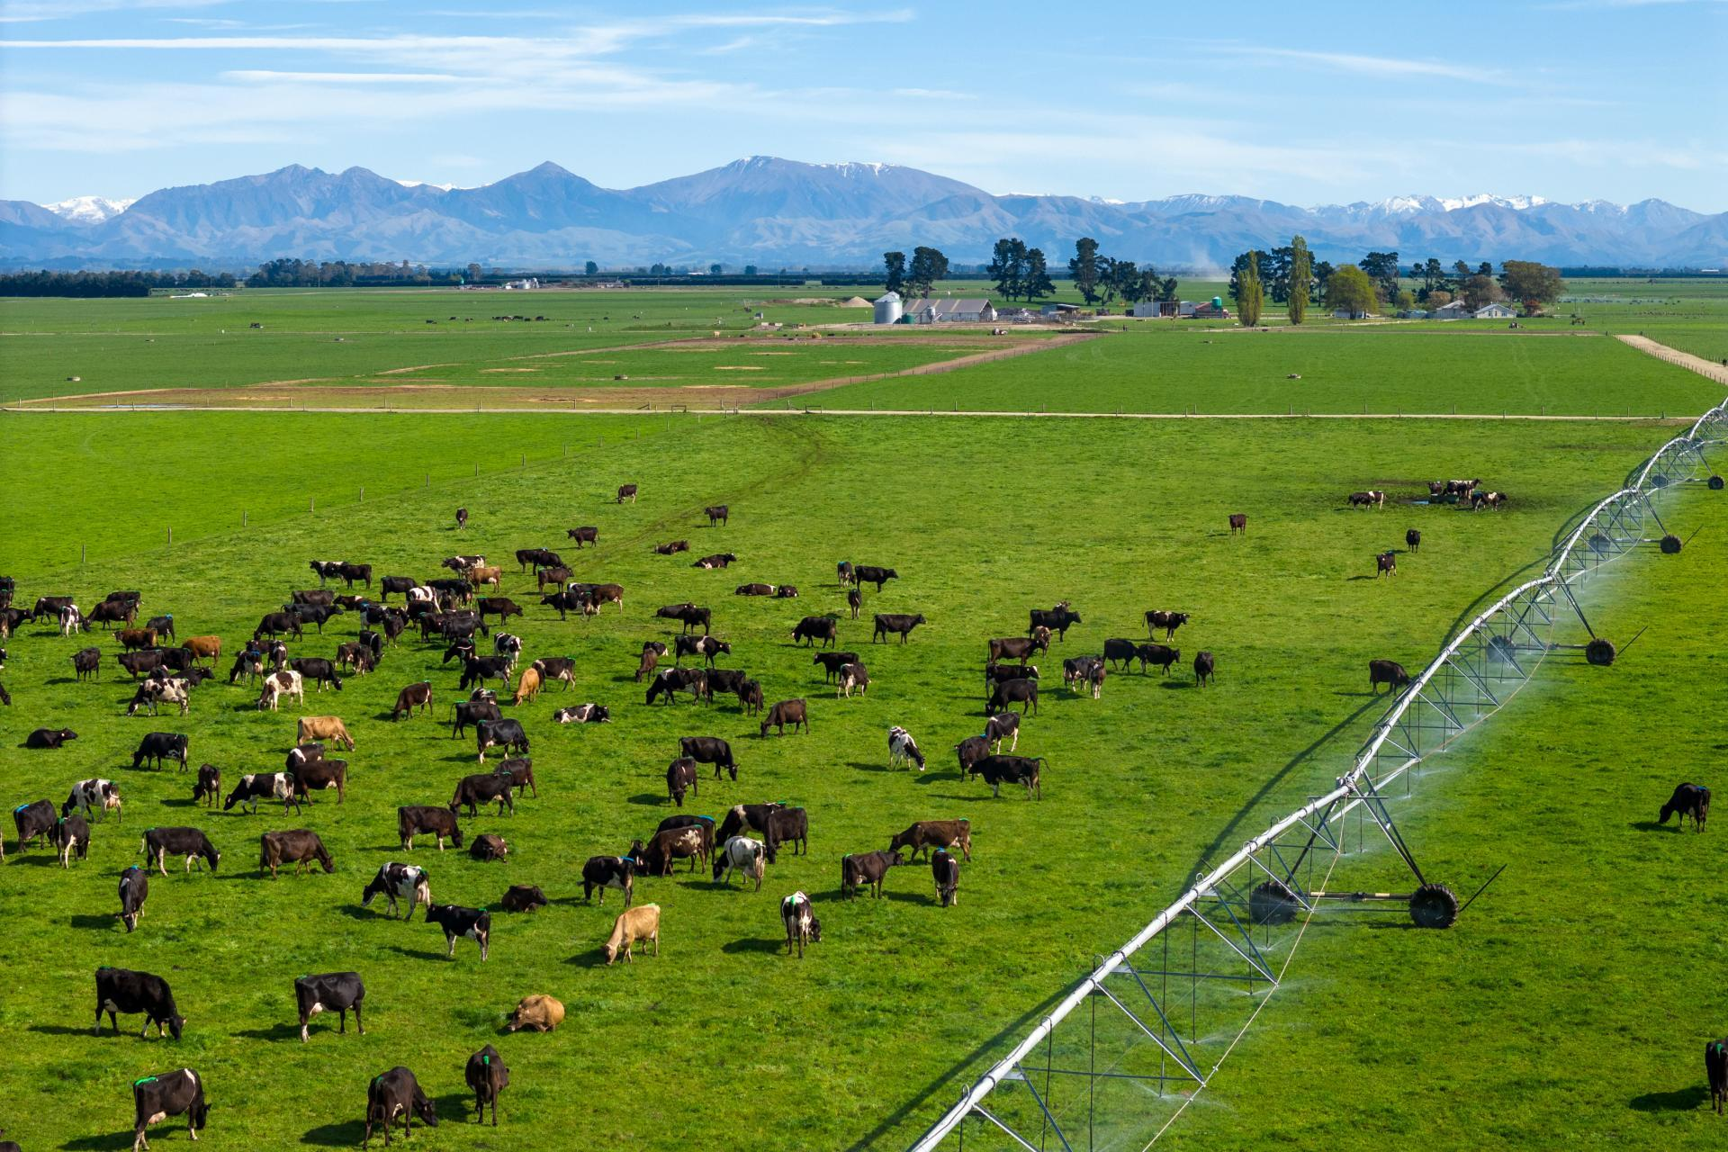
Farm design
Well-designed race ways reduces incidents of lameness and allows cows to move easily between paddocks and the milking shed.
A well-planned milking shed and system reduce stress for both cows and farm staff, improving efficiency and minimising the risk of injury.
Well-planned infrastructure allows for easy observation and management of cow health.
Effective design of paddocks and grazing areas supports rotational grazing, helping to maintain pasture quality and prevent overgrazing.
Good infrastructure makes daily tasks more efficient and less physically demanding for farm staff, reducing stress on both cows and staff.

Slide 9
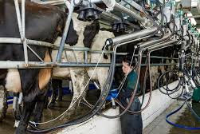
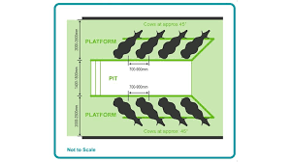
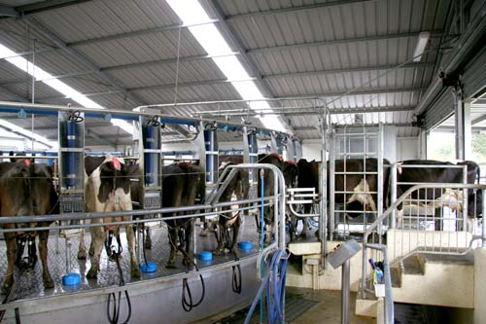
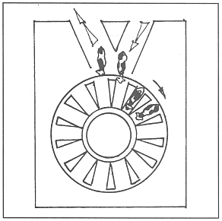
Dairy Sheds
There are 2 main types of dairy shed Herringbone and Rotary.
Dairy shed hygiene is important for
Milk quality
Reducing incidents of mastitis
Meet health and food safety regulations
Minimising health risks for farm staff and cows.

Slide 10
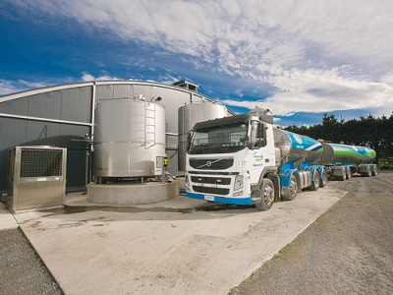
Milk collection
Tankers pick up the milk every 24 to 48 hours, and the milk must be kept chilled in the vats. Before transport, the tanker tests the milk to ensure it meets the required standards and is free from contamination. If the milk doesn't meet these standards, it must be disposed of.
In New Zealand, milk must be chilled to a temperature of less than 6°C within two hours of completion of milking to maintain its quality and safety. This helps prevent bacterial growth and ensures the milk meets the required standards for processing and transport.

Slide 11
Milking intervals
The traditional milking interval is twice a day.
However
Some farmers
milk once a day for whole or part of the season.
have a flexible milking interval for whole of part of the season.
Flexible milking is a term for milking practices that fall between the traditional once-a-day (OAD) or twice-a-day (TAD) milking
Examples are
milking three times in two days (3-in-2)
ten milkings in seven days (10-in-7)

Slide 12
Reason farmers milk once –a-day of flexible milking
Reasons farmers consider once-a-day milking (OAD)
The advantages depends on it the farm system or layout and can include:
Less time spent milking cows
To reduce staff pressure
Feed shortage (plan to milk OAD before feed runs short rather than be forced into it)
Stock health (lame cows, light cows, heifers, milk-fever prone cows)
Reproduction (non-cyclers, heifers or whole herd in a feed shortage)
Small dairy shed for herd size
Farm layout (walking distance to shed)
Reasons for a flexible milking system
The benefits of flexible milking are improved staff wellbeing and cow health,
but,
there are some challenges, such as grazing and pasture management.
Video
Why once a day?

Slide 13
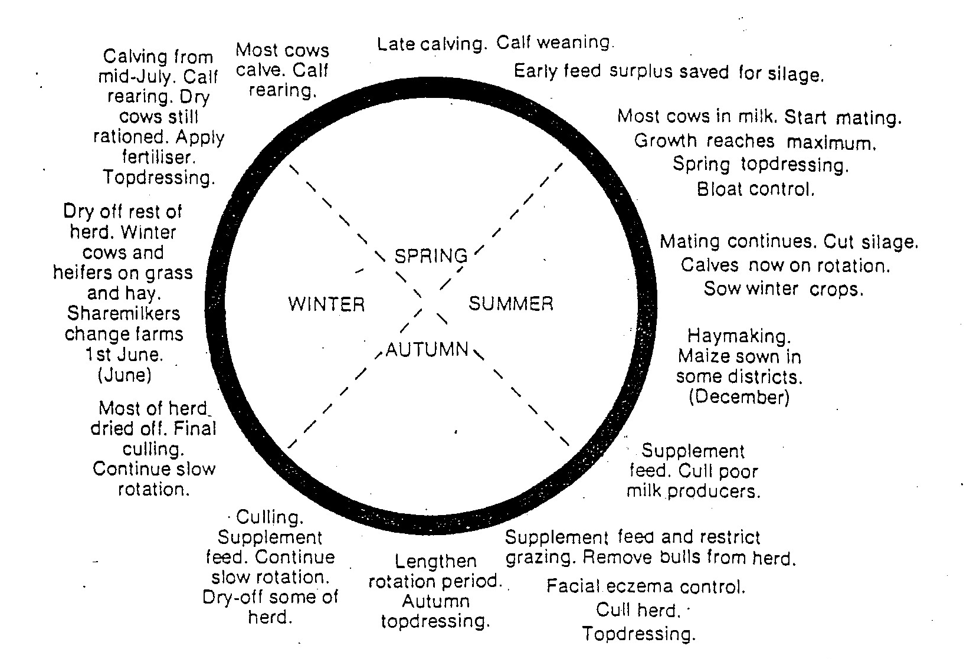
Calendar of Operations
While each dairy farm may operate slightly differently, they generally follow a seasonal pattern. This pattern aligns with the growth of pasture, ensuring that pasture growth is matched with the feed demands of the animals throughout the year

Slide 14
The dairy farming calendar is based around pasture growth.

Slide 15
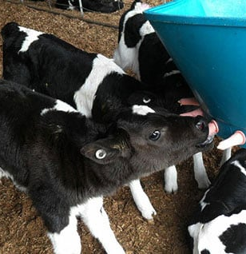
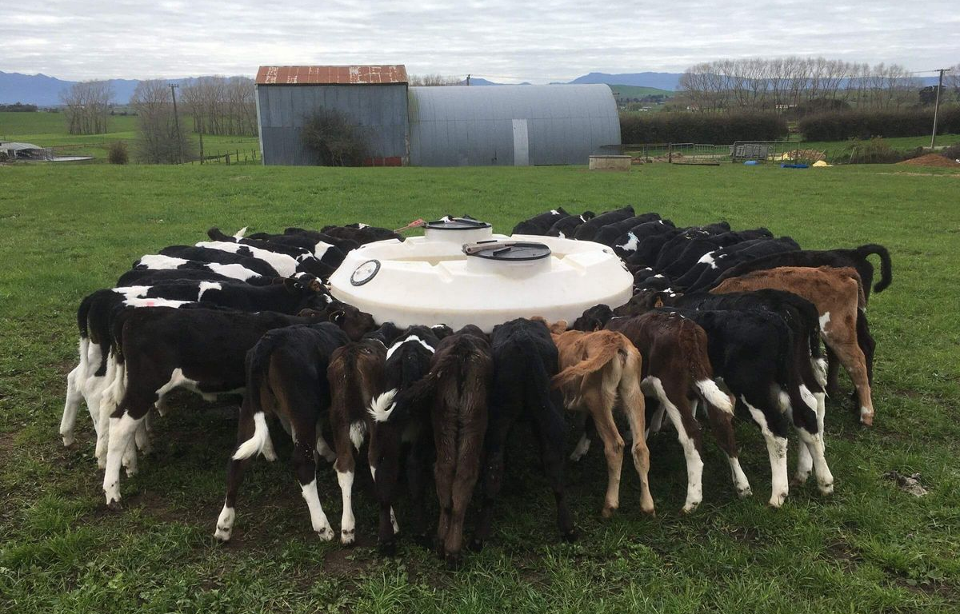
Winter June –Aug
Calving and milking begin, making this the busiest time of the year for dairy farmers.
As cows begin lactating, the first few days of milk—known as colostrum—must be kept separate. Colostrum is vital as it contains antibodies that help immunise the calf against diseases, along with essential vitamins to give the newborn calf a strong start in life. Calving usually lasts 9-10 weeks.
Heifer calves from high producing cows are kept and reared as replacements.
Male Friesian of dairy beef calves are often sold to farmers who raise them for the bull beef or prime meat industry. Male calves not kept for rearing for beef are sold as Bobby Calves as four-day-old.

Slide 16
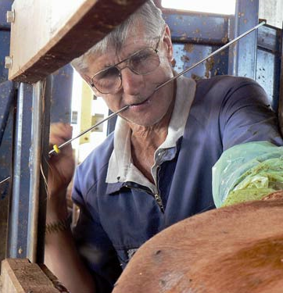
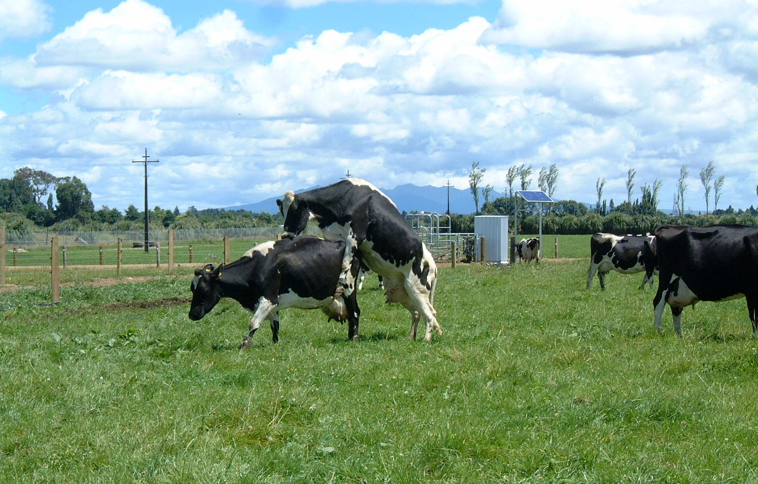
Spring Sep- Nov
In late spring, around late October, cows are artificially inseminated (AI) to get them back in calf. This practice allows the use of genetically superior bull semen of both dairy and beef bulls. A beef bull is still used to breed any cows that do not conceive through AI.
Silage is made in late October, ensuring it's harvested before it flowers for optimal quality.
Hay production takes place in November and December
Summer feed crops such as maize and turnips are planted.

Slide 17
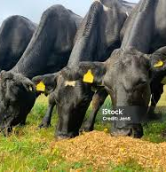
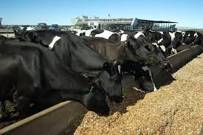
Summer Dec-Feb
Farmers with irrigation begin irrigating their pastures to maintain growth, while those without irrigation start supplementing the cows' feed.
Supplementary feeds include:
Pasture silage or balage
Palm kernel
Crops such as maize and turnips
As grass quality declines during this time, cows' milk production begins to drop. Therefore, poorer milk producers are culled.

Slide 18
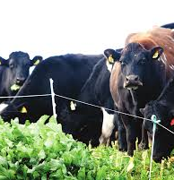
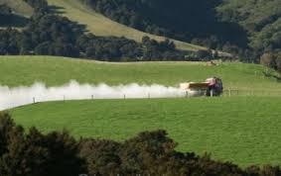
Autumn Mar-May
Culling of poor producing cows continues throughout autumn.
From late April to May, cows are gradually dried off, starting with once-a-day milking, and by mid to late -May, milking stops completely.
Topdressing is carried out during this time, with the type of fertiliser used depending on the season. A poor autumn may require nitrogen-based fertilisers, such as urea, to maintain pasture growth.
While the cows are dry, the dairy shed undergoes maintenance, including replacing milking cups and other parts of the milking plant.
General farm maintenance is also carried out during this period.

Slide 19
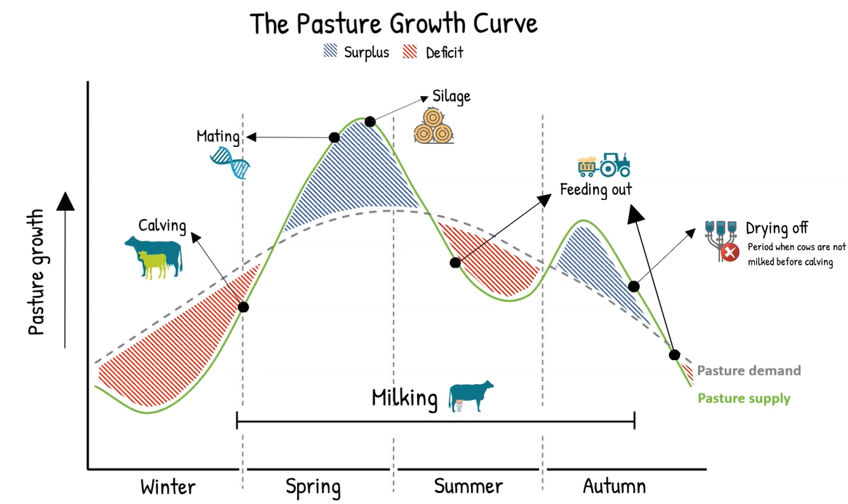
Managing feed deficits
Farmers make silage and/or balage from surplus spring pasture to store for feeding cows during periods of pasture shortage, particularly in summer and winter

