Slide 2
Dairy Farming Calendar of Work

Slide 3
The dairy farming calendar is based around pasture growth.

Slide 4
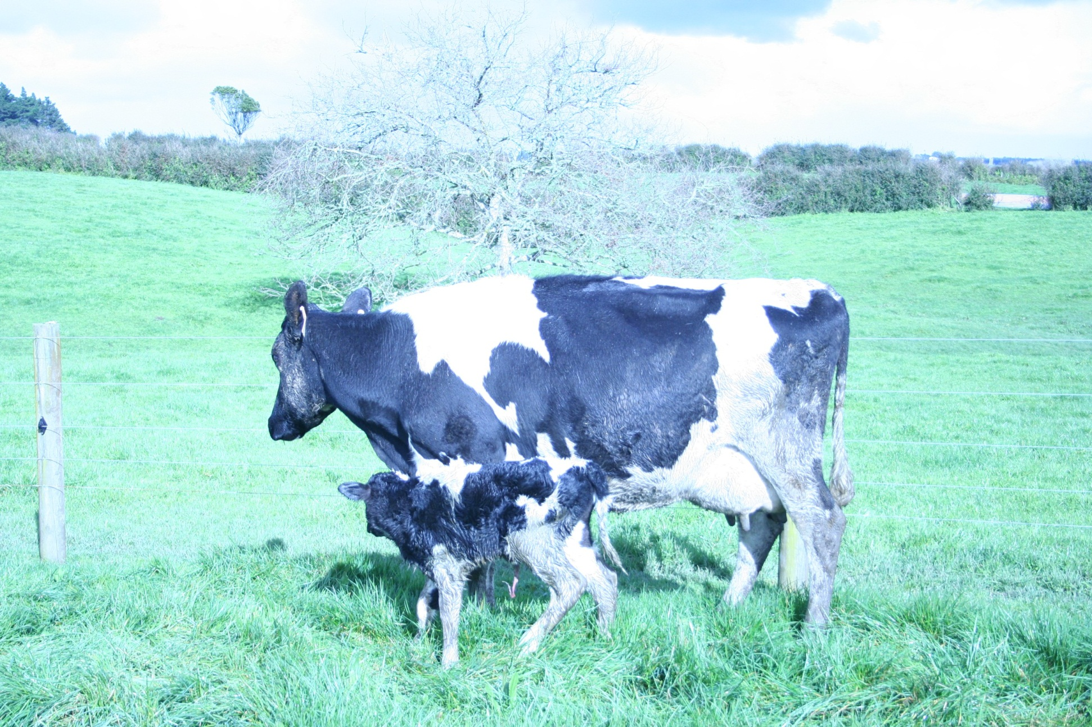
Late winter- Calving starts
Notes:
Most farmers start calving in
Winter June –Aug
Calving and milking begin. This is the busiest time of the year for a dairy farmer.
Calving usually begins in July and the cows start lactating (milking). This is to match feed supply.
The first few days of milk from the cow has to be kept separate as this milk has colostrum in it. Colostrum is milk that immunises the calf against diseases, has lots of vitamins and gives the new born calf a good start in life.
Farmers aim to have all cows calving in under 10 weeks few weeks. The more concentrated the calving the more efficient the farm system.
Some farmers calve in autumn especially in northland to match pasture growth as winters a mild and summers are generally hot and dry.

Slide 5
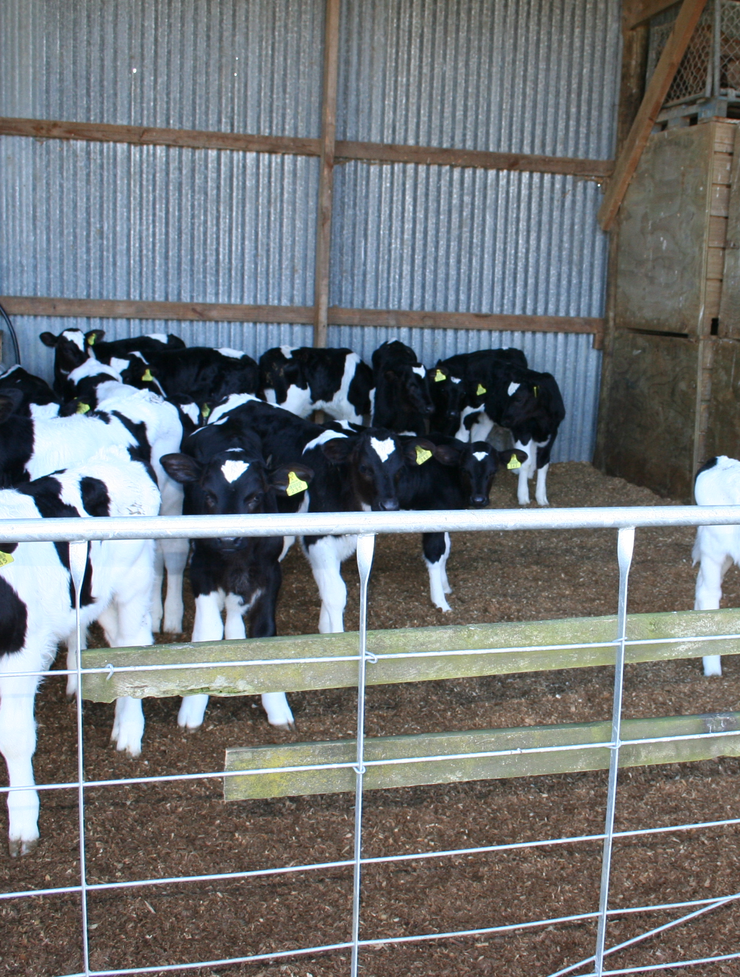
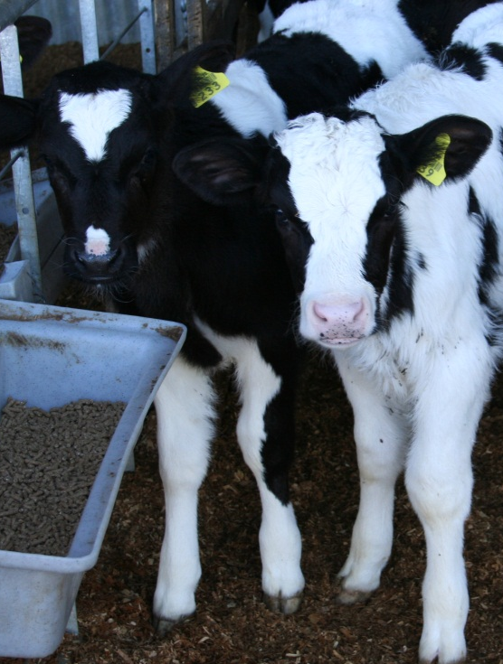
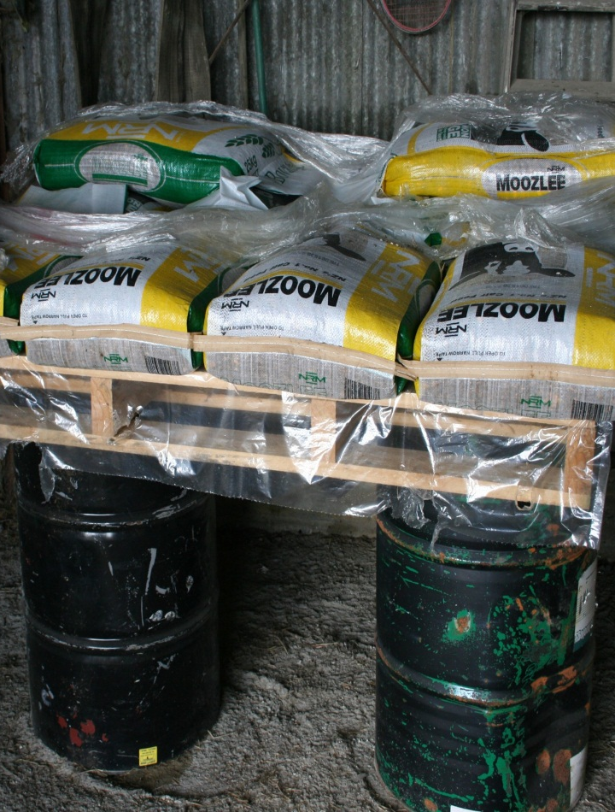
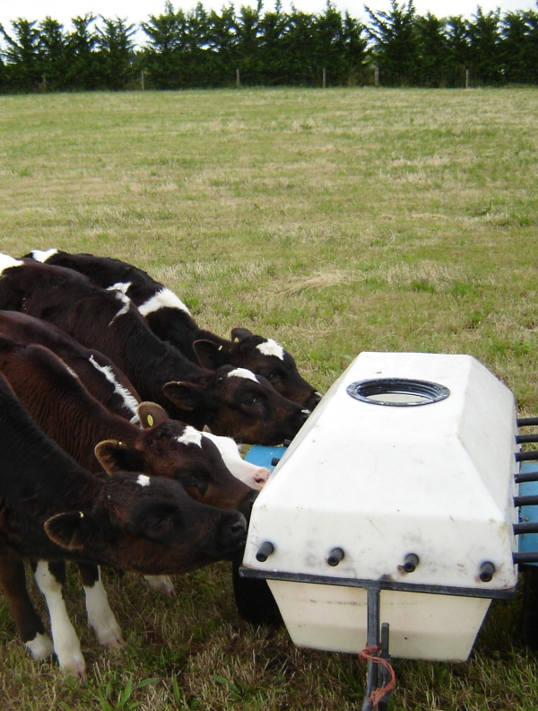
Rearing calves

Slide 6
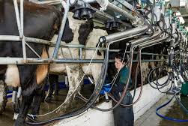
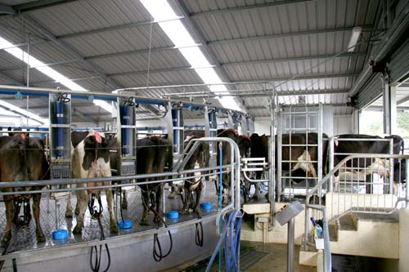
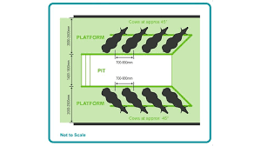
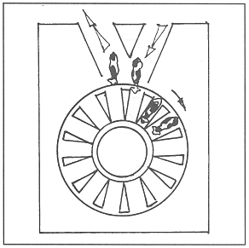
Milking (Lactation)

Slide 7
Putting on Nitrogen Fertiliser
Notes:
N fertliser is spread onto pasture to boost pasture growth in late winter early spring.
N fertiliser is also add to paddocks after silage has been made to speed up growth.

Slide 8
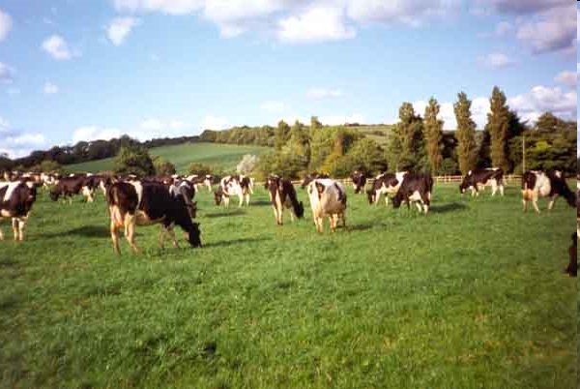
All cows calved Lactation average length 266 days

Slide 9
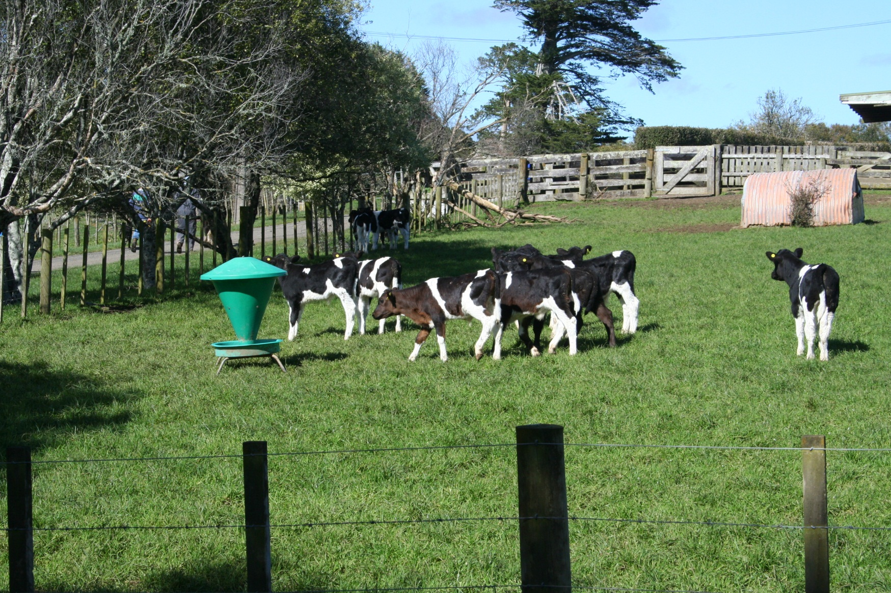
Replacement heifers are weaned

Slide 10
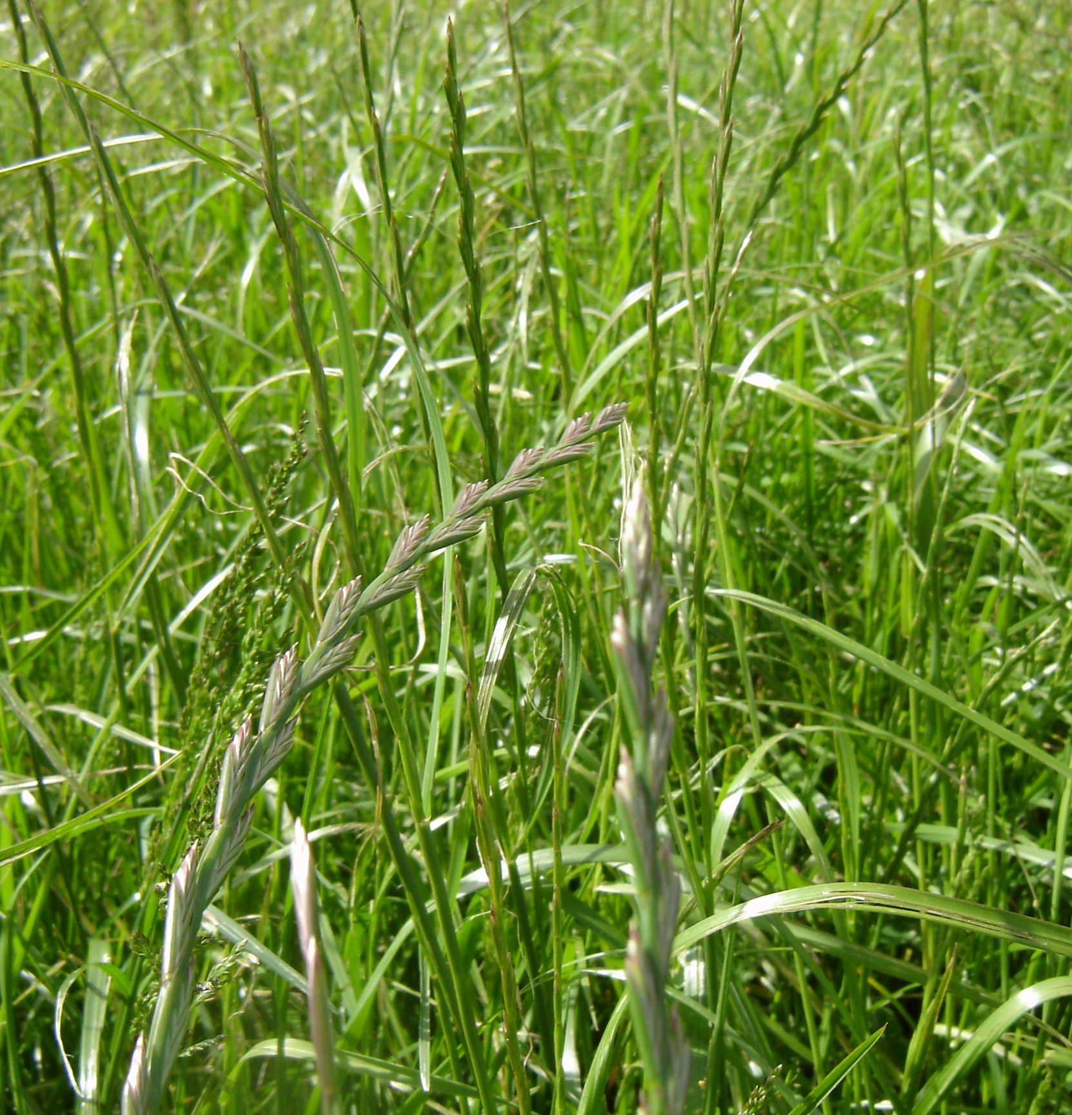
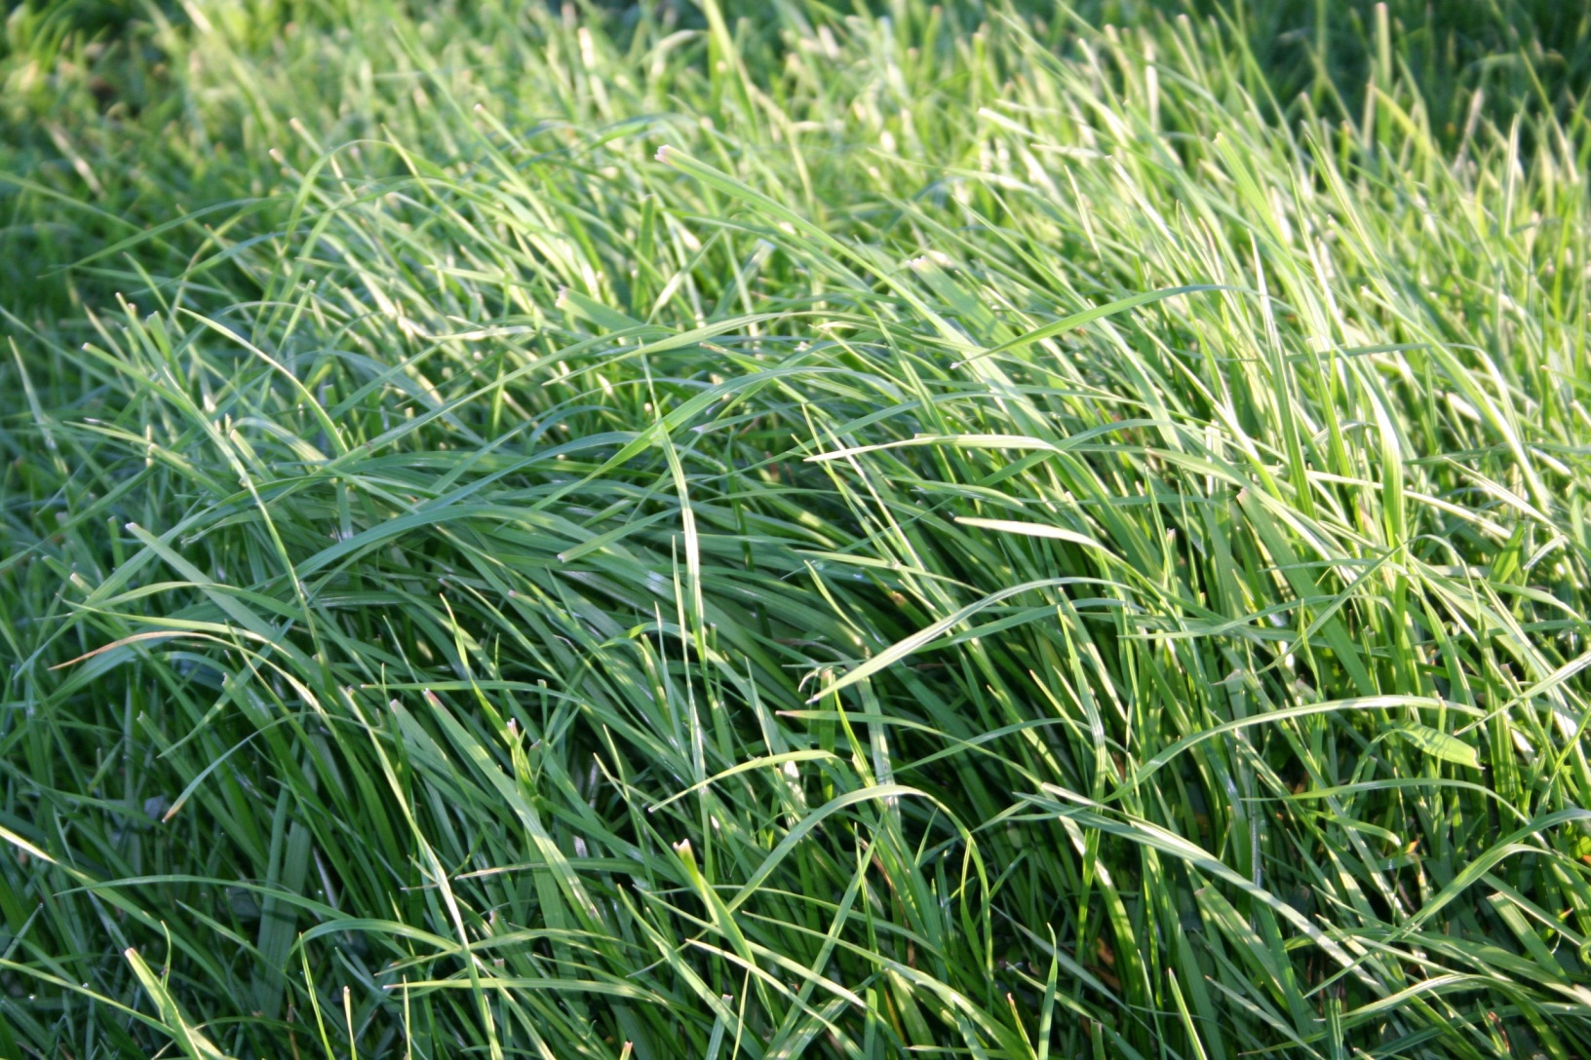
Paddocks Shut for Silage

Slide 11
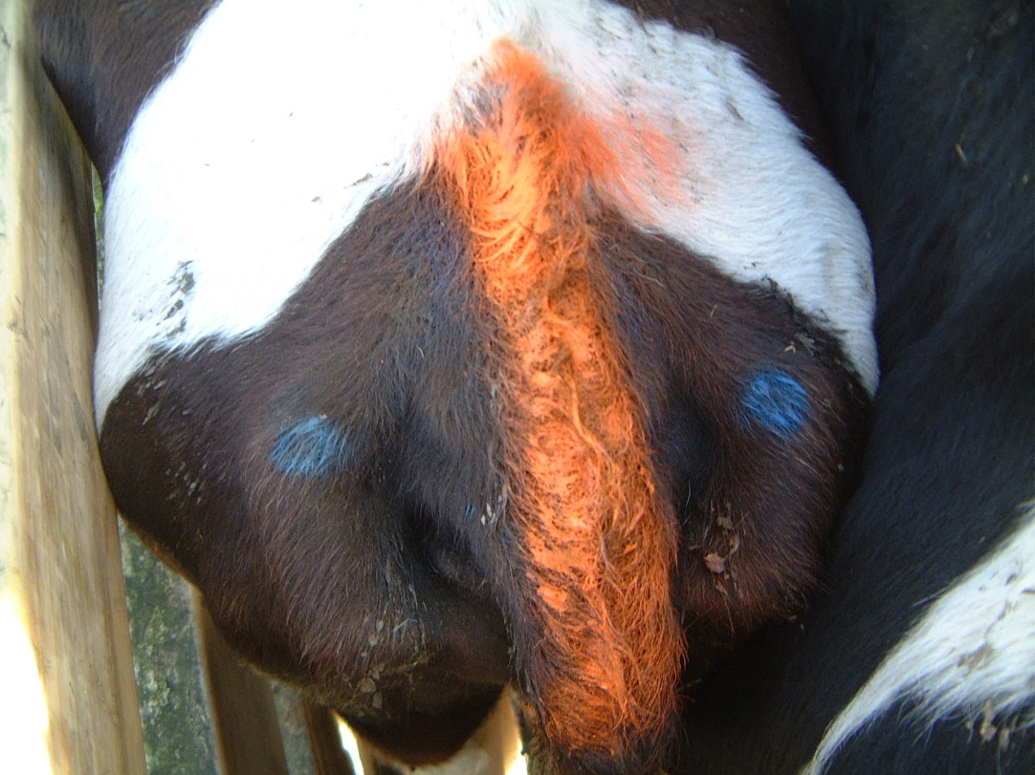
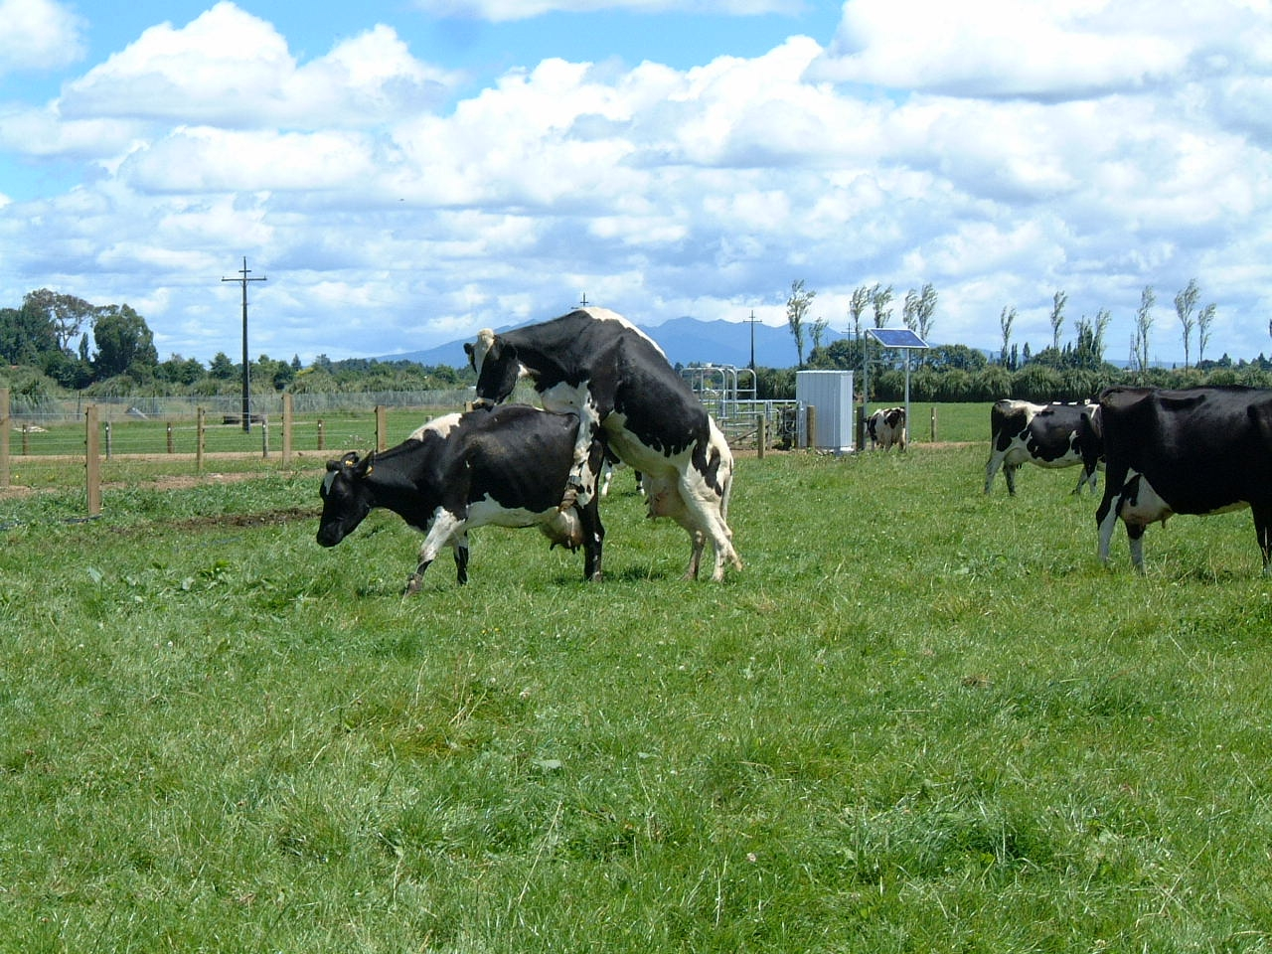
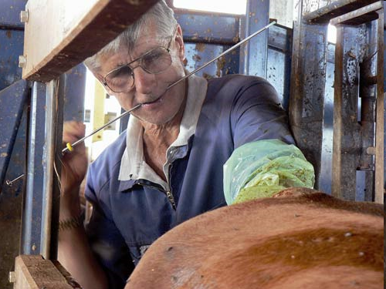
Mating (Artificial insemination)

Slide 12
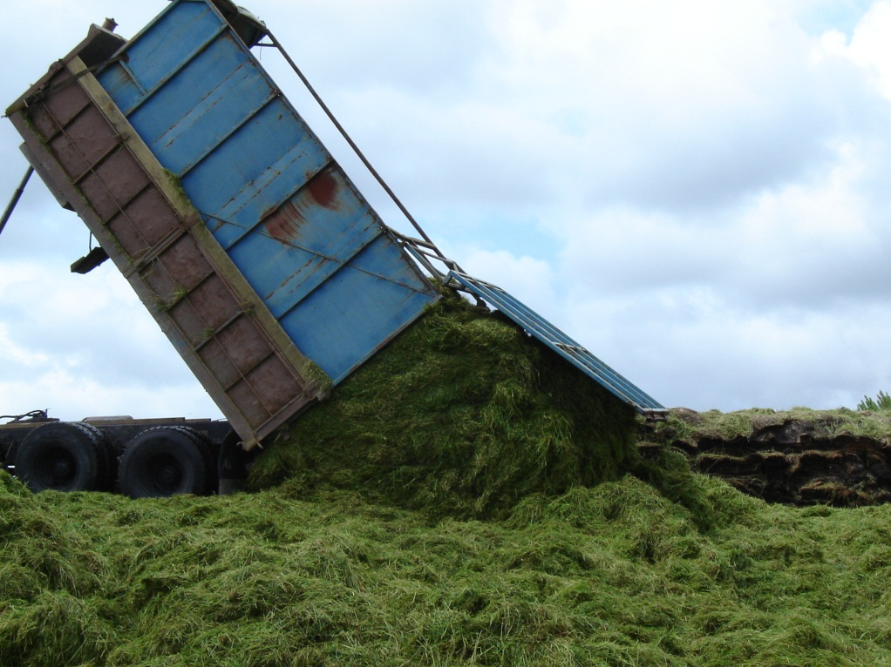
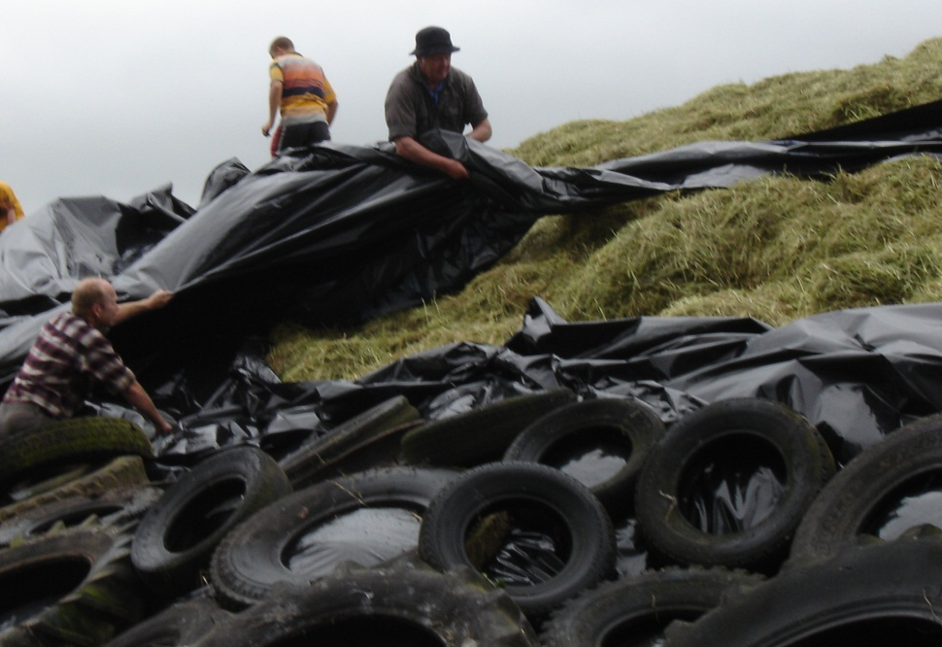
Making Silage

Slide 13
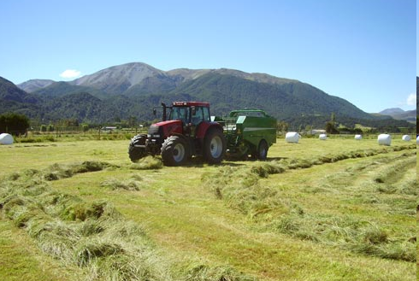
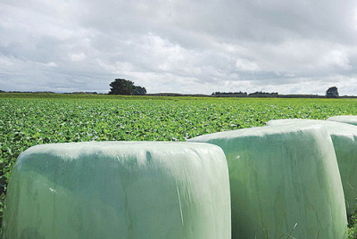
and or Balage

Slide 14
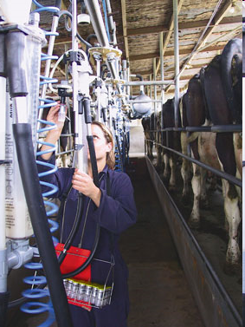
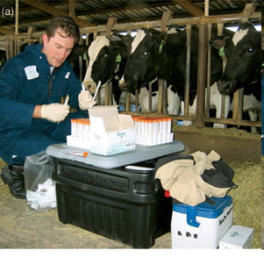
Herd testing

Slide 15
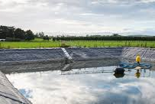
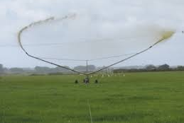
Storing and Spreading effluent

Slide 16
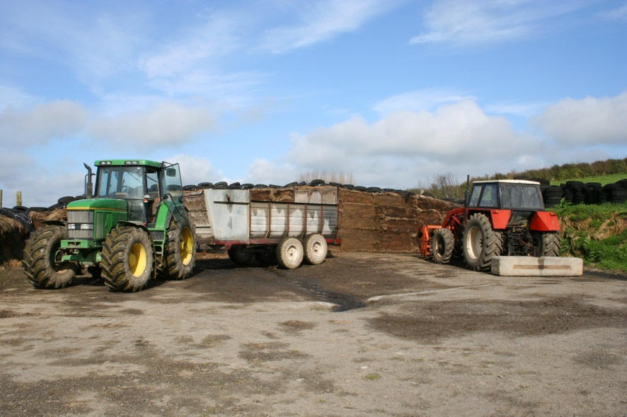
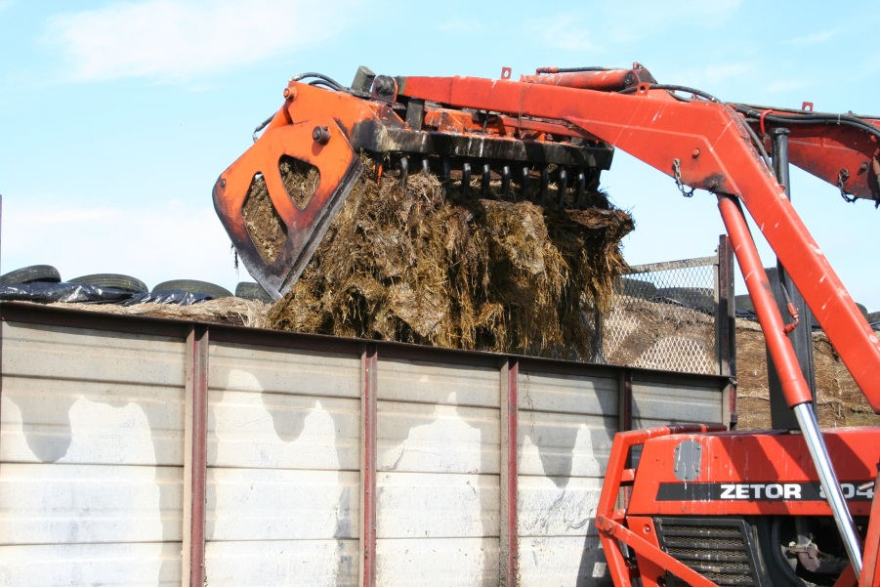
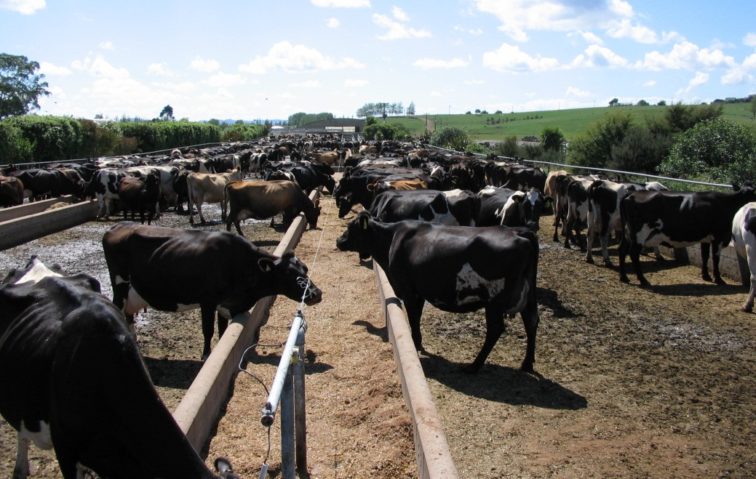
Supplementary Feeding

Slide 17
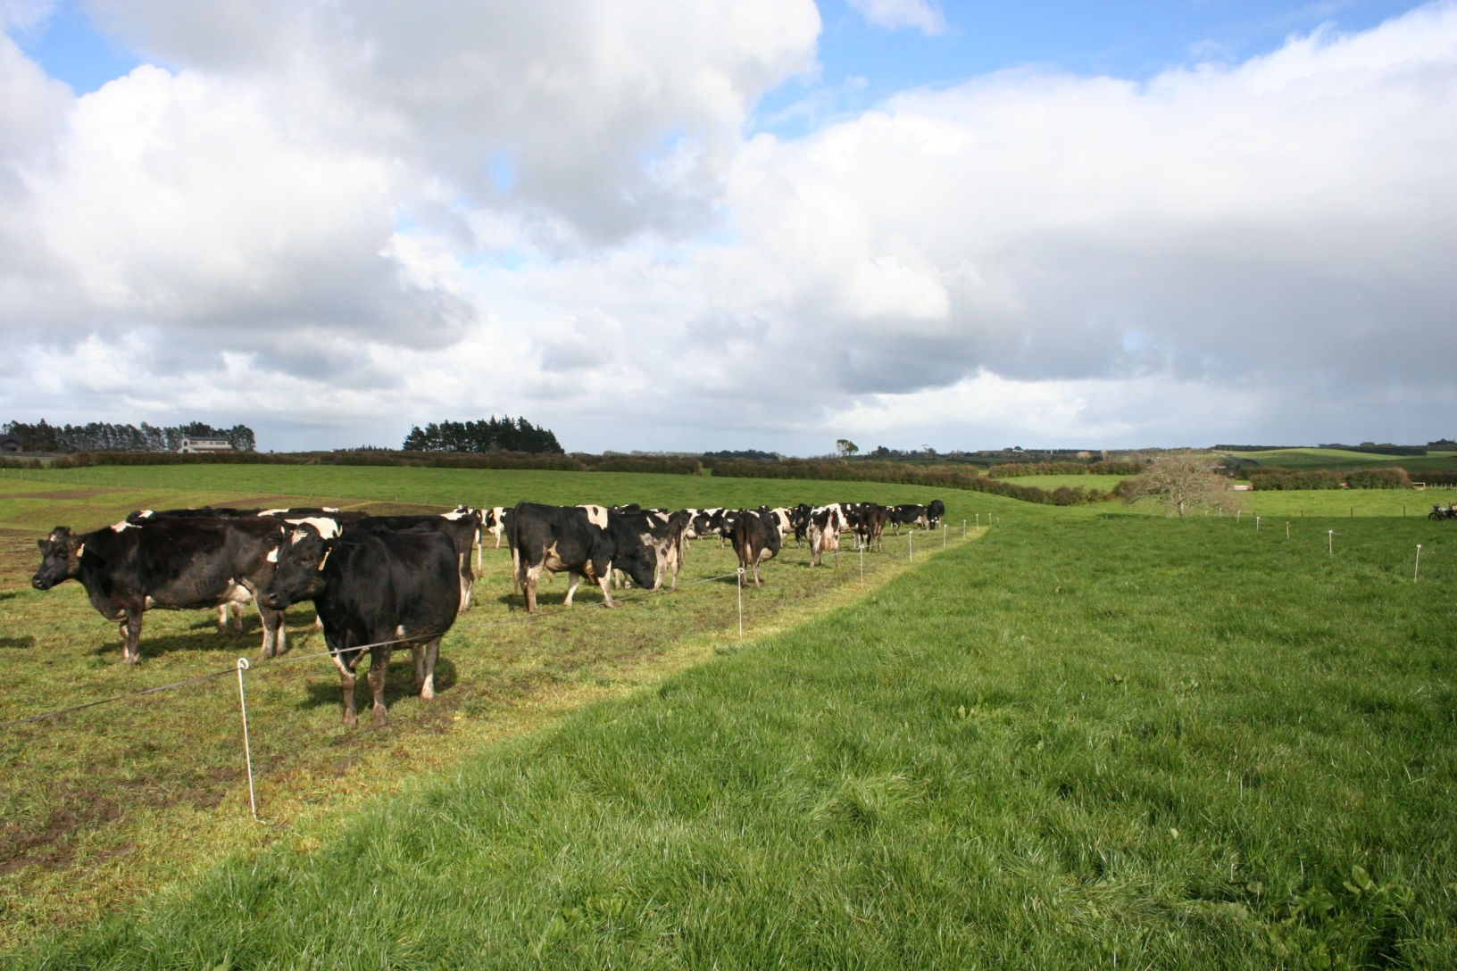
Break Feeding

Slide 18
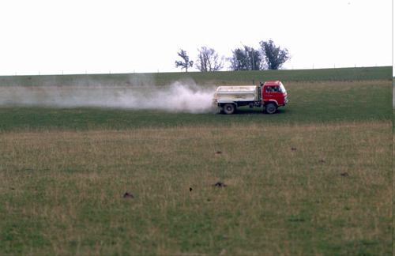
Autumn Fertiliser Application

Slide 19
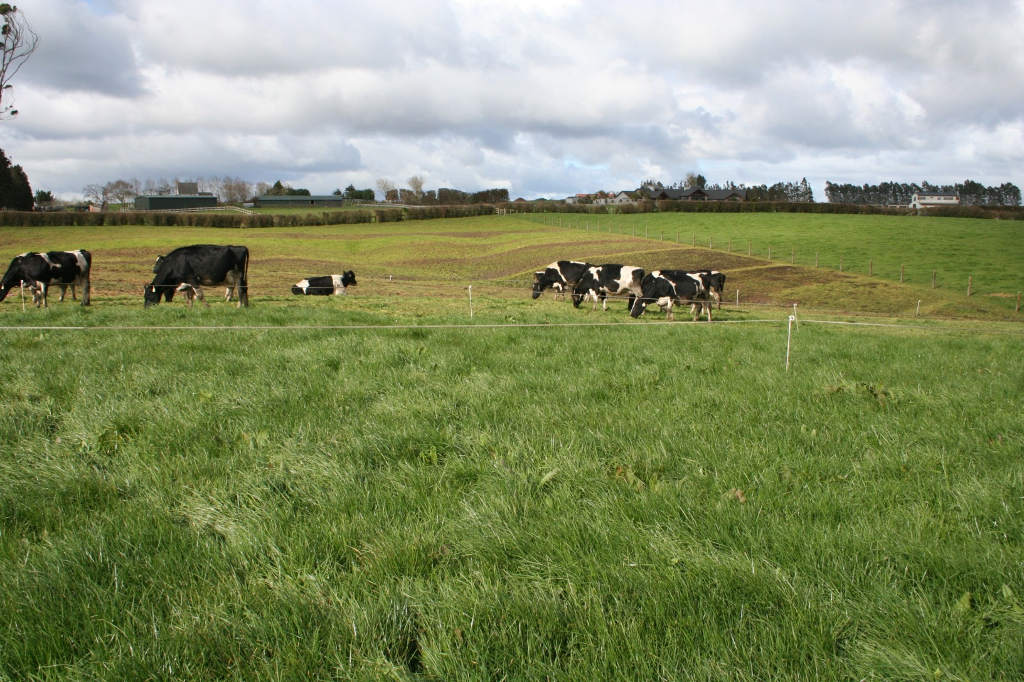
Drying off

