Slide 2
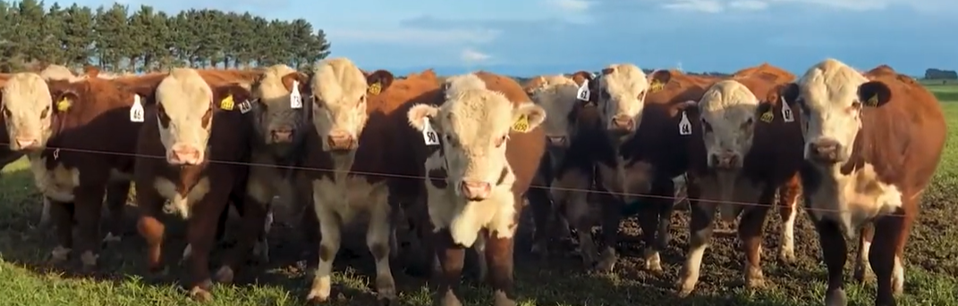
Beef Farming Calendar of Operations

Slide 3
Beef Calendar of Operations
Weaning
Calf sales
Culling
Prime cattle sold
Drench young cattle
Maintenance feeding cow
Bulls removed from cows after 3 cycles
Pregnancy testing
Prime cattle sold
Early weaning
Store cattle sold
Surplus & empty cows culled
Summer
Dec- Feb
Autumn
Mar- May
Hay made
Winter feeding
Crops / hay/ baleage
Spring
Sep-Nov
Winter
June- Aug
Calf tagging
Prime cattle sales
Prime 2yr cattle sold
Buying replacement 2yr old bulls
Increase feeding of cows
Crops sown
Mating Bulls joined with cows & heifers
Bulls checked for fertility
Increase feeding of all cattle
Calving

Slide 4
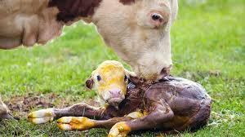
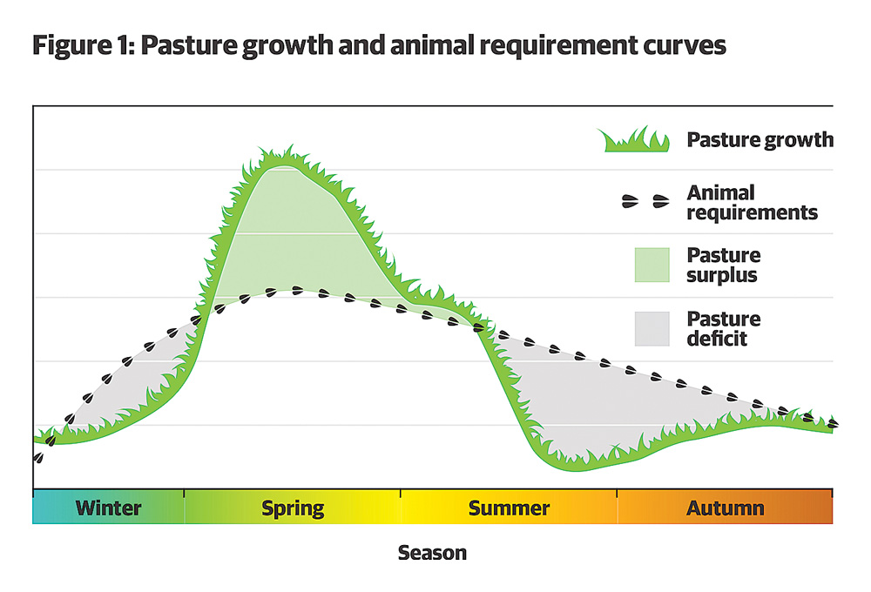
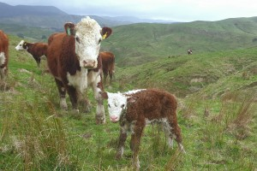
Calving
Starts in late winter early spring as pasture growth increases.

Slide 5
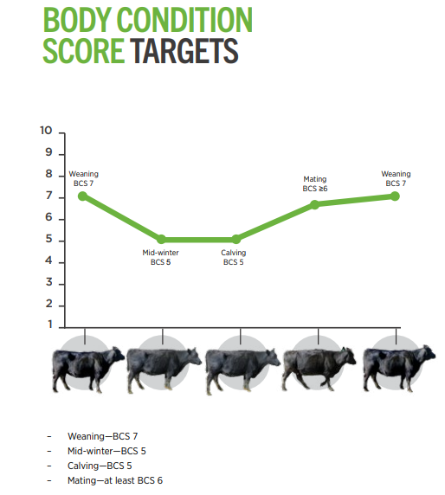
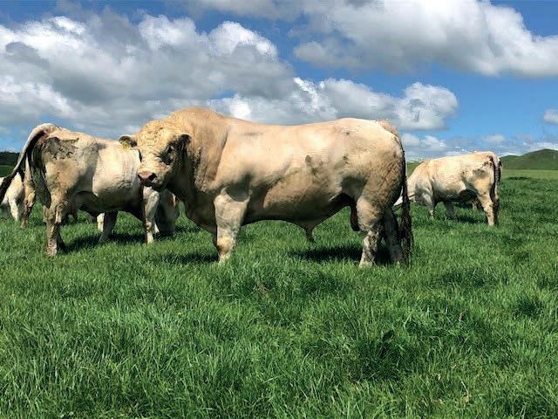
Mating
Cows on a high quality pasture to increase Body Condition Score (BSC) to 6-7
Bulls are checked for fertility
Joined with cows for 3 cycles
Video:
Body Condition scoring beef cows
Video good
For why 4.36-7.30
For how 7.30-

Slide 6
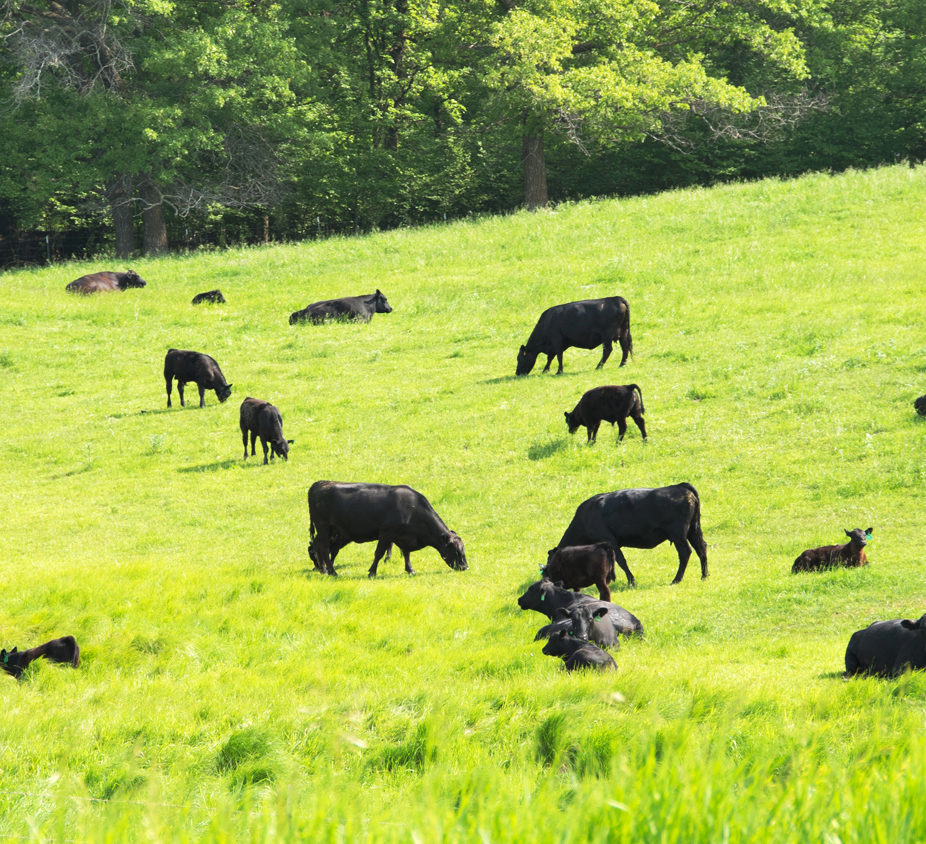
Pre-weaning
Make high quality feed available early on to encourage calves to transition onto this, while their mothers are still around. This will help rumen development and digestion of solid feed will be more efficient come weaning day. Additionally, if fed well early, skeletal and muscle development will be better, leading to an improved frame to build on later and fatten at the finishing stage.
Perform stressful procedures, such as disbudding, well before weaning.
Vaccinate against clostridial diseases

Slide 7
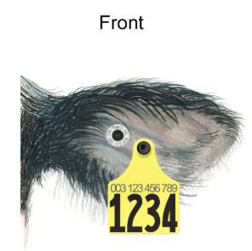
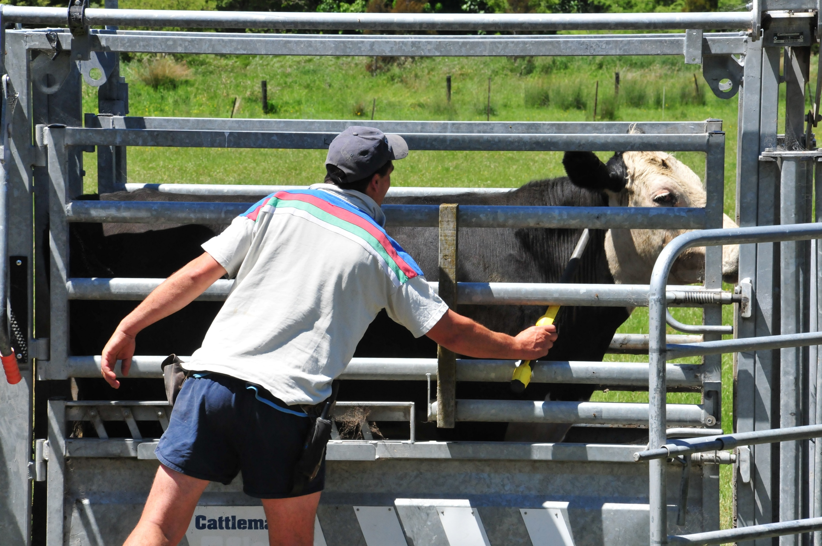
Ear tagging
Ear tags are essential tools for the cattle industry. By applying visual ear tags with unique identification of individual animals, cattle producers can better manage their herds, keep accurate records and make decisions for herd improvement. Electronic (EID) tags allow for digital recordkeeping and lifetime traceability of animals.

Slide 8
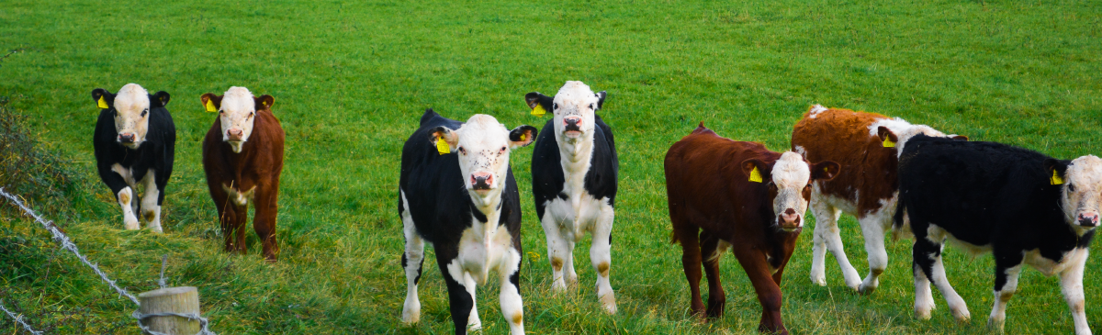
Weaning
Calves weaned between 6-8 months.
Ensure fences are in good condition.
Select a paddock with easily accessible water and good shelter.
Weaned on to high quality pasture for growing on or sold at sales to finishing farms.

Slide 9
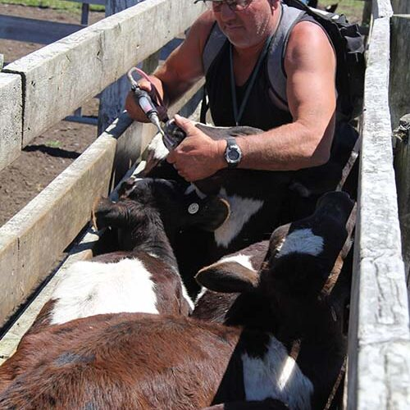
Drenching
The first drench should be given to calves at weaning. Subsequent drenching can be carried out at 28-day intervals, if using oral drenches, or 42 days if using pour-ons or injectables.
Oral drenches should be repeated at a shorter interval as they have no persistence, so only work to kill worms currently present in that animal.
Pour on drenches and injectables have persistence, therefore kill worms present in that animal for a prolonged period after drenching.

Slide 10
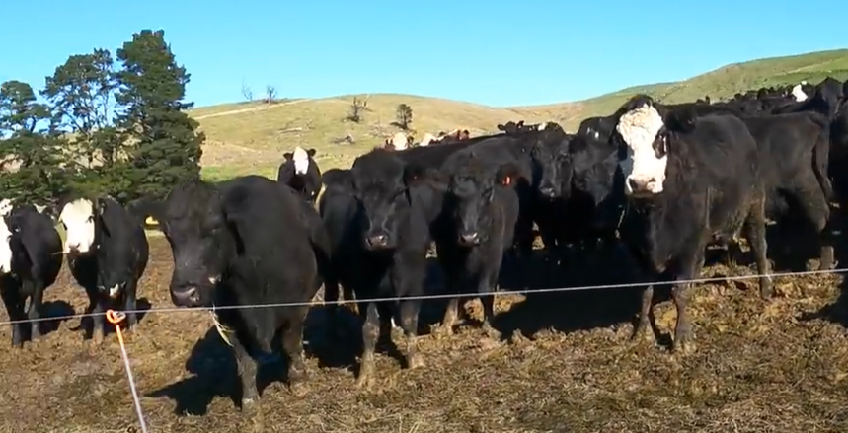
Cows post weaning
Cows on maintenance diet. Used to clean up pasture. They can drop in BCS but ideally not below 5

Slide 11
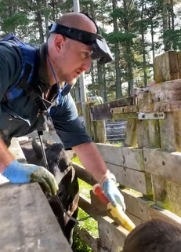
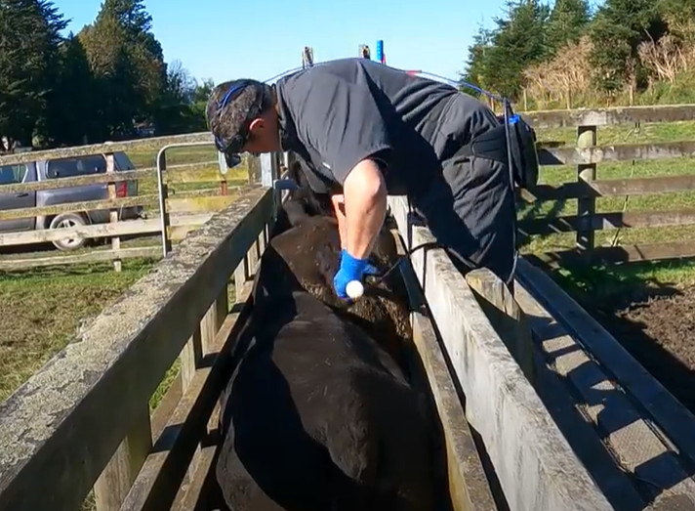
Pregnancy testing.
The benefits of dating beef cattle pregnancies allow you to:
Monitor cows closer at calving. This is especially true with heifers and studs recording calves on the drop.
Calculate a conception rate to each cycle and monitor the efficiency of cow cycling and bull activity.
Winter later cows differently.
Sell 3rd cycle / late calving cows or these can be the first to go if required.
Identify bull sub-fertility. This can be detected if there are different conception rates after bulls have been swapped. Suspect bulls can be serviced tested or culled.
Video: Pregnancy testing Beef cows, How did we do?
Starts at 13.20

Slide 12
Stock sales
Store cattle and culls sold at the sales.

Slide 13
Growing Bulls
Talking Bull: Day-to-day management
Talking Bull: Pasture management

Slide 14
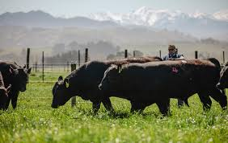
Buying bulls
Why bull selection is important
In a commercial beef herd, without cow recording, the bull contributes about 80% of the herd’s genetic improvement
Selecting a bull;
A bull should:-
be from a high producing cow sired by a high producing bull
have good feet (hoof angle)
good mobility
good temperament
Video: Angus Bull sale in New Zealand. How much did we pay? $$$$$

Slide 15
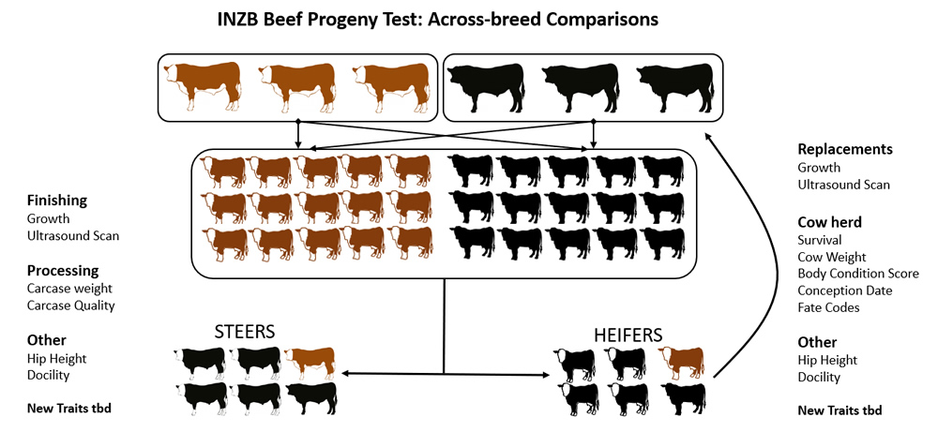
Genetics - driving the future of beef
B+LNZ’s Informing New Zealand Beef Programme
Beef Class Structural Assessment

Slide 16
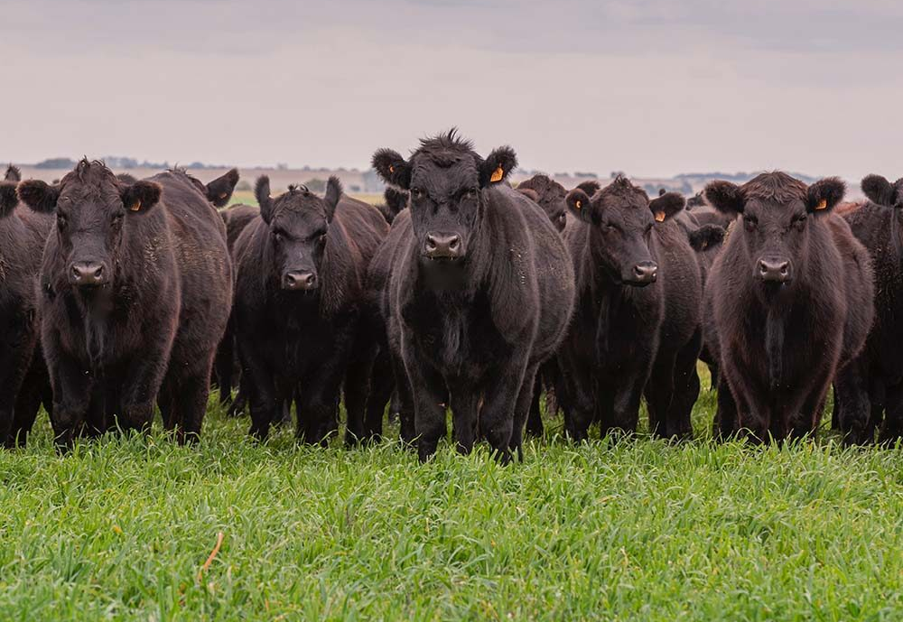
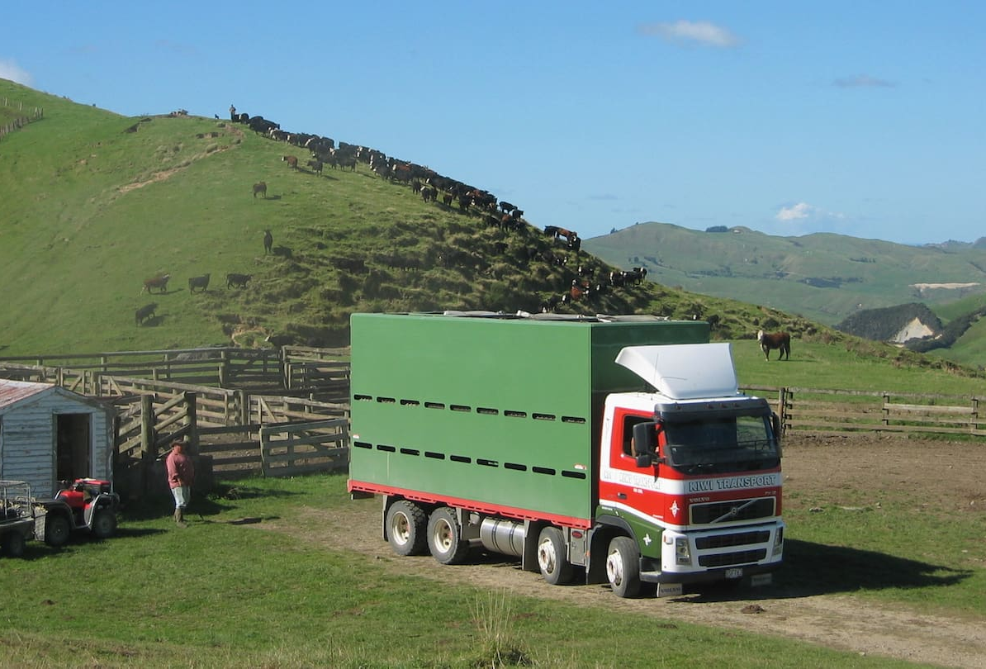
Prime cattle sold

Slide 17
Management Practice | Dec | Jan | Feb | Mar | April | May | June | July | Aug | Sept | Oct | Nov
 | SUMMER |  |  | AUTUMN |  |  | WINTER |  |  | SPRING
Bulls rotated around mobs of cows and heifers. Bulls removed from breeding cow herds after 3 cycles. Beef cows should be gaining weight throughout mating to maximise conception rates and calf growth rates Check water supplies regularly Sale of finished steers takes place Paddocks cut for hay available for grazing. Sale of finished steers takes place. | DRY MONTHS
Calves weaned Pregnancy diagnosed in cows and heifers Surplus and empty cows culled. Surplus weaner steer and heifer calves sold. Weaner calves are put on a drenching programme. Cows restricted to maintenance diet and used to clean up pasture. Feeding of winter crops starts |  |  |  | WEANING, DRENCHING, PREGNANCY
Feeding levels of cows must start to increase towards end of June by feeding on saved pasture. Bulls are puchased as rising two-year-olds |  |  |  |  |  |  | INCREASED FEEDING
Cows calve during the August to October period. Steers can be in the yearling sales at this time. Bulls checked for fertility status |  |  |  |  |  |  |  |  | CALVING
Pasture production reaches peak at the end of October and during November. Bulls are joined (for a maxiumum of 3 cycles) with cows and heifers. Cows fed at high pasture levels. Steers and cull 2-year-old heifers may be sold in the sale yards as store animals. Summer forage crops, if grown are sown from October to January. Hay and silage paddocks are closed dependent on pasture growth. Beef cows should be gaining weight throughout mating to maximise conception rates and calf growth rates |  |  |  |  |  |  |  |  |  | PASTURE PRODUCTION & MATING

