Slide 2
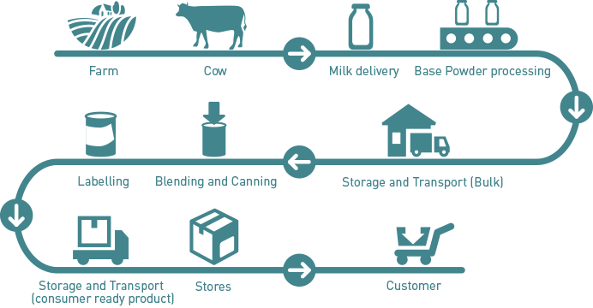
Value Chain

Slide 4
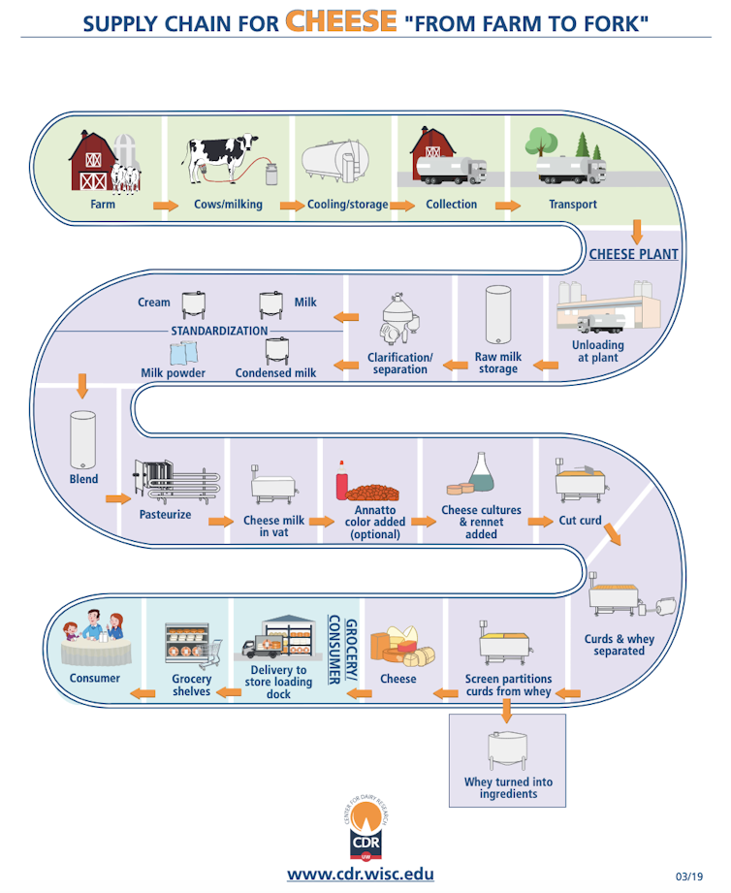

Slide 5
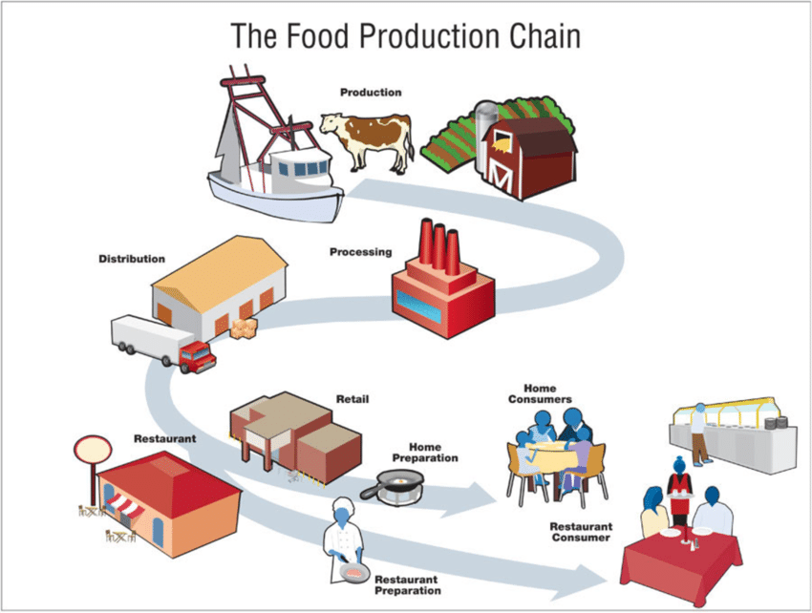
Steps
Production
Processing
Preparation
Ready to eat

Slide 6
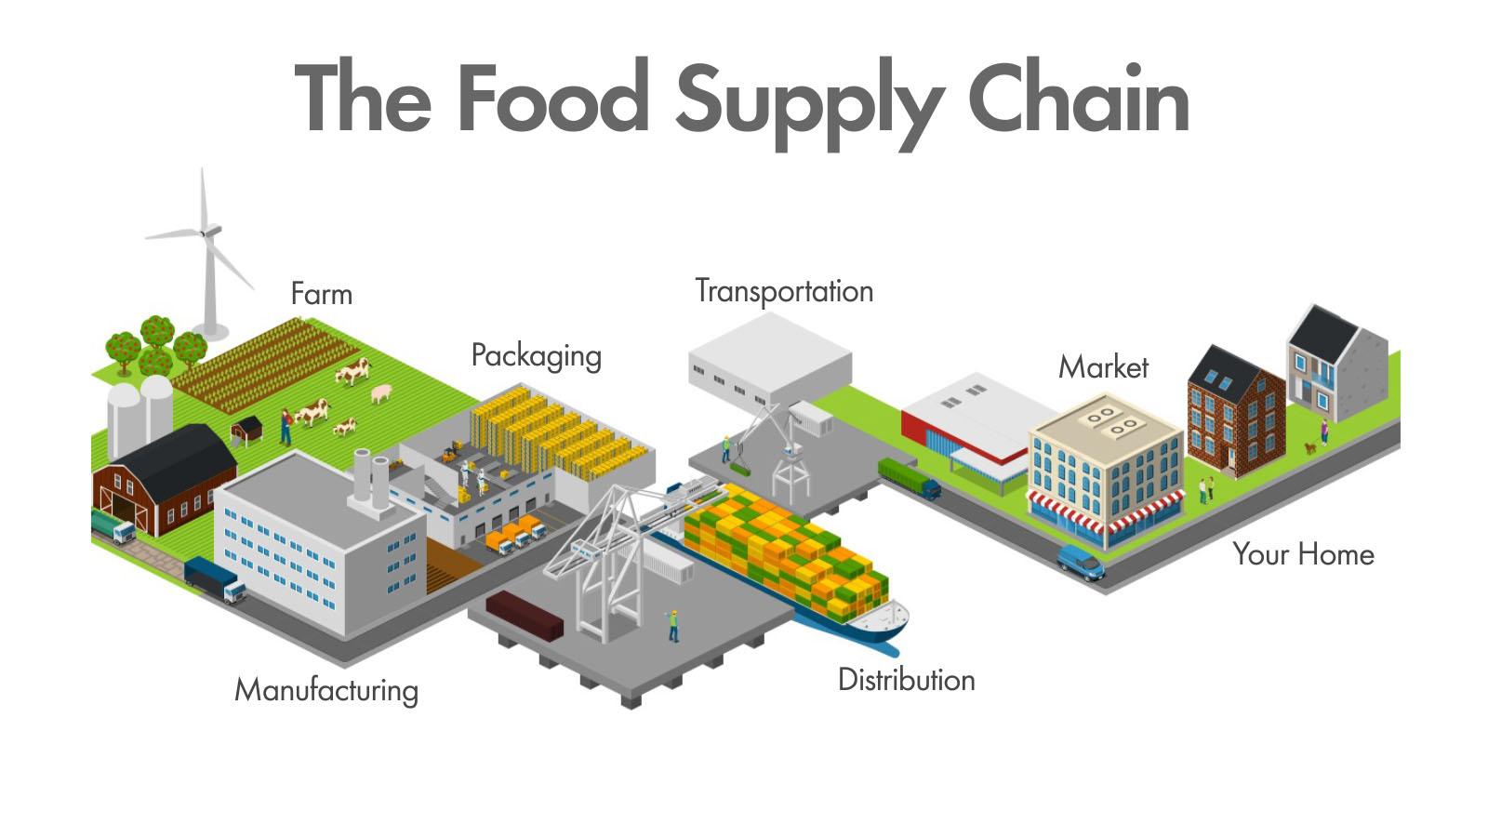
Steps
Production
Processing
Consumer

Slide 8
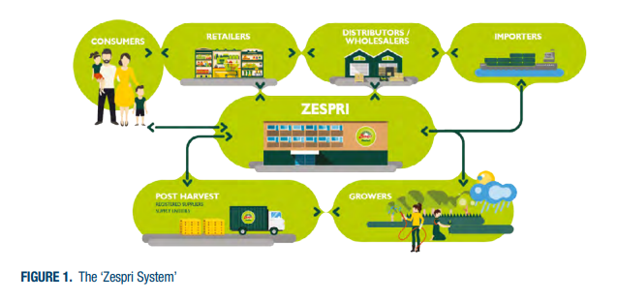

Slide 9
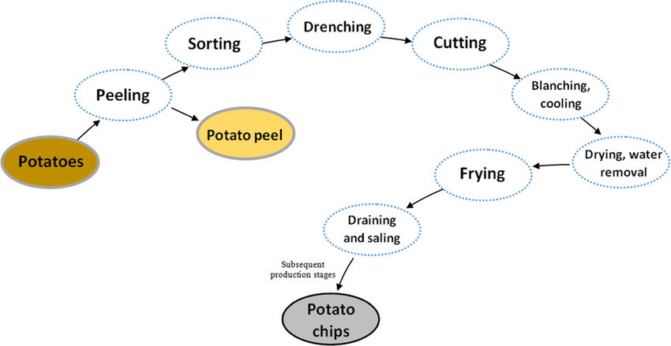
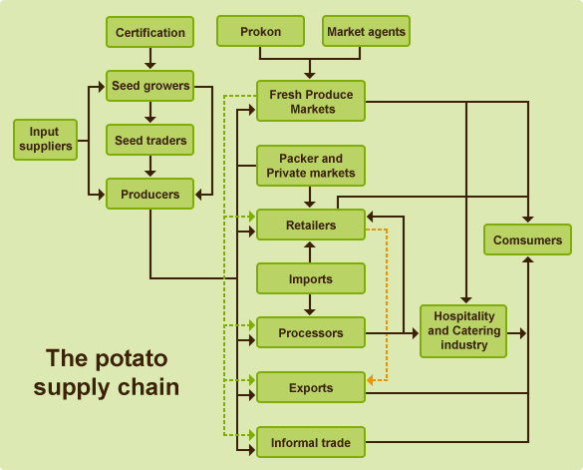

Slide 10
Wool Supply Chain:- Farm to processing
What is involved in getting wool from farm to floor
Godfrey Hirst tell the story of how they transform quality New Zealand wool into luxurious, environmentally friendly carpet.
https://woolclassers.org.nz/education/virtual-tours/
https://woolclassers.org.nz/education/virtual-tours/

