Slide 2
New Zealand’s Primary Production Sectors.

Slide 3
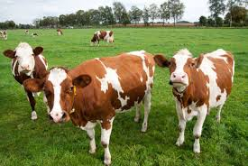
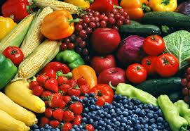
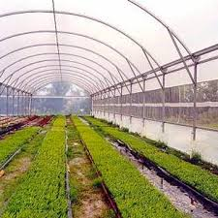
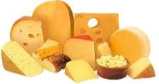
7 primary production sectors
Agriculture,
Dairy manufacturing,
Horticulture
Forestry,
Seafood,
Equine,
Sports turf.

Slide 4
Primary Sector Economic Contribution.
New Zealand’s primary industries have a pivotal role in New Zealand economy and contribute to 81.9 % of exports

Slide 5
Agricultural Contribution.
1. Dairying.
This is New Zealand’s largest export earner, with $24.2. billion in 2024. In the 2022/23 season, there were 4.67 million cows, a 6.7% decrease from peak cow numbers of 5.01 million in 2014/15. Cow numbers are predicted to continue to decline. Dairy companies processed 20.7 billion litres of milk in 2022/2023 season. 95% or milk produced in New Zealand is exported to more than 130 countries.
2. Sheep Meat
Sheep meat (lamb and mutton) was worth $3.83 billion in exports to New Zealand’s economy in 2023. On an annual basis, New Zealand produces about 280,000 tonnes of lamb and 91,000 tonnes of mutton. New Zealanders consume about 4 kilograms of lamb (and .04 kilograms of mutton) per person a year. Total sheep numbers in 2023 was 24.4 million. Number are decline and predicated to decline further.
3. Beef
The beef industry is the third largest export earner for agricultural products, with $4,597 million exported in 2023. The dairy industry is making a contribution to beef production. Culled dairy cows and bulls originating from dairy herds now contribute approximately 60% of all annual beef exports.
4. Wool
$4513million worth of wool and wool products was exported overseas in 2023. New Zealand is the world’s third largest exporter of wool and produces 9.3% of world production.
5. Deer
New Zealand is the major world market supplier of venison earning 175million and one of the main suppliers of deer velvet worth $102 million to the New Zealand economy in 2022/23.
6. Arable
The main arable crops grown in New Zealand are vegetable seeds, barley, wheat, maize grain, and oats. They are mainly growing in Canterbury and Southland. Exports are valued at $310 million.

Slide 6
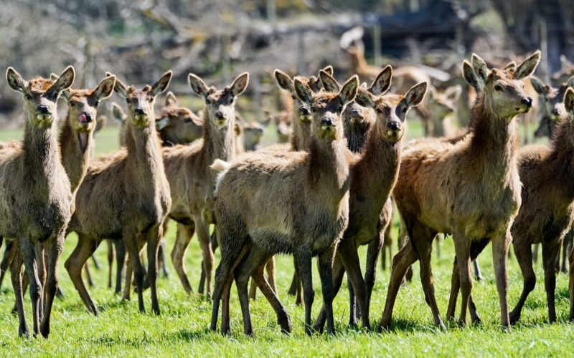
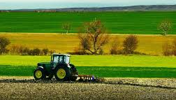
Agricultural main products
Dairying (milk only),
Lamb,
Beef,
Wool,
Deer,
Arable – grains and cereals.

Slide 7
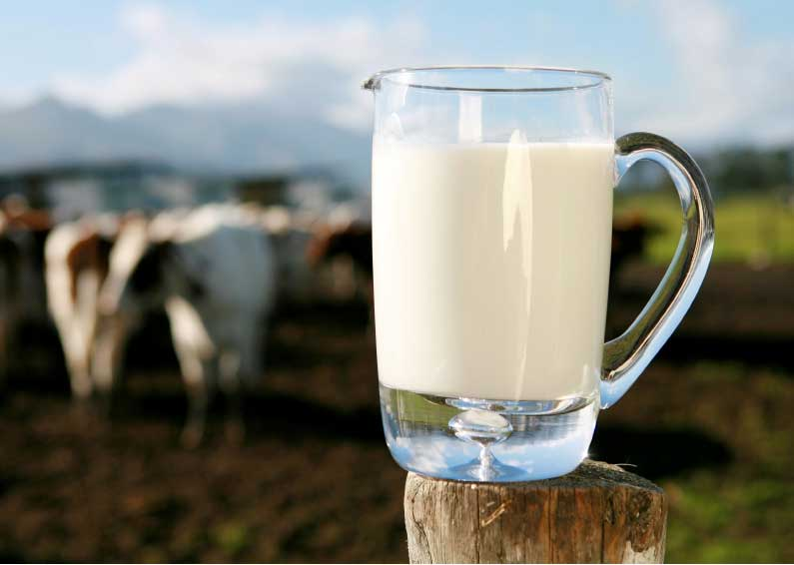
Dairy manufacturing from raw milk, processed milk, & dairy substitutes.
Products produced are;
Milk powders, whole-milk, skim-milk & buttermilk powder;
Cream products, butter, milk fat and ghee;
Cheese, mainly cheddar, & specialist cheeses;
Protein products such as casein & caseinates;
Alcohols.

Slide 8
Dairy manufacturing contribution
The dairy sector currently contributes over 25.7 billion New Zealand dollars to the country's economy. It is by far the most dominant goods export sector for the country.
Dairy is New Zealand's largest value-added contributor by far.

Slide 9
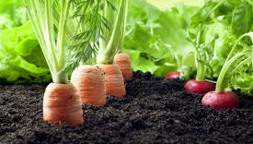
Horticulture main products
Fruit – wine grapes, kiwifruit, apples & pears;
Vegetables – onions, squash, potatoes.
Flowers

Slide 10
Horticultural Contribution.
In 20234/34, the horticulture industry is New Zealand third largest export earner. The export revenue was $7.1 billion. Horticulture exports make up about 11% of total New Zealand merchandised exports. About 40,000 people are employed in the horticulture industry.
Kiwifruit exports are now earning more than $2.5 billion. New Zealand kiwifruit are enjoyed by consumers in more than 50 countries, with two thirds of kiwifruit exports (by value) supplied to Asian countries.
New Zealand's wine exports have also reached a new high earning more than $1.4 billion. New Zealand wine was exported to more than 100 countries, with three quarters of New Zealand's wine production dedicated to Sauvignon blanc.
Other crops are also in demand by export markets. New Zealand apple exports have more than doubled in value since 2012 and now earn more than $892 million. New Zealand-bred varieties such as Jazz, Envy, Rockit and Pacific branded apples account for more than one quarter of exports.
Onions are New Zealand’s largest vegetable export crop. Export earnings were $140 million in 2022, with the majority of exports supplied to the UK and Europe.
Potato exports remain steady, at close to $130 million, primarily as processed product for the Australian market.
The New Zealand’s avocado export earning was $37 million in 2023/24

Slide 11
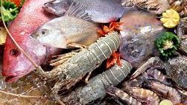
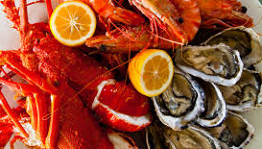
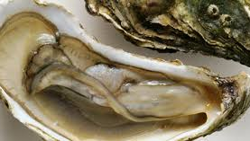
Seafood & aquaculture
Seafood & aquaculture main products are;
Harvesting fish from deep-sea or inshore fishing, e.g., rock lobster, hoki, squid, & orange roughy;
Aquaculture – growing & harvesting fish & shellfish in marine farms, e.g., greenshell mussel, oysters king salmon & yellow tailed kingfish
Processing fish & shellfish (at sea or on shore).

Slide 12
Seafood & aquaculture contribution
Seafood is New Zealand's fifth largest export by value and represents 3.2 percent of total exports. This includes fishing and seafood harvesting for deep water, inshore, highly migratory species and shellfish.
Wild capture has a revenue of over 1.5 billion
Aquaculture has a revenue of over $500 million.
Total export revenue is over $2billion

Slide 13
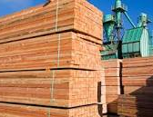
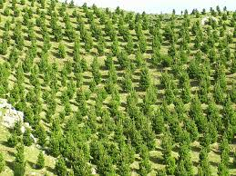
Forestry main products
Forestry - planning, establishment, silviculture, and harvesting of trees);
Sawmilling & remanufacturing;
Wood panels;
Pulp, paper and tissue; and
Furniture.
Forestry export revenue was $5.9 billion in 2023/24

Slide 14
Forestry Contribution.
Forestry contributes:
an annual gross income of around $6.6 billion
1.6% of New Zealand's GDP (Gross Domestic Product)
to the employment of 35,000- 40,000 people in wood production, processing, and the commercial sector.

Slide 15
Equine
The horse industry covers areas such as:
Semen exporting
Breeding and selling of racehorses
TAB betting
New Zealand's Thoroughbred, Standardbred and sport-horse industries collectively generate more than $NZ2 billion in gross domestic product (GDP) each year. That represents about 2% of the country's total GDP. The racing sector alone contributed an estimated $1.4 billion annually.

Slide 16
Sports Turf
This area includes:
City councils- parks/gardens , public sports fields
Companies that are contracted by the council to look after sports fields
Schools (ground staff)
Racecourses, bowling greens and golf courses

Slide 17
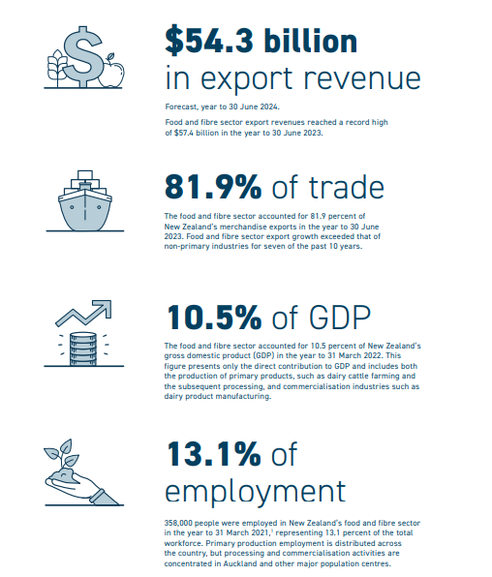
National importance
Economic
Employment
Export Revenue 2024
Dairy $24.2 billion
Sheep & Beef $ 11.4 billion
Horticulture $7.1billion
Forestry $5.9 billion
Viticulture $ 2.1 billion
Arable $310million

Slide 18
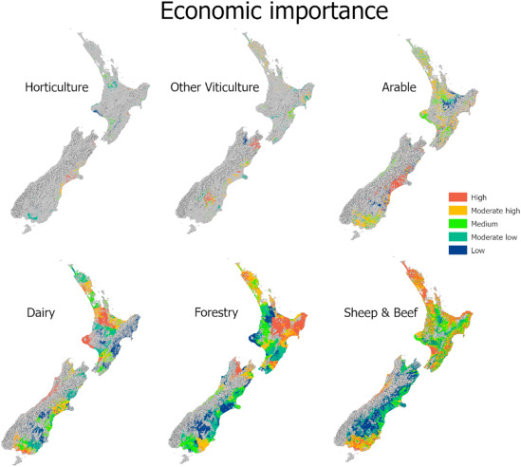
Regional Importance
Supports rural and urban communities
Income
Employment
Infrastructure

Slide 19
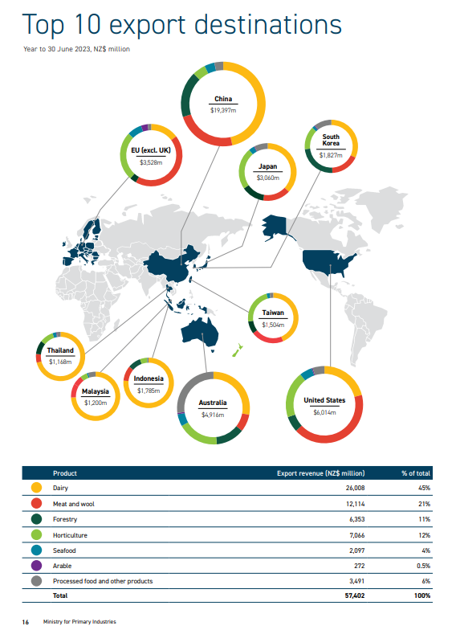
Export markets
What are New Zealand’s 5 biggest exporting sectors?
What are New Zealand’s 3 biggest export markets?

