Slide 2
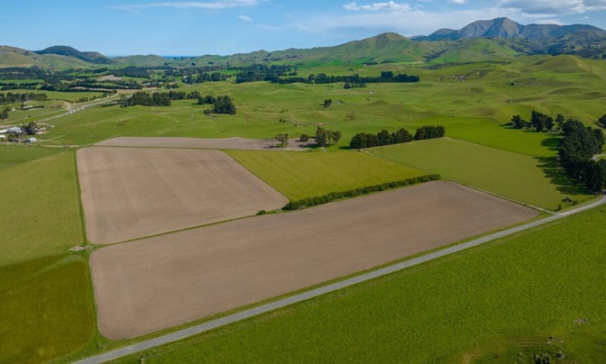
Reasons why New Zealand is good at primary production
New Zealand is a long narrow country that has:-
a temperature range that is suitable for growing plants and grazing animals outdoors all year round.
regular rainfall or access to water for irrigation for growing pasture and crops.
flat to rolling land suitable for growing crops and animal that require lots of grass
hilly and mountainous country suitable for grazing sheep and cattle as well as forestry
Other reasons
the expertise to help primary producers produce quality products efficiently and sustainably.
a number 8 wire can do attitude.
small population with 85% living in urban centres.

Slide 3
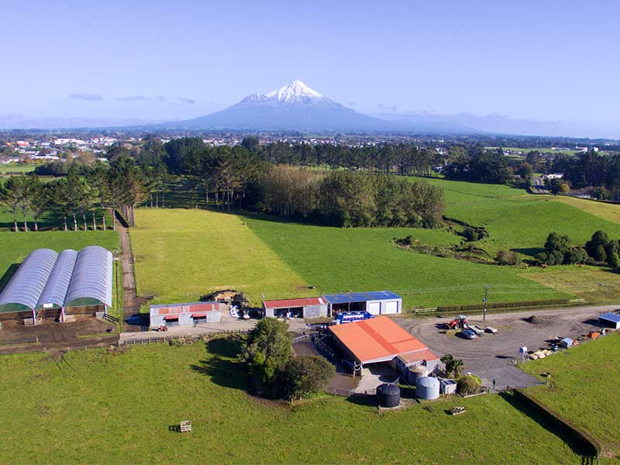
Factors that influence the location of primary production systems
Physical factors
Topography-slope of the land ( flat, rolling hills, hilly and mountainous)
Fertile soils
Climate factors
Rainfall
Temperature
Sunlight hours

Slide 4
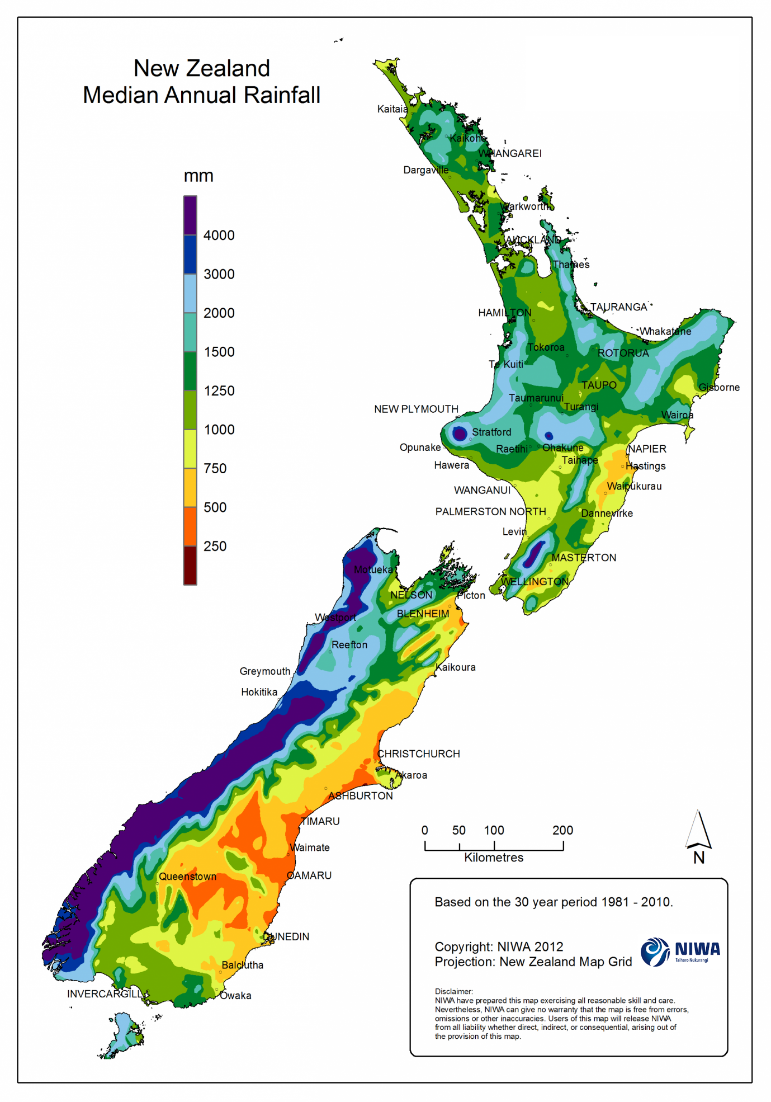
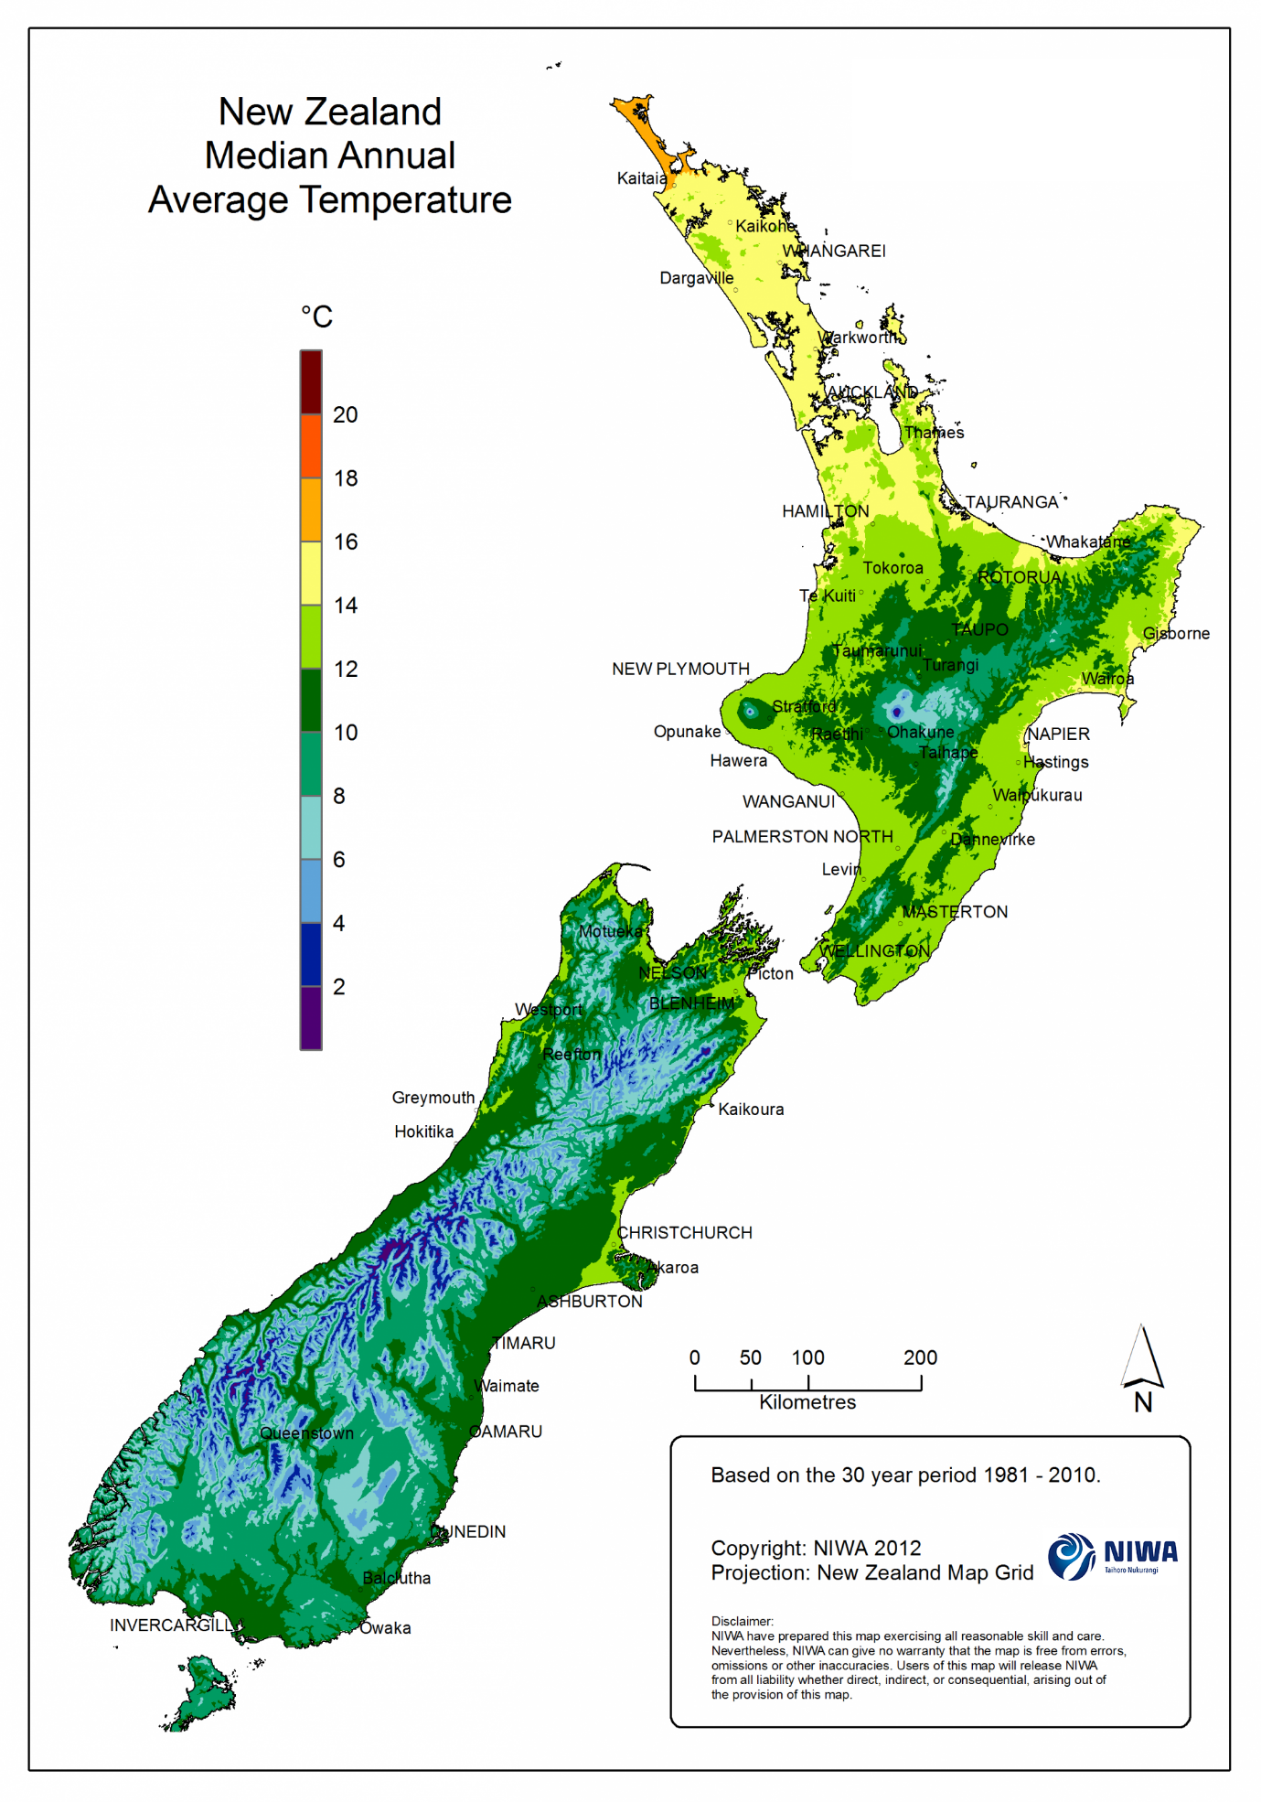

Slide 5
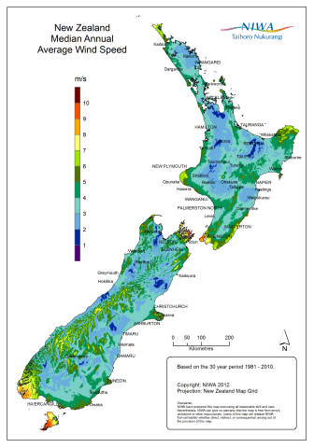
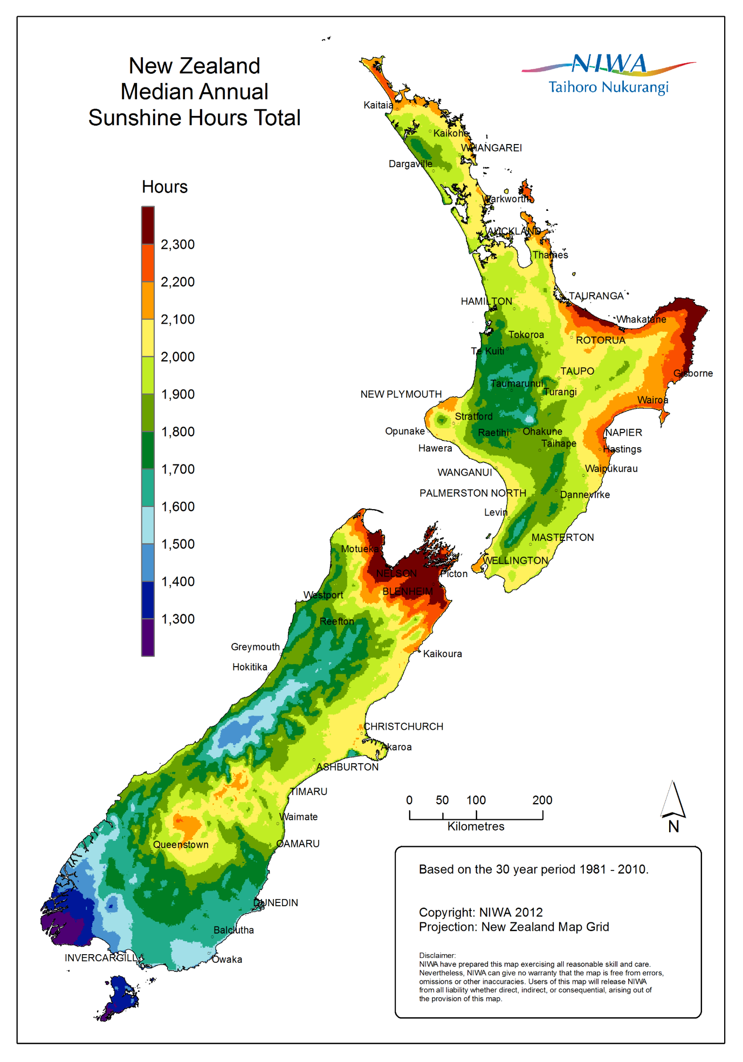

Slide 6
Climate Information
REGION | MEAN ANNUAL |  |  | Temperature |  | Number of days with frosts
 | Rainfall (mm) | Sunshine (hours) | Temperature (°C)
 |  |  |  | Very highest (°C) | Very lowest (°C)
Northland | 1412 | 2021 | 15.6 | 30.8 | -0.1 | 5
Auckland | 1240 | 2060 | 15.1 | 30.5 | -2.5 | 10
Bay of Plenty | 1198 | 2260 | 14.5 | 33.7 | -5.3 | 42
Waikato | 1190 | 2009 | 13.7 | 34.7 | -9.9 | 63
Gisborne | 1051 | 2180 | 14.3 | 38.1 | -5.3 | 33
Taranaki | 1432 | 2182 | 13.7 | 30.3 | -2.4 | 15
Hawkes Bay | 803 | 2188 | 14.5 | 35.8 | -3.9 | 29
Wanganui | 882 | 2043 | 14.0 | 32.3 | -2.3 | 7
Manawatu | 967 | 1733 | 13.3 | 33.0 | -6.0 | 38
Wairarapa | 979 | 1915 | 12.7 | 35.2 | -6.9 | 60
Wellington | 1249 | 2065 | 12.8 | 31.1 | -1.9 | 10
Nelson | 970 | 2405 | 12.6 | 36.3 | -6.6 | 88
Marlborough | 655 | 2409 | 12.9 | 36.0 | -8.8 | 60
West Coast | 2875 | 1860 | 11.7 | 30.0 | -3.4 | 54
Canterbury | 648 | 2100 | 12.1 | 41.6 | -7.1 | 70
South Canterbury / North Otago | 573 | 1826 | 11.2 | 37.2 | -6.8 | 84
Otago | 812 | 1585 | 11.0 | 35.7 | -8.0 | 58
Southland | 1112 | 1614 | 9.9 | 32.2 | -9.0 | 94

Slide 7
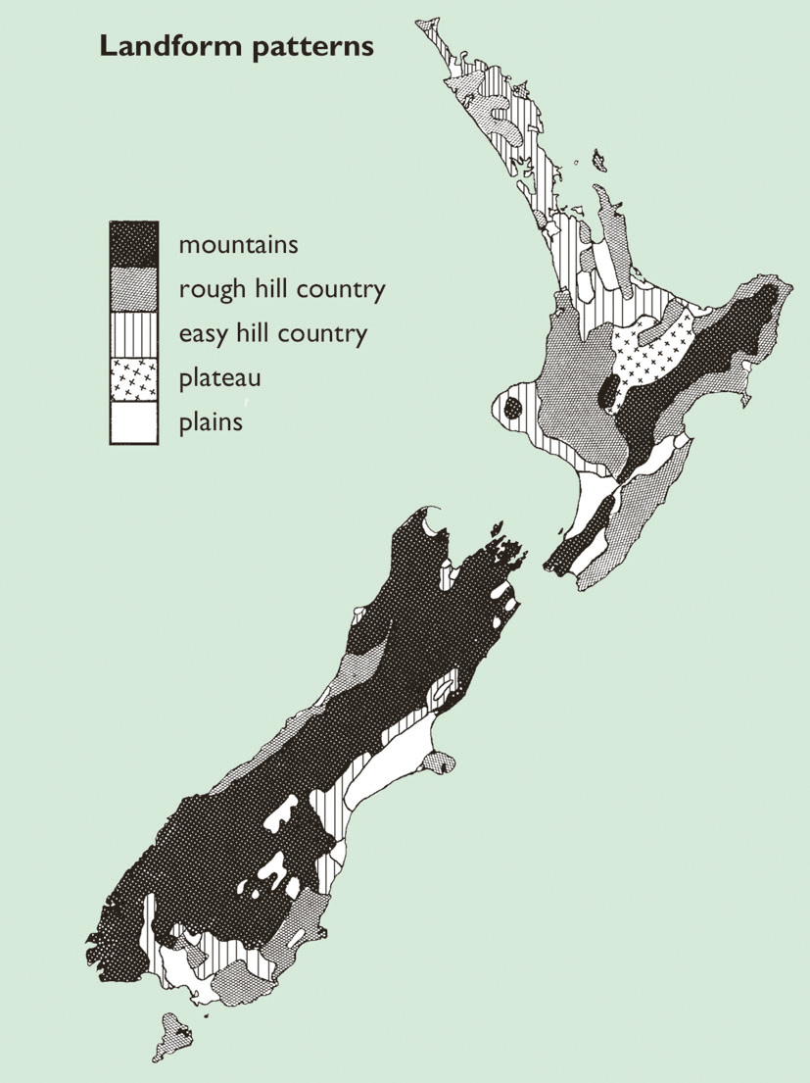
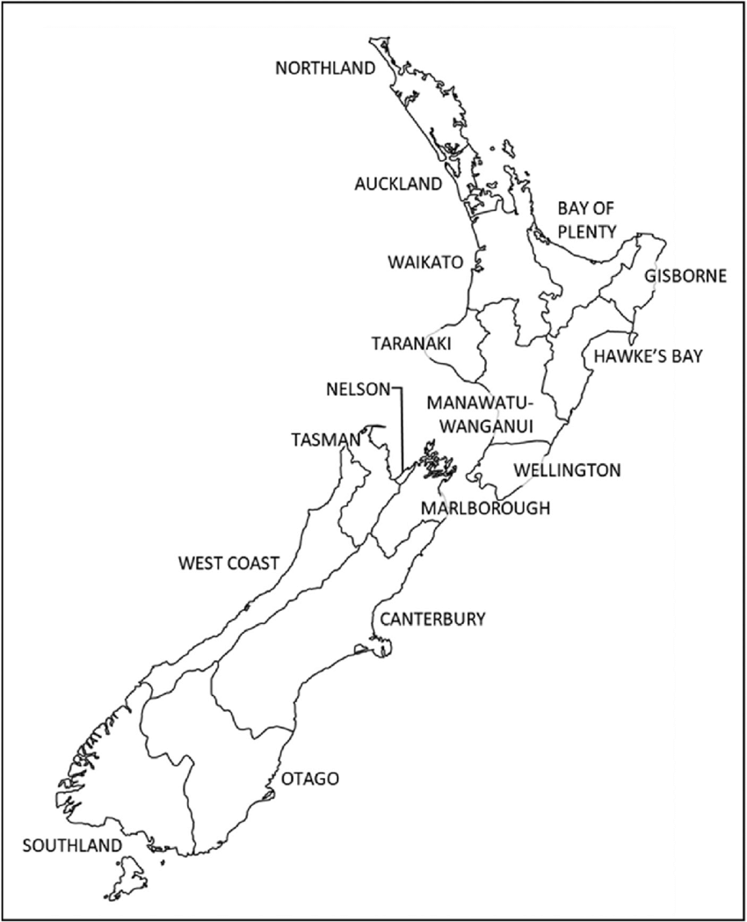

Slide 8
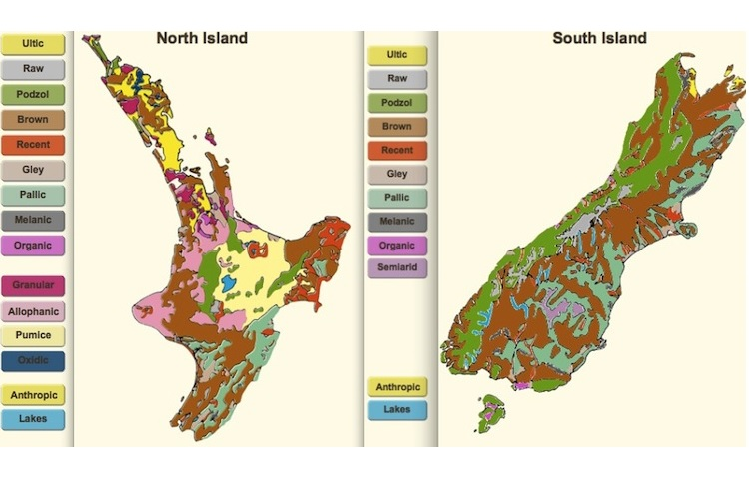
New Zealand soils

Slide 9
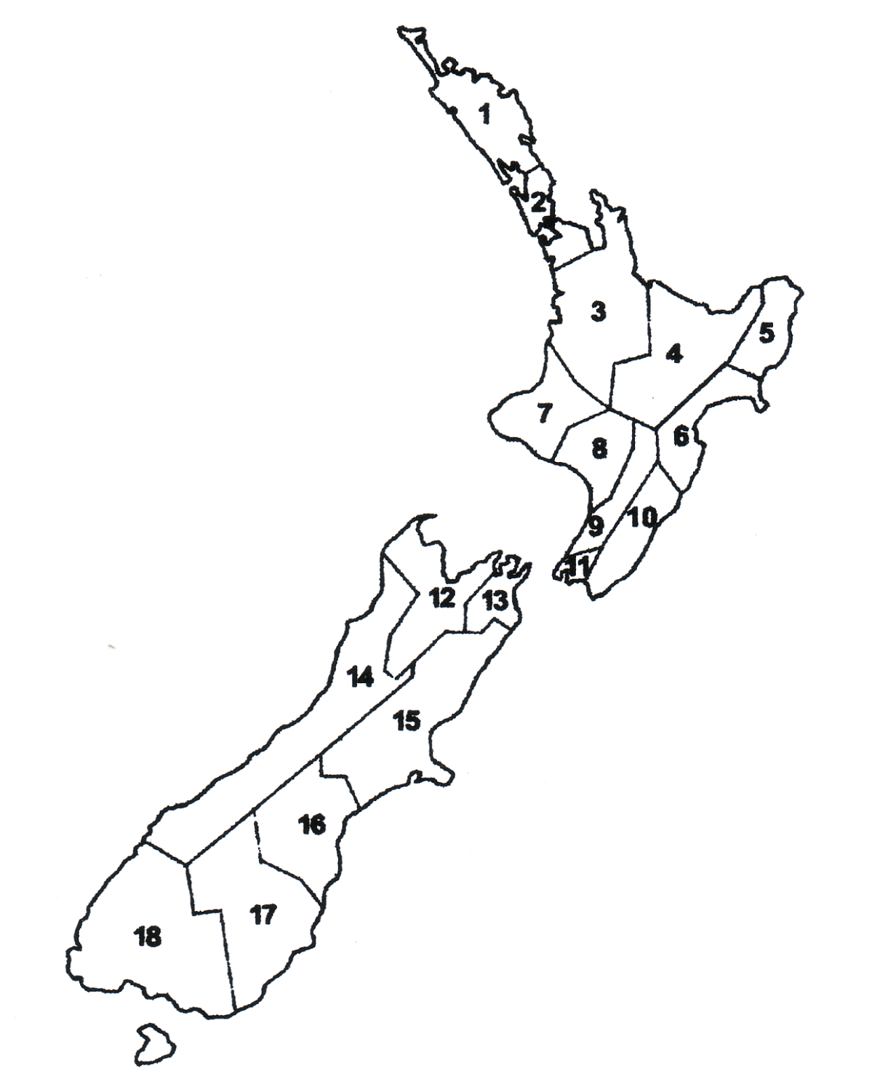
Regions of New Zealand
Northland
Auckland
Waikato
Bay Of Plenty
Gisborne / East Coast
Hawkes Bay
Taranaki
Whanganui
Manawatu
Wairarapa
Wellington
Nelson
Marlborough
West Coast
Canterbury
South Canterbury
Otago
Southland
Draw an arrow matching the region with correct number

Slide 10
Regions of New Zealand
Northland
Auckland
Waikato
Bay Of Plenty
Gisborne / East Coast
Hawkes Bay
Taranaki
Whanganui
Manawatu
Wairarapa
Wellington
Nelson
Marlborough
West Coast
Canterbury
South Canterbury
Otago
Southland
Answers

Slide 11
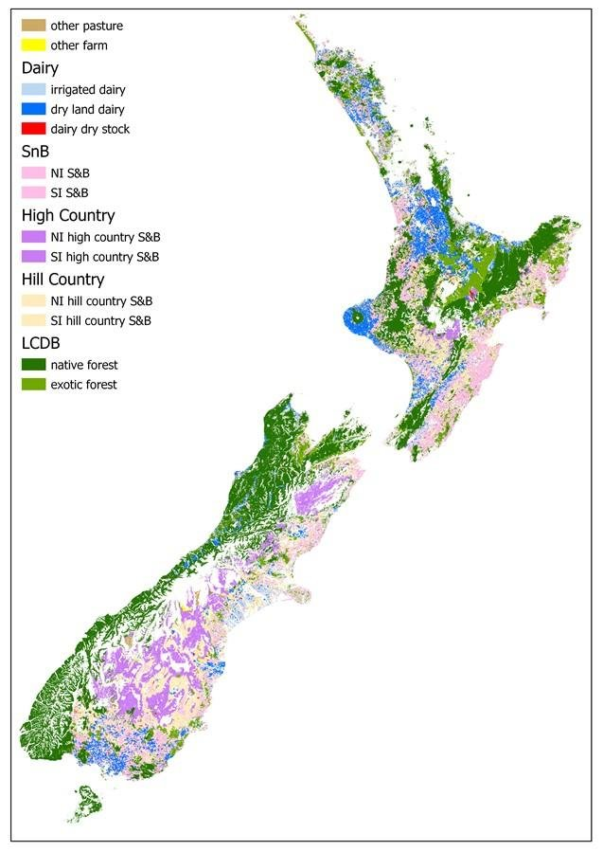
Location of Primary Production

Slide 12
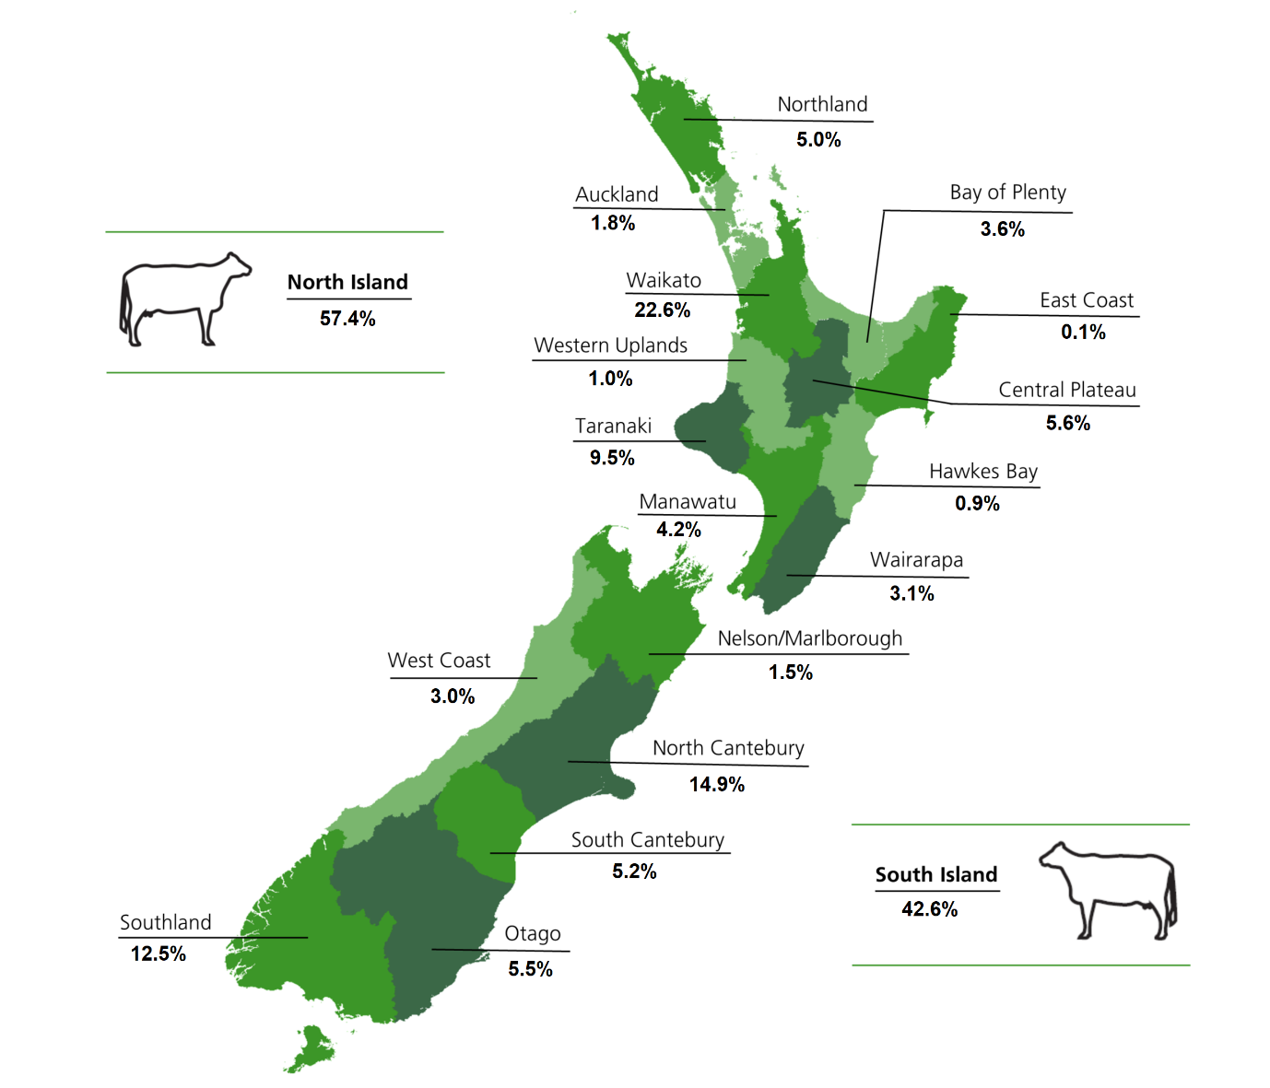
Dairy Farming
Dairy farms need to grow lots of grass all year to feed cows. Dairy farming is found in many regions. The biggest regions are Waikato, Taranaki, Canterbury and Southland. These regions have:-
Areas of flat to rolling country that is easily accessible by machinery.
Moderate temperatures for growing grass and crops to feed cow outside all year round.
Reliable rainfall either natural rain or from irrigation
Fertile soils.

Slide 13
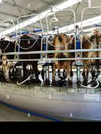
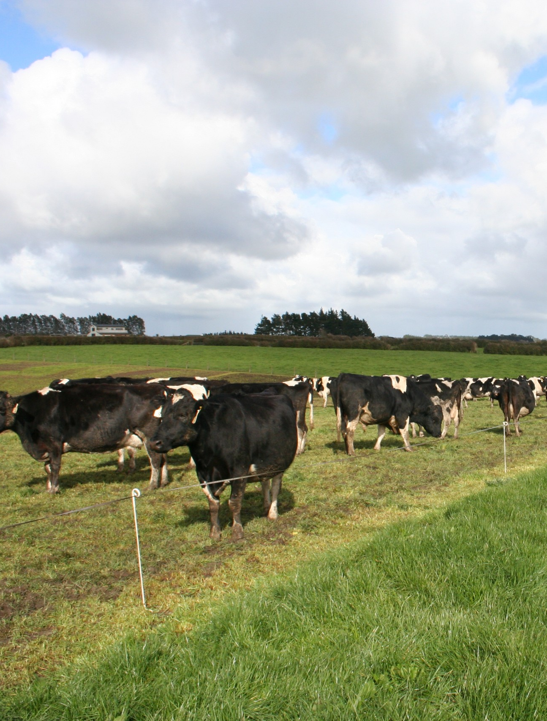
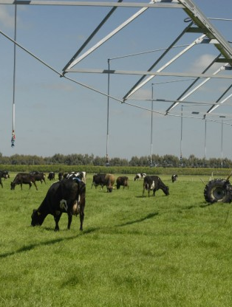
Intensive dairy farming

Slide 14
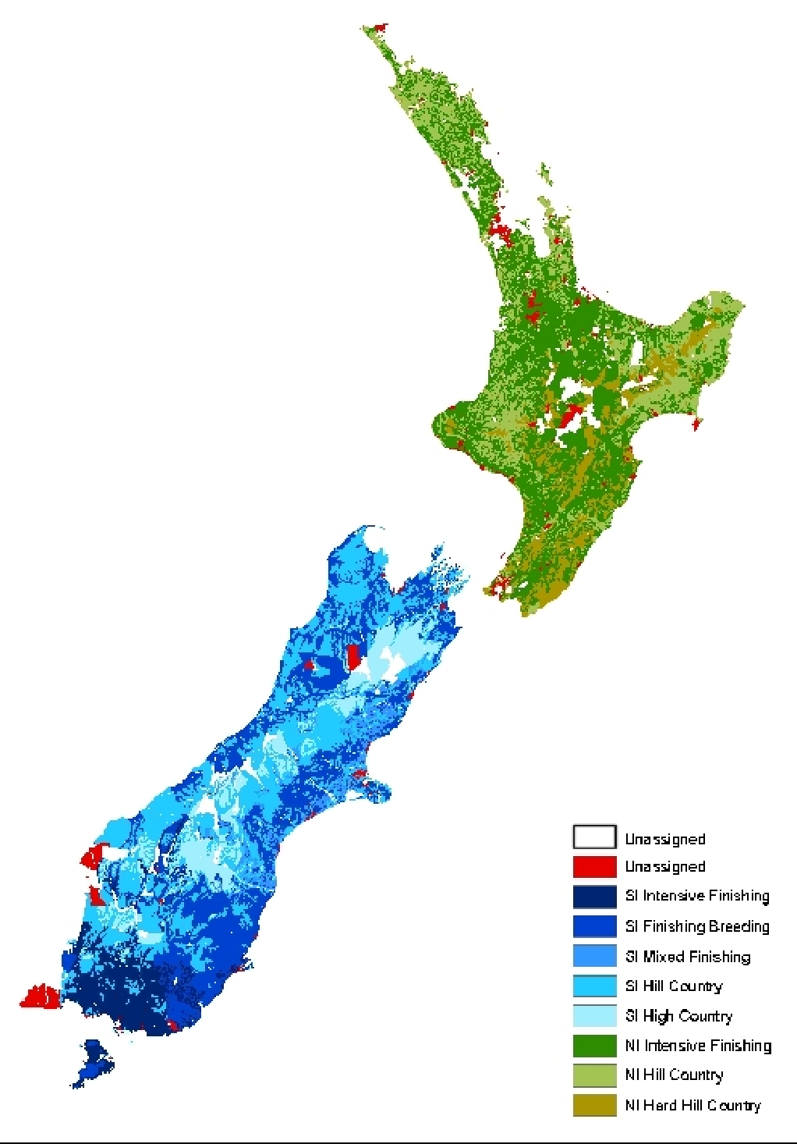
Sheep & Beef Faming Systems
Sheep & beef farming is found in many regions throughout New Zealand.
They are predominantly found on easy to steep hill country in both islands. The summers are dry and winters are cold, limiting pasture growth.
High country sheep & beef farms are found in the central South Island. The climate is dry in summer, cold in winter with periods of snow.

Slide 15
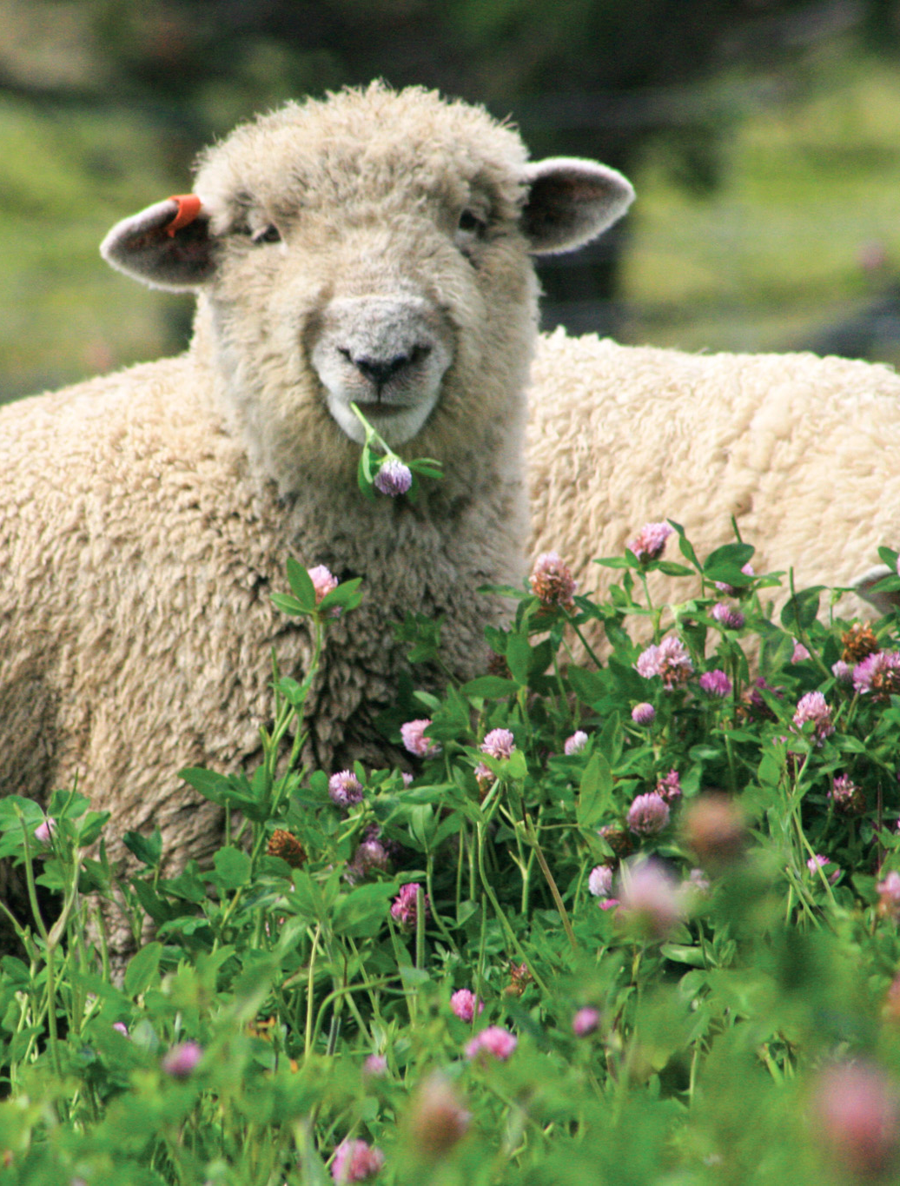
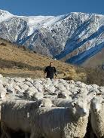
Sheep and beef farming systems
Semi- extensive
Extensive
Intensive finishing

Slide 16
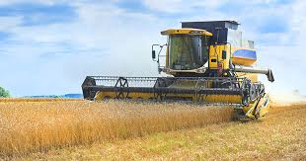
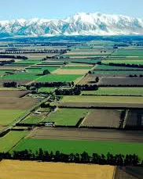
Arable farming
The Canterbury plains is the main region of arable farming.
The land is flat, providing easy access for big cultivating and harvesting machinery.
Soils are fertile and responds well to fertiliser.
Summers are dry to ripen grain crops.
Water is available for irrigating crops.

Slide 17
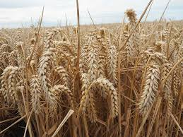
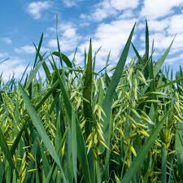
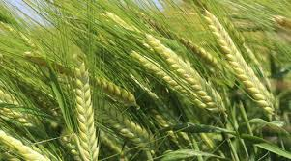
Arable crops
Wheat
Oats
Arable Crops
Wheat Barley Maize Oats Grass, crop & vegetable seed
Barley

Slide 18
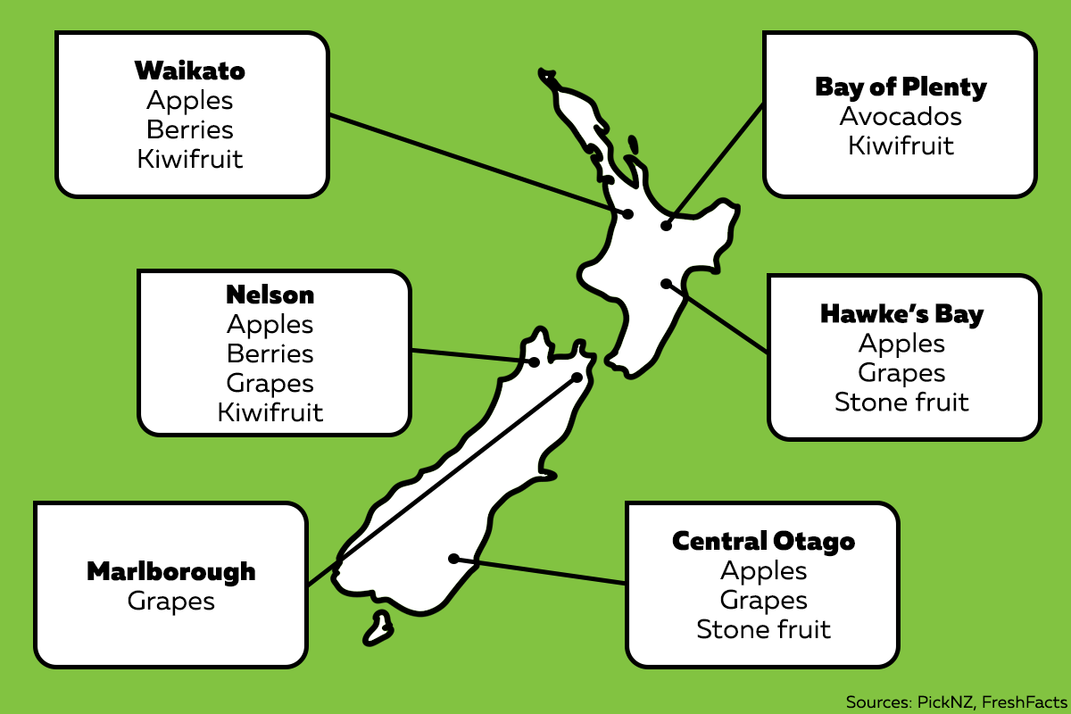
Horticulture
There are pockets of horticulture in both the North and South Islands. Horticulture is predominantly found on flat land with fertile soils and access to a good water supply for irrigation.
Crops are grown in regions that meet the temperature and sunshine hour requirements for good growth.

Slide 19
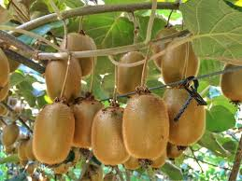
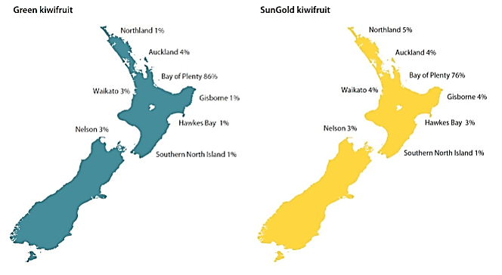
Kiwifruit
Over 80% of Kiwifruit produced in New Zealand is grown in the Bay of Plenty. Kiwifruit is grown on flat land, in fertile free draining soils. This region has a mean temperature of 14.5⁰C, high sunshine hours and has low risk of frosts.

Slide 20
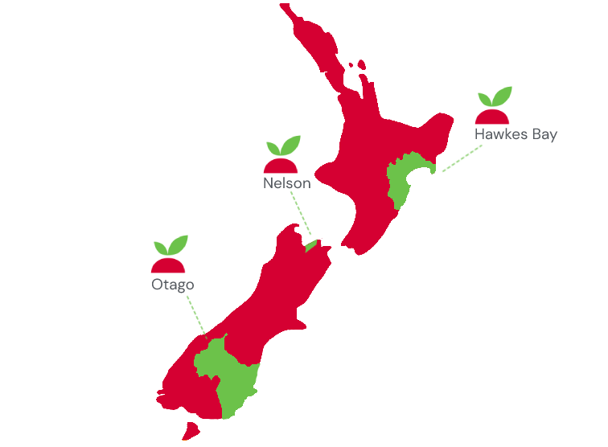
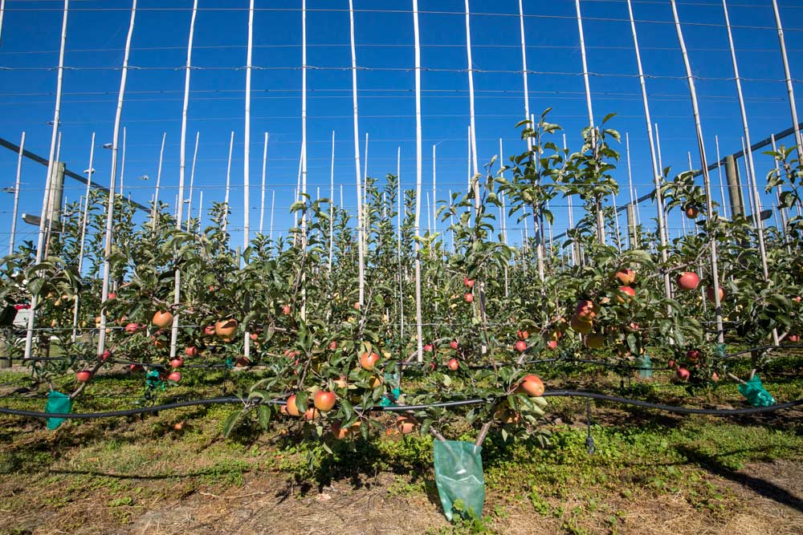
Pipfruit:- apples & pears
Pipfruit are predominantly grown in Hawkes Bay, Nelson and central Otago on flat land that has fertile free draining soils. These regions have long dry summers needed for colouring up and ripening fruit.

Slide 21
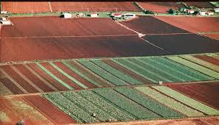
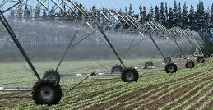
Commercial Vegetable Production
Commercial vegetable production is found in several regions
on flat to slightly rolling land with fertile soils suited to being cultivated.
on flat land with fertile soil where the infrastructure for large scale indoor commercial vegetable production can be built.
in areas where temperatures are warm, and frosts are rare.
where there is good annual rainfall or a good water supply for irrigation.

Slide 22
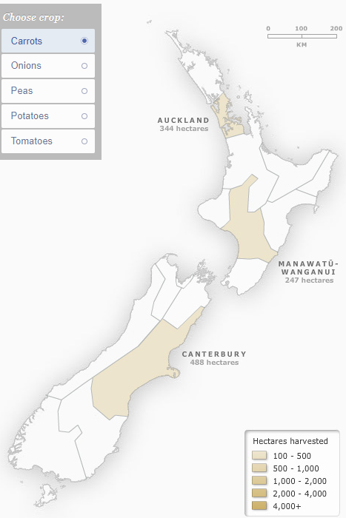
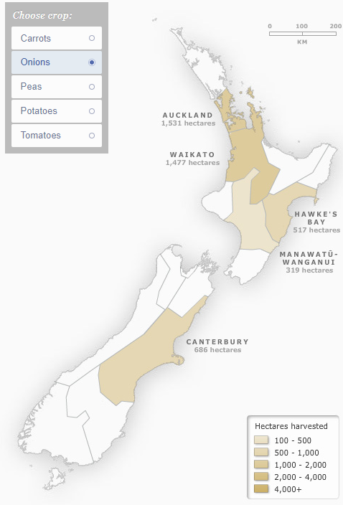
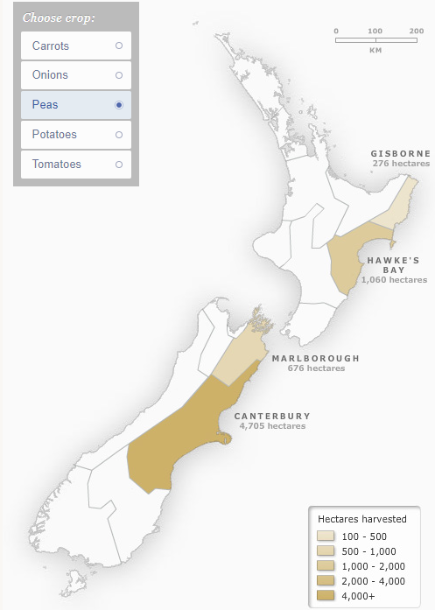
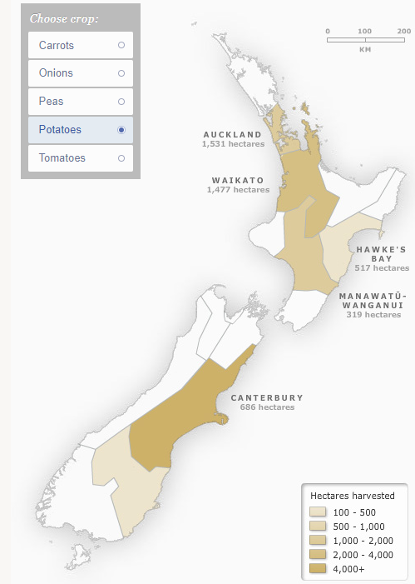
Major vegetable crops
Growing carrots
Growing onions
Growing peas
Growing potatoes

Slide 23
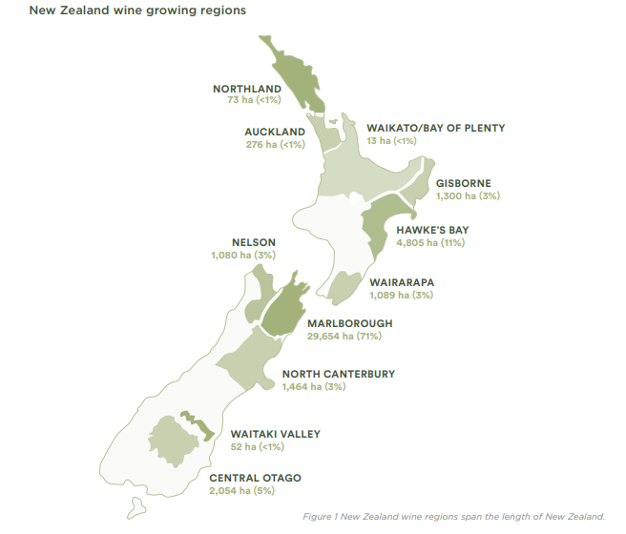
Viticulture Growing grape for wine
Grapes can be grown on flat to slightly rolling land in many regions in New Zealand. However, the main regions are Hawkes Bay and Marlborough.
These regions have low rainfall, high sunshine hours, well drained soils and access to a reliable water supply for irrigation.

Slide 24
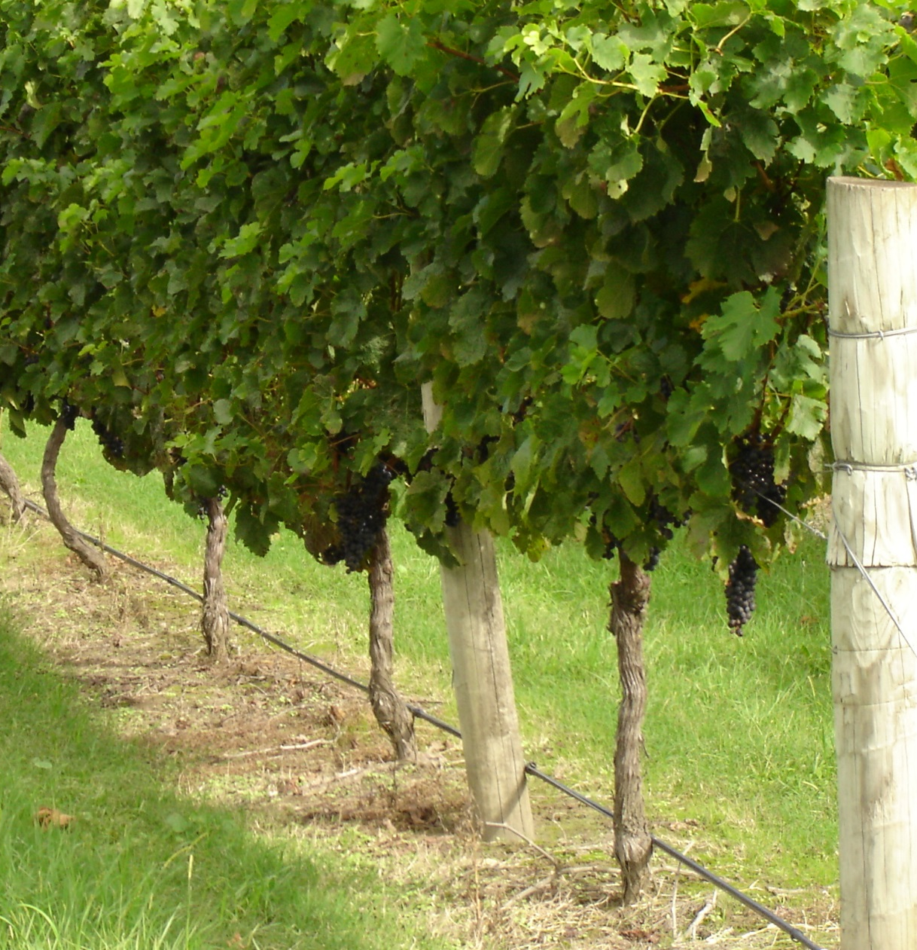
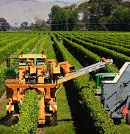
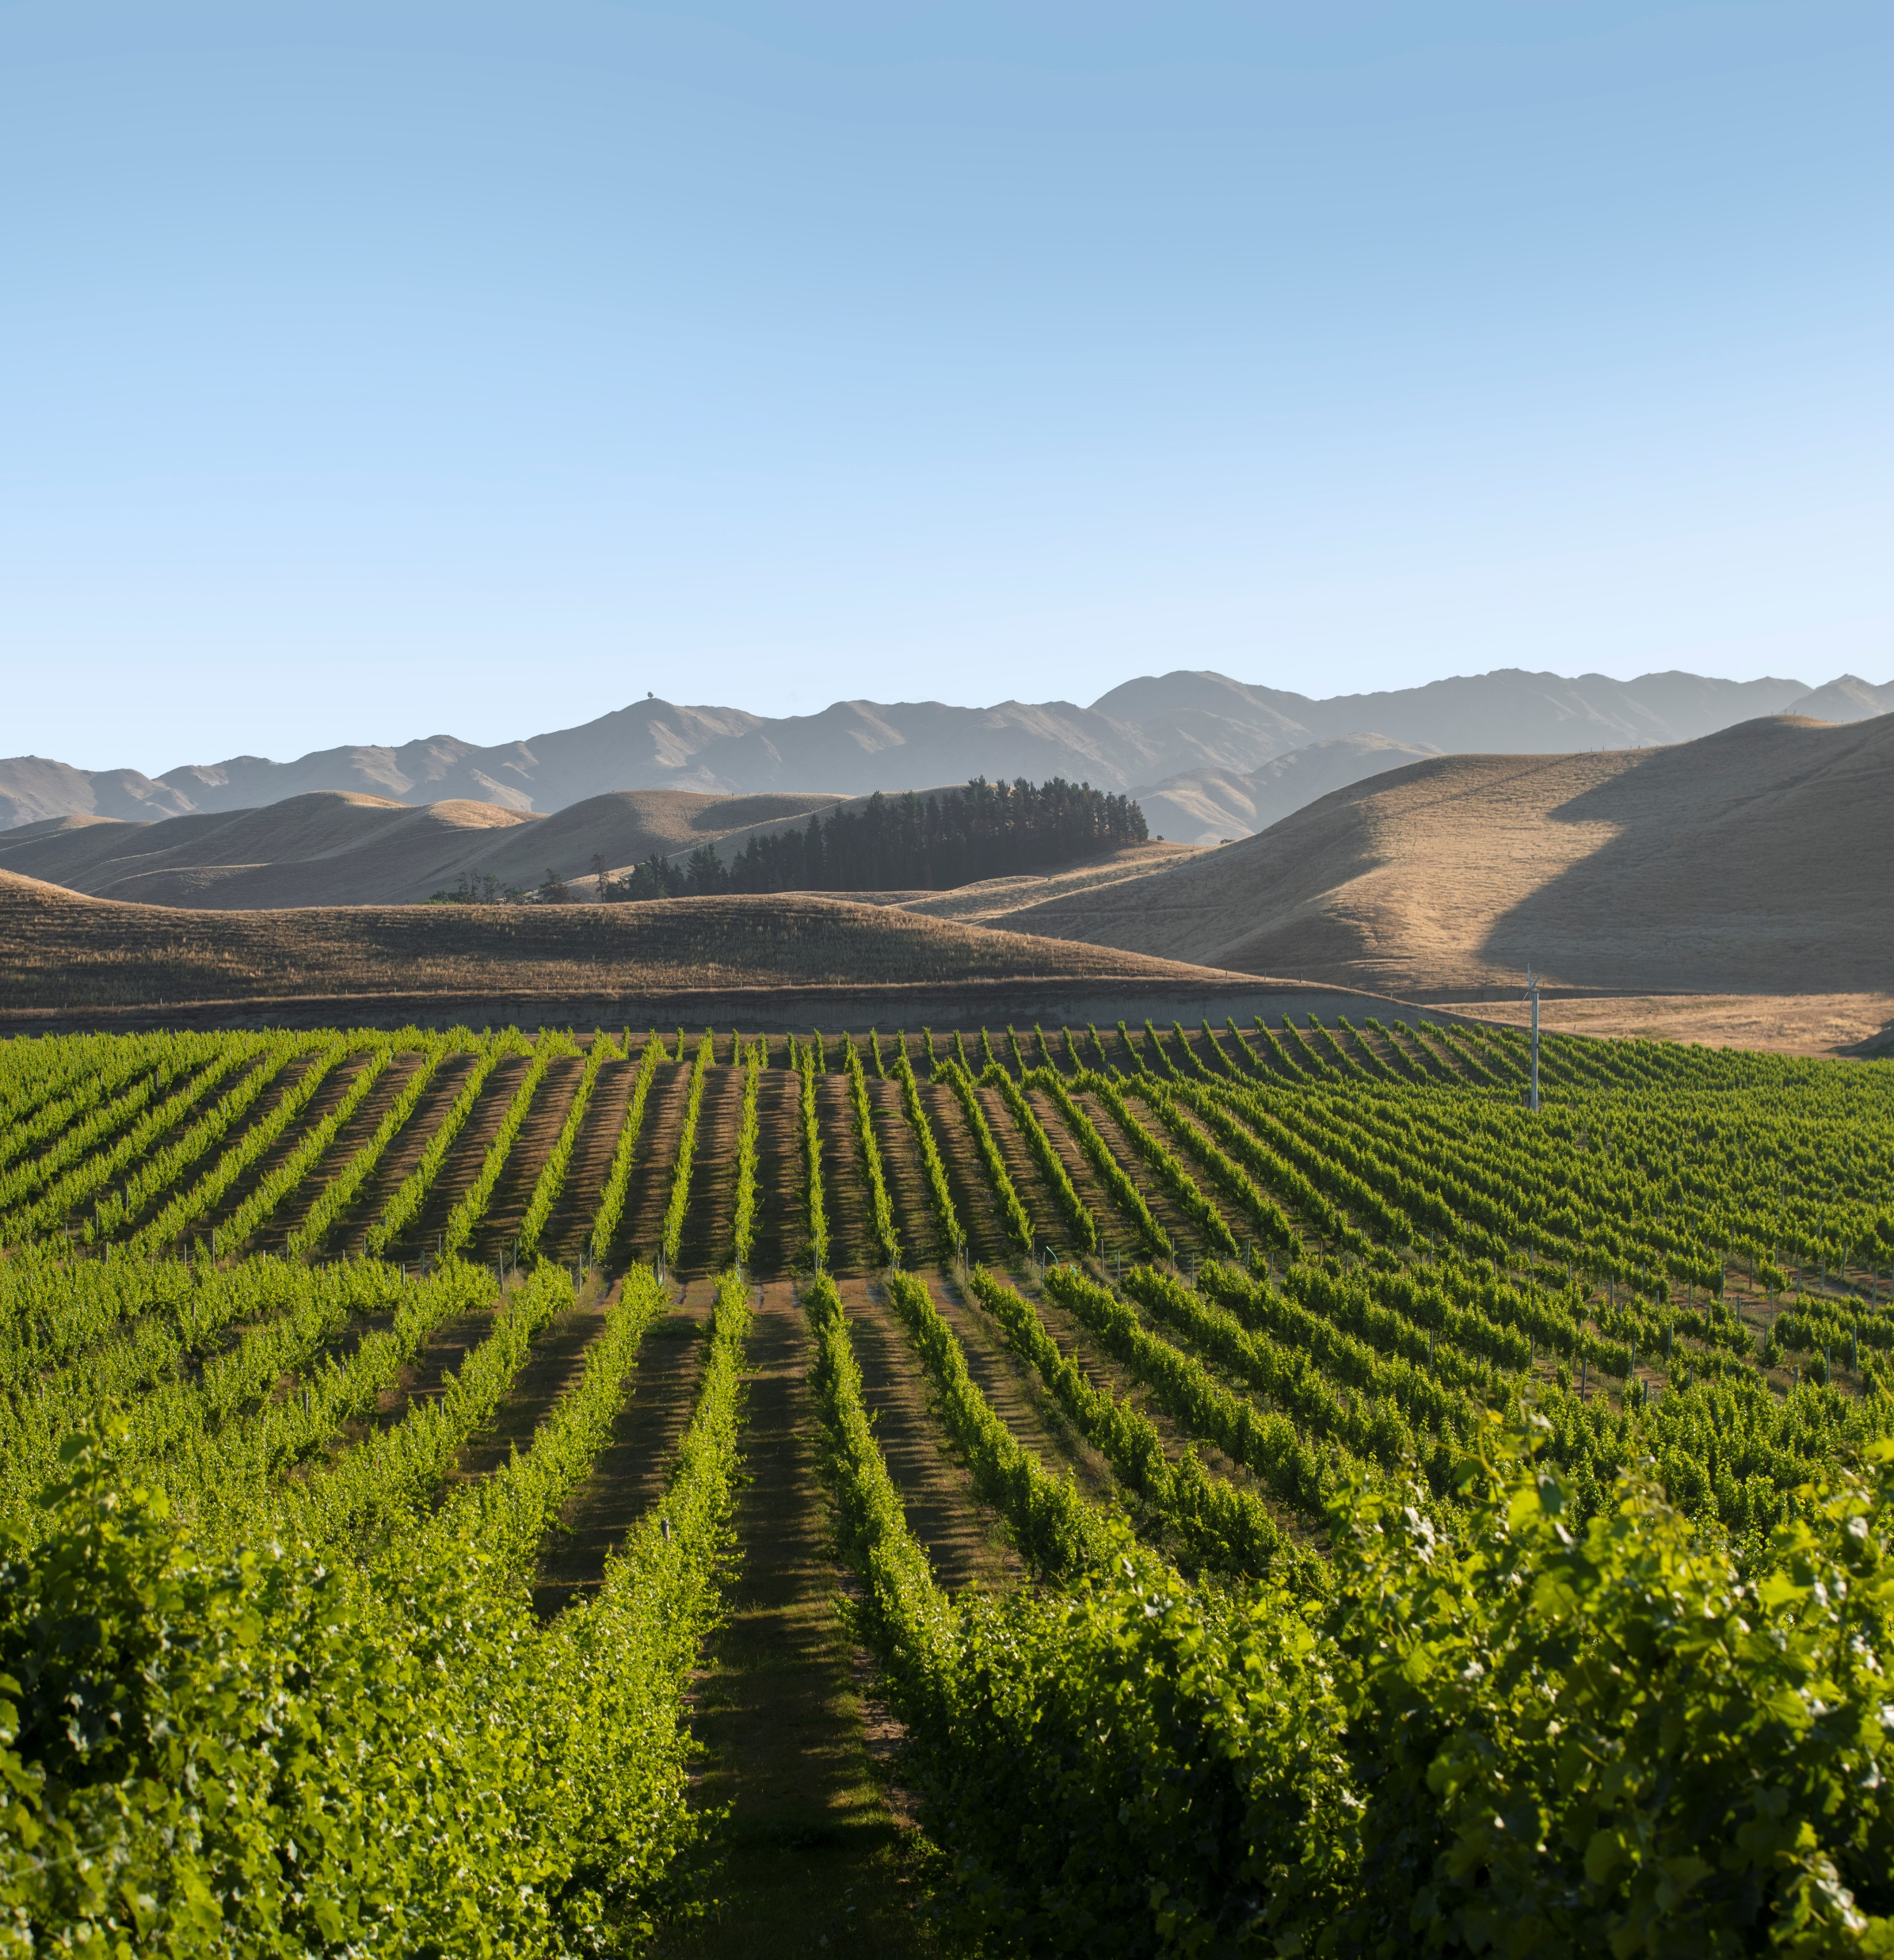
41, 806 hectares of vines are planted in New Zealand

Slide 25
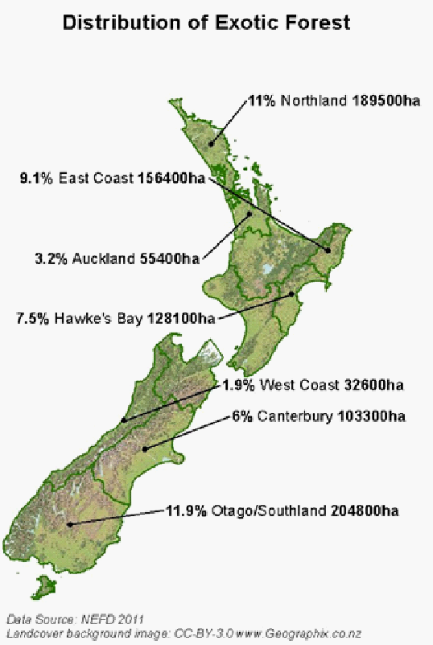
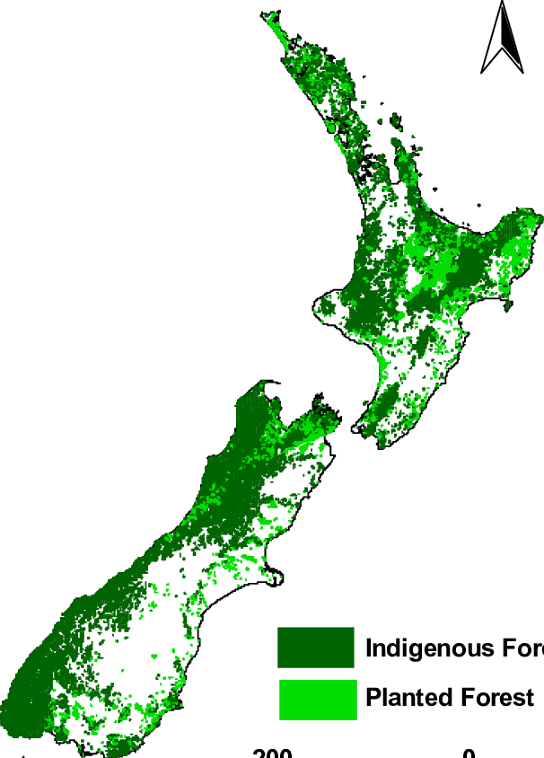
Forestry
Planted forests are found throughout New Zealand predominantly on hill country and in areas with poor soil fertility.
Indigenous Forest
Planted Forest

Slide 26
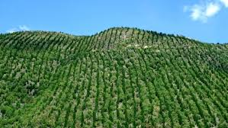
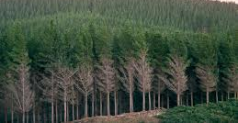
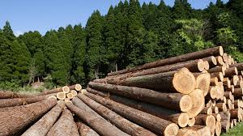
Forestry
Radiata pine (Pinus radiata) is the dominant plantation tree crop. Other exotic forest crops are Douglas fir, Eucalyptus, Redwoods, and Cypress.
New Zealand’s indigenous forests are largely protected from logging. However, some species can be grown specifically for timber production, making them a viable alternative to radiata pine or as an option for mixed land-use. These are Kauri and Tōtara.

Slide 27
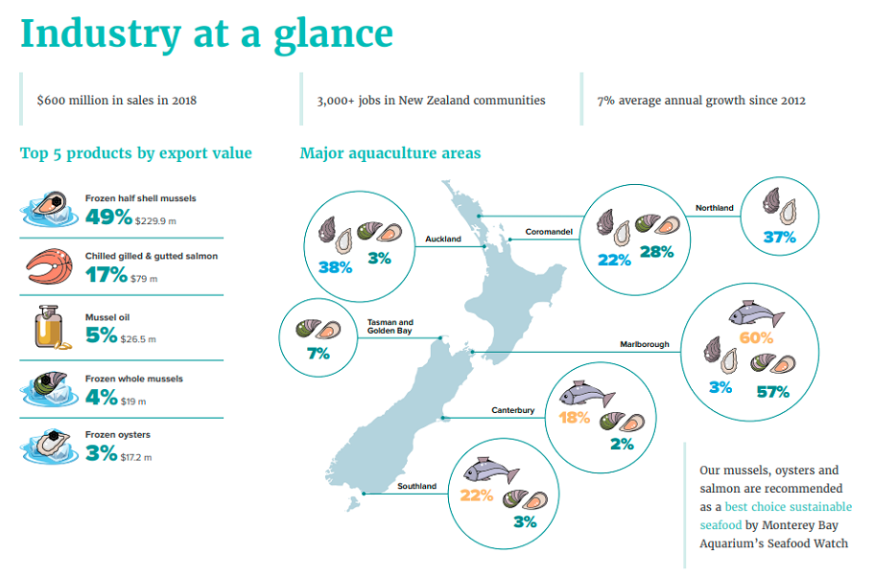
Aquaculture
Is found in regions with suitable water temperature and good ocean currents

Slide 28
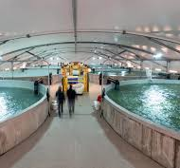
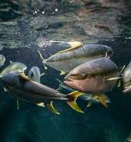
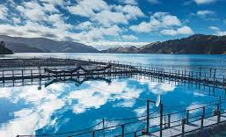
Aquiculture
King Ocean Salmon
12 surface hectares of salmon farm space
Yellow Tailed Kingfish
600 tonnes of fish could be harvested per year on the 35,000 square metre site.
Oysters

Slide 29
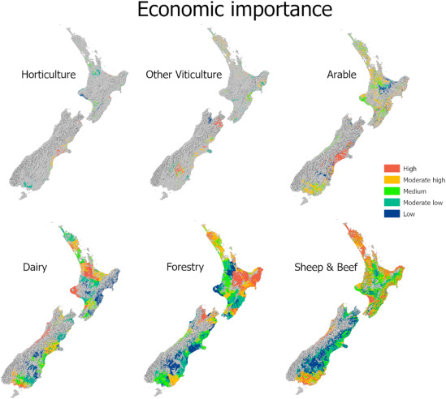
Export Revenue 2024
Dairy $24.2 billion
Sheep & Beef $ 11.4 billion
Horticulture $7.1billion
Forestry $5.9 billion
Viticulture $ 2.1 billion
Arable $310 million

