Slide 1
Geographic Distribution Sorting
By Marjan Shelton- Wairarapa College

Slide 2
Purpose and Location sorting activity
Aim/purpose
This resource was created to give students a tactile activity to use whilst covering AS91929 (1.2) Demonstrate understanding of factors that influence the purpose and location of primary production.
The activity covers a range of learning content including:
Name and location of regions in NZ (Note, each region has a specific colour,/pattern and this continues throughout the activity so that it’s not too difficult to work out the answers).
Iwi who settled each of the regions (it was too difficult to include all Iwi, so I have tried to include the largest iwi of each region)
Main soil types for each region
Topography across each region
Average annual rainfall across each region
Average annual temperature across each region
Average annual sunshine hours across each region
Some of the primary products that are produced in each region (this is NOT colour coded but there is an answer sheet, which is colour coded).
Instructions for making the activity
Print out the NZ map on a sheet of A2 and laminate this sheet (we did it in A3 but it’s too small)
Colour print each of the other slides (4-11), cut up them up and laminate. Place each slide’s worth of cards in a separate little bag.
The final slide (12) has the answers to the ‘Guess the main primary products produced in each region’ so you could print and laminate just one answer sheet.
I recommend printing 10 sets so that you have enough for a class activity. You may want to number each card in the set so that if a card goes missing, you know which set it belongs to.
Delivering the activity.
Use as you see fit ☺
I wouldn’t recommend using all cards at the same time as it’ll get too jumbled and messy so, instead, you might spend the first half of a lesson using the regions cards, and the second half of the lesson you might use the sunshine hours cards.

Slide 3
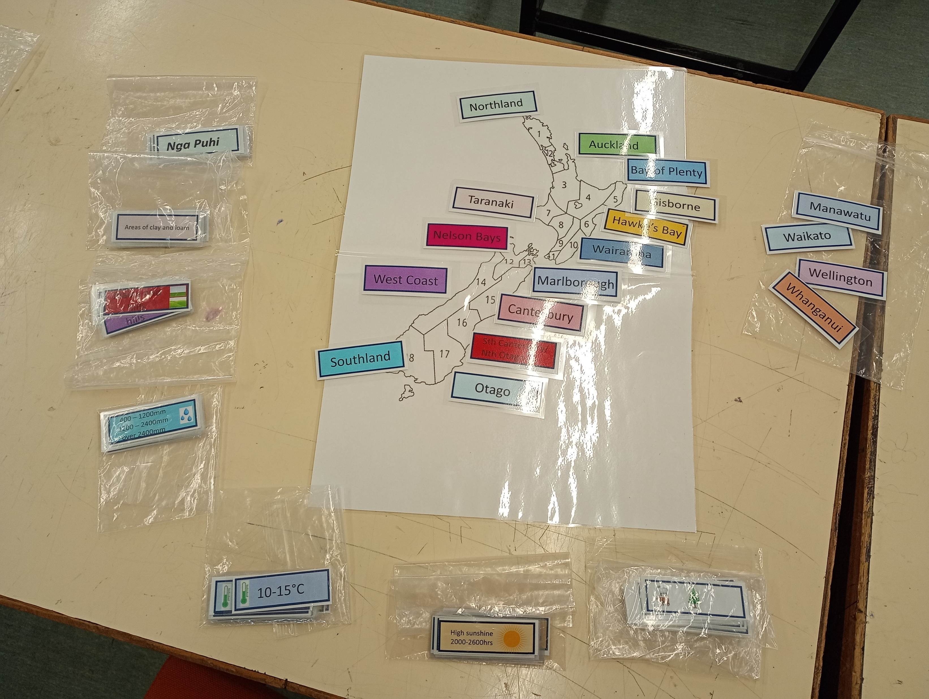
This photo shows 1 of the 10 sets that I created for the class.

Slide 4
Student instructions
On the map of New Zealand
Match
the location with the region
the Iwi who settled each of the regions
the main soil types for each region
the topography across each region
the average annual rainfall across each region
the average annual temperature across each region
the average annual sunshine hours across each region
some of the primary products that are produced in each region
Hint each region has a specific colour,/pattern and this continues throughout the activity so that it’s not too difficult to work out the answers).

Slide 5
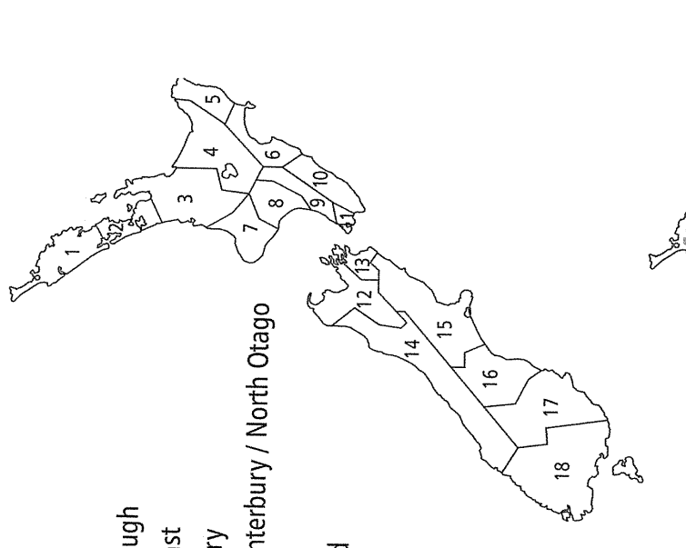
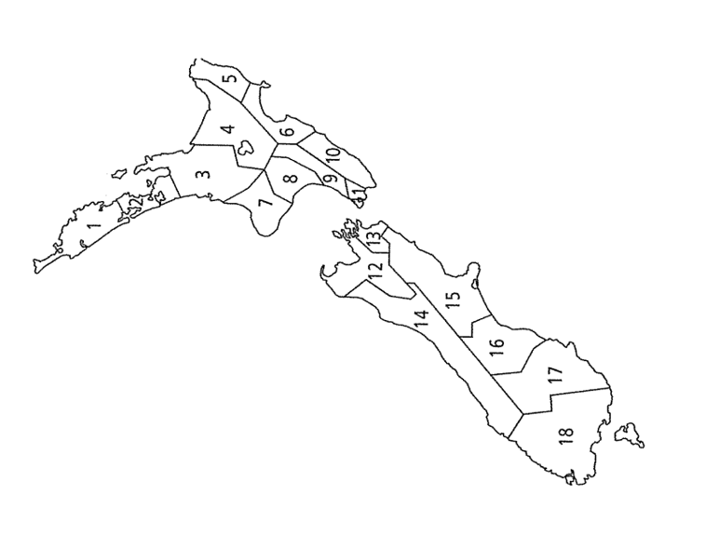

Slide 6
Northland
Taranaki
Marlborough
Auckland
Whanganui
West Coast
Waikato
Manawatu
Canterbury
Regions
Wairarapa
Sth Canterbury/
Nth Otago
Bay of Plenty
Gisborne
Wellington
Otago
Hawke’s Bay
Nelson Bays
Southland

Slide 7
Nga Puhi
Taranaki
Nga Ruanui
Nga Rauru
Rangitane
Ngati Haua
Te Ati Hau
Nga Tahu
Ngati Mamoe
Ngati Apa
Ngati Whatua
Tainui
Ngati Maniapoto
Rangitane
Ngati Apa
Ngai Tahu
Ngati Mamoe
Iwi
Te Arawa
Ngati Awa
Ngati Tuwharetoa
Tuhoe
Ngai Tahu
Ngati Mamoe
Ngati Kahungunu ki Wairarapa
Rangitane
Ngati Porou
Rongo Whakaatu
Ngati Toa
Te Ati Awa
Ngai Tahu
Ngati Mamoe
Ngati Koata
Te Ati Awa
Ngati Kuia
Ngai Tahu
Ngati Mamoe
Ngati Kahungunu

Slide 8
Highly fertile soil amongst stony soils
Areas of clay and loam
Areas of clay and loam
Highly fertile soil amongst clay soils
Areas of clay and sand
Areas of clay and sand
Areas of clay, sand
and loam
Highly fertile soil amongst clay soils
Soils
Areas of loam and sand
Areas of sand and highly fertile soil
Areas of clay, loam and
highly fertile soil
Clay soils
Sandy soils
Clay soils
Clay soils
Areas of sand, loams, highly fertile soil
Areas of loam and highly
fertile soil amongst clay
Areas of clay and loam

Slide 9
Plains and hills
Plains and hills
Steep hills
Plains and hills
Plains and hills
Plains
Plains and hills
Plains and hills
Plains
Topography
Plains and hills
Plains and hills
Rolling hills
Plains and hills
Rolling hills
Rolling hills
Plains and hills
Rolling and
steep hills
Plains and hills

Slide 10
400 – 1200mm
1200 – 2400mm
over 2400mm
400 – 1200mm
1200 – 2400mm
1200-2400mm
400 – 1200mm
1200 – 2400mm
1200-2400mm
0ver 2400mm
400 – 1200mm
1200 – 2400mm
1200-2400mm
400 - 1200mm
Average annual Rainfall
400 – 1200mm
1200 – 2400mm
1200-2400mm
400 - 1200mm
400 – 1200mm
1200 – 2400mm
over 2400mm
1200-2400mm
400 - 1200mm
400 – 1200mm
1200 – 2400mm
400 – 1200mm
1200 – 2400mm
over 2400mm
400 – 1200mm
1200 – 2400mm
over 2400mm

Slide 11
10 - 15°C
Over 15°C
5 - 10°C
10 - 15°C
10-15°C
5 - 10°C
10 - 15°C
Under 5°C
5 - 10°C
10 - 15°C
10-15°C
5 - 10°C
10 - 15°C
5 - 10°C
10 - 15°C
10-15°C
Average annual temperature
5 - 10°C
10 - 15°C
5 - 10°C
10 - 15°C
10-15°C
5 - 10°C
10 - 15°C
10-15°C
10-15°C
5 - 10°C
10 - 15°C
Under 5°C
5 - 10°C
10 - 15°C
10-15°C

Slide 12
High sunshine
2000-2600hrs
Medium high sunshine
1800-2200hrs
High sunshine
2000-2600hrs
Medium high sunshine
1800-2200hrs
Medium high sunshine
1800 - 2200hrs
Medium sunshine
1600-2000hrs
Medium sunshine
1600-2000hrs
Medium sunshine
1600-2000hrs
Medium high sunshine
1800-2200hrs
Average annual sunshine hours
Medium to high sunshine
1800 - 2600hrs
Medium high sunshine
1800-2200hrs
Medium high sunshine
1800-2200hrs
Medium to high sunshine
1800 - 2600hrs
Medium sunshine
1600-2000hrs
Medium sunshine
1600-2000hrs
Medium high sunshine
1800-2200hrs
Medium to high sunshine
1800 - 2600hrs
Low to medium sunshine
900 - 1800hrs

Slide 13
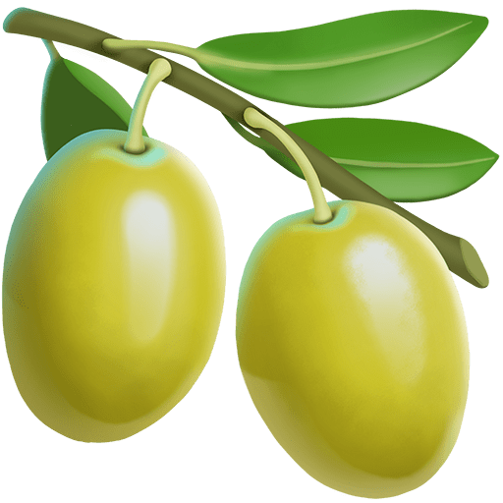
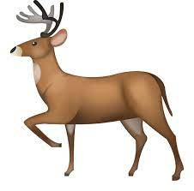
Guess the main Primary products produced in each region.

Slide 14
Answers Guess the main Primary products produced in each region.

