Slide 1
Dr Alison Bailey Professor of Farm Management

Slide 2
Undergraduate Programmes
Agribusiness and Food Marketing (BAFM)
Commerce (Agriculture) (BCom(Ag))
Commerce (Agriculture & Professional Accounting)
Land & Property Management (Rural, Urban)
Commerce
Majors in: Global Business, Marketing, Accounting and Finance, Food and Resource Economics, Supply Chain Management, Hotel and Tourism Management
Agriculture/Agricultural Science

Slide 3
People
Alison Bailey (Programme Director, BCom (Ag))
Nic Lees (Programme Director, BAFM)
Birgit Schulze-Ehlers (Global Business)
Sue Trafford (Food Supply Chains)
JD van Heerden (Finance)
Katie Bicknell (Economics)

Slide 4
BCom(Ag) & BAFM
Preparing graduates for leadership in farming and agribusiness
Themes: production, supply chain management, marketing, accounting and finance, economics and markets, valuation, environment, human resources
Bachelor of Commerce (Agriculture)
Bachelor of Agribusiness and Food Marketing
Input Supplies
On farm production
Processing
Distribution
Retailer
Consumer
Adapted from Nic Lees, 2016

Slide 5
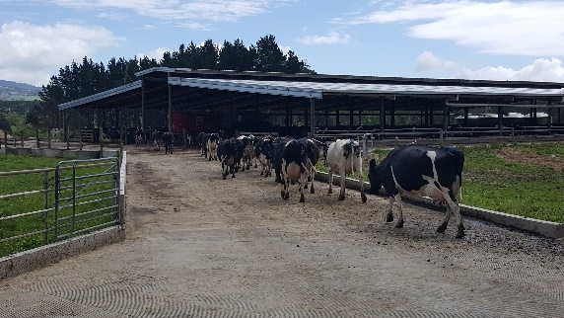
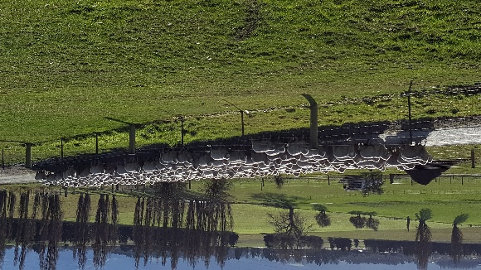
Students and Learning
Students
Rural backgrounds
+ Urban
+ International
Learning
Commerce rather than science
Context based teaching
Field trips
Guest speakers
Practical work requirement

Slide 6
Programme Structure
Made up of 24 papers (courses)
8 per year over three years
Some core
Remaining electives
Plus a period of practical work
BAFM 18 weeks
BCom (Ag) 30 weeks
Notes:
Max 11 @ 100 level
Need 5 @ 300 (4 mgmt plus 1)

Slide 7
Bachelor of Agribusiness and Food Marketing
Degree developed in conjunction with leading agri-food companies.

Slide 8
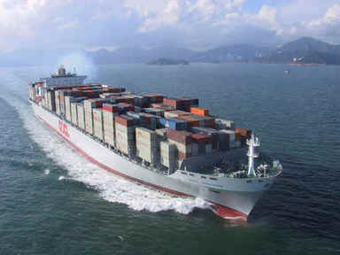
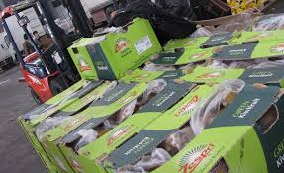
Bachelor of Agribusiness and Food Marketing
Bachelor of Agribusiness and Food Marketing
Management of Plant and Animal Production Systems
Agribusiness Management
Food Processing, Quality and Innovation
Economics, Finance and Law
Agri-Food Marketing
Supply Chain Management
International Trade and Global Business

Slide 9
Global Business
30% of NZ’s GDP from exports
Business development
Project management
50% of exports from food & forestry
International relationships are key to NZ’s success
Foreign Direct Investment
Global partnerships
International Mergers & Acquisitions
Source: MFAT 2017
Far beyond export!

Slide 10
Supply Chain Management
Controlling the flow from point of production to point of consumption across many firms globally
Logistics activities account for 8-15% of a nation’s GDP, SCM activities account for 80%
Taught with a ‘system’s view’
Simulations, games, case studies, in-class and online
Strong links with industry and jobs
Supply Chain Management
Supply Chain Strategy
Production Operations
Physical Flow
Supply Chain Networks
Performance Measures
Logistics Operations
Channel Integration
Customer Satisfaction

Slide 11
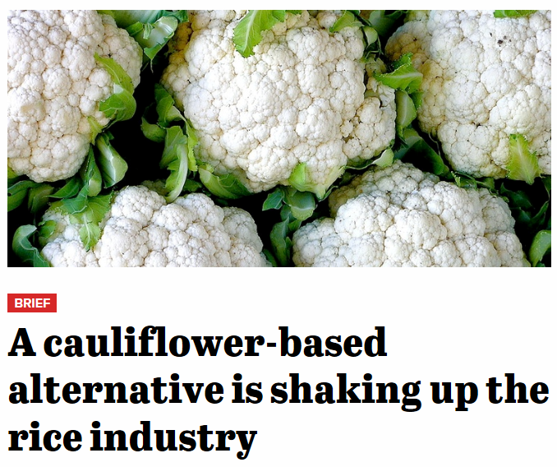
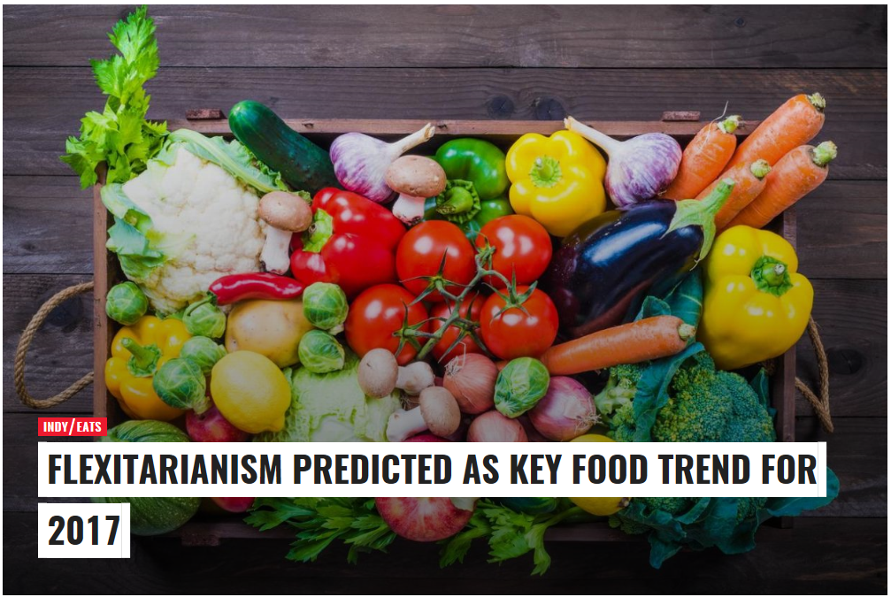
Marketing
… a broad field
Courses
Branding
International marketing
B2B & B2C
Social Marketing
Promotions
Services Marketing
Industry specific
New Product Development
Marketing Research
Sales Management
Retailing
Consumer behaviour
Research
From concept to analysis and write-up
Product design project

Slide 12
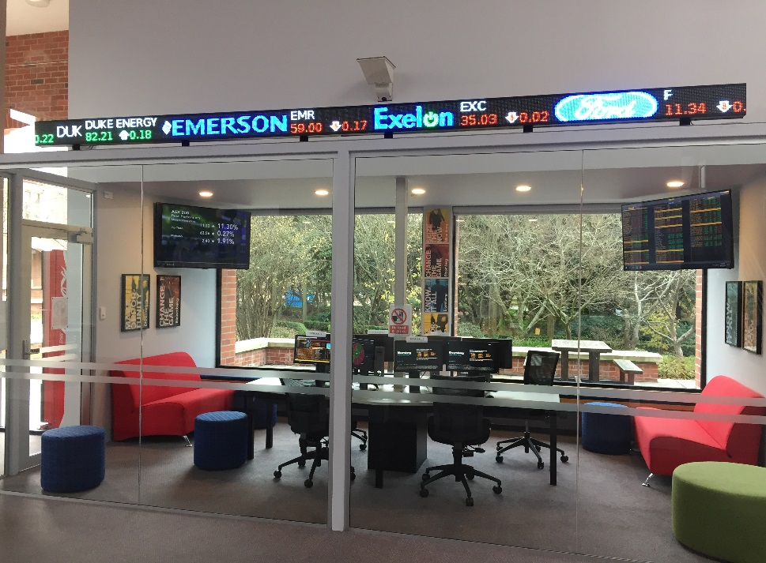
Finance
An industry need for:
Agri-sector Investment Analysts
Agri-sector Financial Risk Managers
Agri-sector Accountants
The Bloomberg Financial Markets Lab provides students with a wealth of data that can be tracked, downloaded and analysed.

Slide 13
Economics, Ag & Food Systems
Does maximum output equate to maximum profit?
Is it worthwhile farming when you’re making a loss?
What is the profit maximising combination of enterprises?
What is the least cost combination of inputs

Slide 14
Any questions?
Alison.Bailey@lincoln.ac.nz

