Slide 1
NZ National Agricultural Fieldays
Notes:
Held each year in June over 4 days

Slide 2
Fieldays Facts
A not-for-profit organisation
First Fieldays held at Te Rapa Racecourse in 1969
Moved to Mystery Creek in 1971
Covers over 94 hectares
History
Today
Today
Future
Notes:
The NZ National Agricultural Fieldays Society is a not-for-profit organisation that relies heavily on volunteer input
Society originally set up to provide a conduit between rural and urban businesses
First Fieldays held at Te Rapa with a budget of $10,500 attracting around 15,000 visitors
It was moved to its permanent home at Mystery Creek Event Centre in 1971
It is held over 94 hectare’s.

Slide 3
Fieldays Facts
1,400 sites
Approximately 1,000 exhibitors
Largest Agribusiness event in the Southern Hemisphere
Attracts over 130,000 visitors each year
History
Today
Future
Notes:
The event has grown so much that it now hosts over 1,400 sites with approximately 1,000 exhibitors utilising these sites
It is the largest agricultural event held in the Southern Hemisphere
Visitor numbers ever increasing

Slide 4
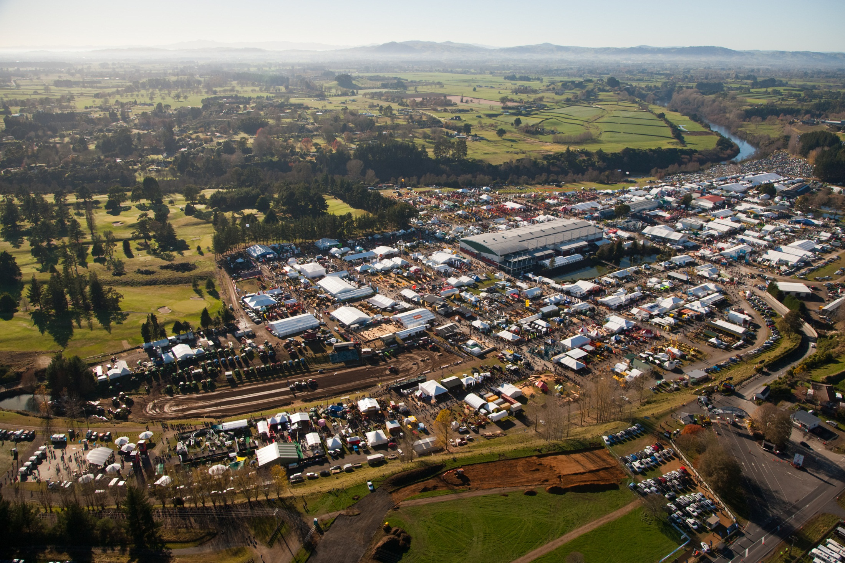
History
Today
Future
Notes:
Aerial photo taken at Fieldays 2012

Slide 5
SOCIETY STRUCTURE
BoardBoard
Staff
Audit, Risk and
Finance Committee
HR Committee
Assets and Property
Committee
Membership Group
Ag Heritage
Section Committee
Ag Fieldays
Section Committee
Events
Section Committee
Clydesdale Museum
Fire Brigade Society
DC3 TRUST
Chairman’s
Group
J.V. (Boat Show)
Premier
Feature
Committee
Couriers
Committee
Parking
Committee
Tractor Pull
Committee
Fencing
Committee
Demonstration
Committee
Exhibits
Committee
Hosting
Committee
Young
Farmers
Committee
International
Business
Innovations
Committee
Notes:
Discuss structure
Warwick Roberts – President of the Society
Peter Nation – Vice President of the Society
Jon Calder – New Zealand National Fieldays CEO

Slide 6
Strategic Partners
Fieldays
.
.
History
Today
Future
Notes:
The NZ National Fieldays is involved in a long term commitment with the ANZ and the University of the Waikato for the purpose of achieving specific goals

Slide 7
Planning The Event
Designing the Prospectus
Site Application Process
Areas In Which To Exhibit
Communicating with exhibitors
Highlighting current theme
Finding homes for 1000 exhibitors
Agriculture
Premier Feature
Rural Living
History
Today
Future
Notes:
The Prospectus is the initial literature sent to potential exhibitors outlying:
Site application process
The theme of the event
Where to exhibit
How to plan your presence
Exhibiting conditions
Advertising
Payment dates

Slide 8
Planning The Event
Designing the Prospectus
Site Application Process
Areas In Which To Exhibit
Communicating with exhibitors
Highlighting current theme
Finding homes for 1000 exhibitors
Agriculture
Premier Feature
Rural Living
History
Today
Future
Notes:
Sites are allocated according to whether or not you are a reserved site holder or not
What product or service are you selling?
Depending on product will determine where you may exhibit. If not Ag related, you would be based down in the Rural Living area

Slide 9
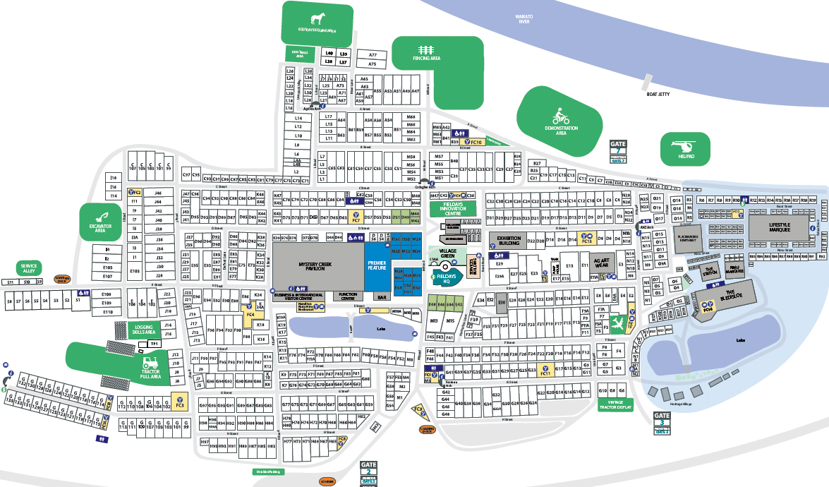
History
Today
Future
Notes:
Agricultural sites
Mystery Creek Pavilion
International Exhibition Area
Exhibition Building
Outdoor
Rural Living Area
Outdoor
Kiwis Best
Lifestyle Marquee
The Bledisloe
Rimu Marquee
The Station

Slide 10
Planning The Event
Designing the Prospectus
Site Application Process
Areas In Which To Exhibit
Communicating with exhibitors
Highlighting current theme
Finding homes for 1000 exhibitors
Agriculture
Premier Feature
Rural Living
History
Today
Future
Notes:
Agricultural sites
Mystery Creek Pavilion
International Exhibition Area
Exhibition Building
Outdoor
Rural Living Area
Outdoor
Kiwis Best
Lifestyle Marquee
The Bledisloe
Rimu Marquee
The Station

Slide 11
Entertainment
Tractor Pull
Fencing
Ag Art Wear
Innovation Centre
Kiwis Best
Canine/Sheep Trials
Equine Area
History
Today
Future
Notes:
To compliment the key focus and to create a well rounded event, we have created a number of competitions, demos and sub events.
These include the Fencing competition which has been a part of Fieldays since its inception
Innovation Centre- biggest crowd puller and the most important reason why visitors come to Fieldays
Kiwis Best – 2nd biggest draw card to the event
Tractor Pull – 3rd biggest crowd puller
Fencing
Ag Art Wear
Equine area
Canine/sheep dog trials

Slide 12
Sustainability
Fuel
Water
Waste
Transport
Energy
History
Today
Future
Future
Notes:
2012 saw the introduction of a sustainability programme.
An independent company was contracted to monitor our fuel, water, waste, transport and energy consumption
The sustainable event programme aims to highlight operation efficiencies and determine areas where further improvements can be made. This will involve working with organisers and stakeholders to collect information on areas such as energy use, waste collection, water consumption, packaging materials; amongst other contributing environmental factors.
As a significant event in the global agriculture industry, it is important that Fieldays embody environmental awareness by showcasing innovative examples of sustainability in action.
During the lead up to the 2015 event, organisers will be working with Instep to undertake the sustainable event programme. General objectives and initiatives will be shared with exhibitors in pre-event communications and exhibitors may be asked for their own ideas and involvement with specific initiatives. Not only will this allow Fieldays 2015 to maximise the benefits of the programme, but will give exhibitors a platform to present their own sustainability efforts.

Slide 13
Fieldays Moving Forward
AgriBusiness
Innovation
Exports
New Trading Partners
History
Today
Future
Notes:
Establishment of Agribusiness with the primary focus of connecting NZ business with international markets
Trade barriers are constantly being reduced with Free trade agreements such as the recently established agreement with China, which creates a New opportunity for NZ exporters to access 1.3 billion consumers, in an economy with high growth.
Innovation is a competitive advantage for NZ with some of the most developed agricultural systems in the world. These skills are very important to countries who are desperate to become more efficient and provide enough food and produce for their growing populations. The development of the Fieldays Innovation Centre is at the heart of the New Zealand innovative culture and “can do attitude” this creates a platform for new Zealand companies to showcase their products to a international market.

