Slide 1
New Zealand Primary Sectors.

Slide 2
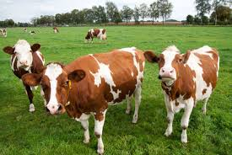
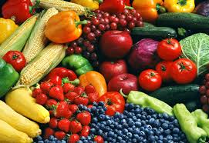
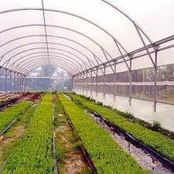
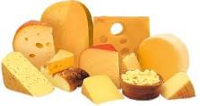
7 primary sectors
Agriculture,
Dairy manufacturing,
Equine,
Forestry,
Horticulture,
Seafood, and
Sports turf.

Slide 3
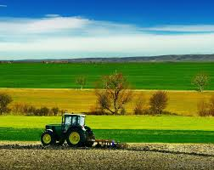
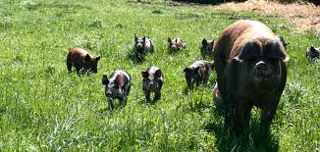
Agricultural main products
Dairying,
Lamb,
Beef,
Wool,
Deer,
Arable.

Slide 4
Equine
Breeding & management of race horses.
Sports Turf
Sports turf managers and groundskeepers.

Slide 5
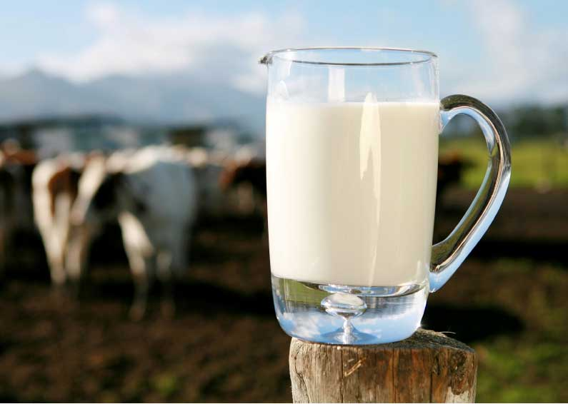
Dairy manufacturing from raw milk, processed milk, & dairy substitutes.
Products produced are;
Milk powders, whole-milk, skim-milk & buttermilk powder;
Cream products, butter, milk fat and ghee;
Cheese, mainly cheddar, & specialist cheeses;
Protein products such as casein & caseinates;
Alcohols.

Slide 6
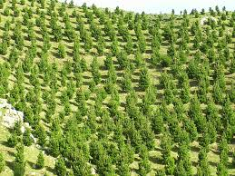
Forestry main products
Forestry - planning, establishment, silviculture, and harvesting of trees);
Sawmilling & remanufacturing;
Wood panels;
Pulp, paper and tissue; and
Furniture.

Slide 7
Horticulture main products
Fruit – wine grapes, kiwifruit, apples & pears;
Vegetables – onions, squash, potatoes.

Slide 8
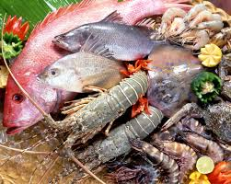
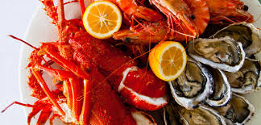
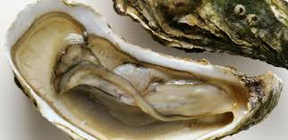
Seafood & aquaculture
Seafood & aquaculture main products are;
Harvesting fish from deep-sea or inshore fishing, e.g. rock lobster, hoki, squid, & orange roughy;
Aquaculture – growing & harvesting fish & shellfish in marine farms, e.g. greenshell mussel, king salmon & oyster farming;
Processing fish & shellfish (at sea or on shore).

